Slide 1
INCIDENT PREVENTION AND MANAGEMENT SYSTEM TRAINING
ALABAMA DEPARTMENT OF MENTAL HEALTH
DIVISION OF DEVELOPMENTAL DISABILITIES
OFFICE OF QUALITY ENHANCEMENT

Slide 2
IPMS PHILOSOPHY
Providers must eliminate preventable incidents.
Reduce serious incidents where people live, work, and learn.
People are entitled to appropriate services.
Provide the most caring & hospitable environment possible.

Slide 3
IPMS CHANGES
Updated Reporting Timelines
Improved State Oversight
Introduction of Critical Incident Review and Management
New Reporting Requirements for Behavioral Issues and Restraints

Slide 4
STRENGTHENING THE SYSTEM
PROTECTION
OVERSIGHT & RESPONSE
IMPROVE SYSTEMS

Slide 5
IPMS COMPONENTS
PREVENTION
IDENTIFICATION
CLASSIFICATION
PROPER REPORTING & INVESTIGATION
REMEDIATION

Slide 6
HEALTH SAFETY & WELFARE

Slide 7
WHAT IS AN INCIDENT?

Slide 8
REPORTABLE INCIDENTS
NEW REQUIREMENT

Slide 9
CRITICAL INCIDENTS
MAJOR REVIEW | MINOR REVIEW
DEATHS | VERBAL ABUSE
PHYSICAL ABUSE | MISTREATMENT
SEXUAL ABUSE | SEVERE BEHAVIOR: PROPERTY DAMAGE
SEXUAL ASSAULT
NEGLECT
EXPLOITATION
SUICIDE ATTEMPTS
UNSCHEDULED HOSPITAL ADMISSIONS
SEVERE INJURIES
MODERATE INJURIES
LEVEL 3 MEDICATION ERRORS
AWOL/MISSING PERSON

Slide 10
CRITICAL INCIDENT REVIEW
 | LEVEL OF HARM
Level 1 | None
Level 2 | Injury or harm requiring treatment up to and including first aid
Level 3 | Injury or harm requiring medical treatment beyond first aid, that may require hospitalization
Level 4 | Injury or harm resulting in death

Slide 11
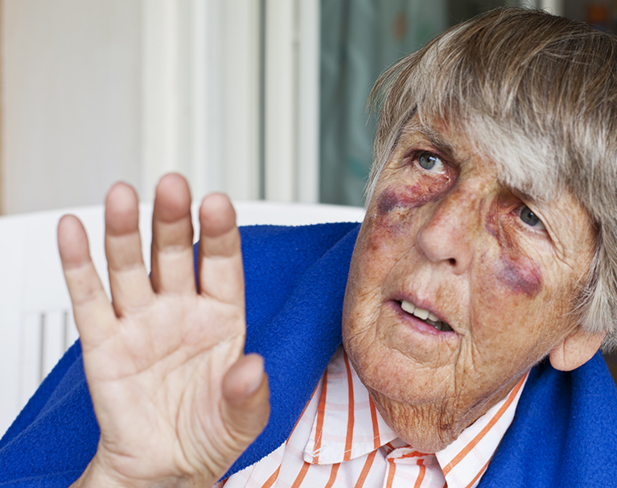
PHYSICAL ABUSE
Any assault by someone other than another person supported, upon a person supported. Physical abuse includes, but is not limited to, hitting, kicking, pinching, slapping, or otherwise striking a person or using excessive force regardless of whether an injury results.
RCS NOTIFICATION: IMMEDIATE
THERAP APPROVAL: 24 HRS
LEVEL OF HARM (1-4)

Slide 12
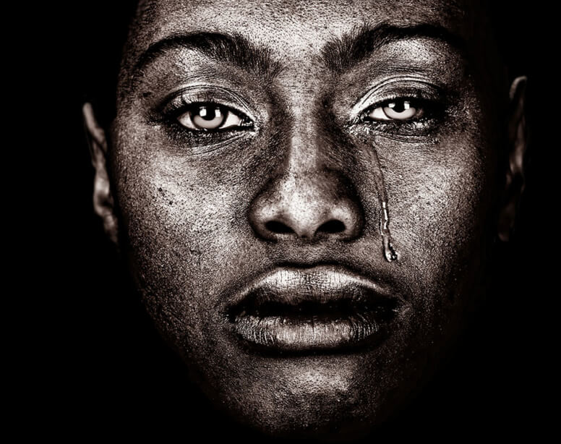
SEXUAL ABUSE
Any sexual conduct with a person supported by someone other than another person supported, with the intent to gratify the sexual desire of himself/herself or the person. Sexual abuse includes, but is not limited to, sexual intercourse, deviant sexual intercourse, or any form of sexual contact to include any touching of the sexual intimate parts. Sexual abuse also includes any incitement by an employee/agent of a person supported to engage in any form of sexual activity with another person or other person supported.
RCS NOTIFICATION: IMMEDIATE
THERAP APPROVAL: 24 HRS
LEVEL OF HARM (1-4)

Slide 13
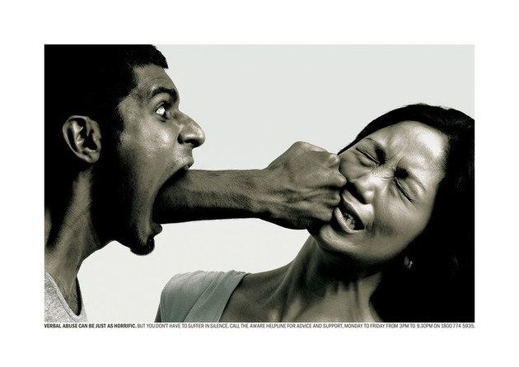
VERBAL ABUSE
Verbal conduct by someone, other than another person supported that demeans or could reasonably be expected to cause shame or ridicule, humiliation, embarrassment, or emotional distress. Verbal abuse includes, but is not limited to, threatening, using abusive, obscene or derogatory language, teasing or taunting in a manner to expose the person to ridicule.
RCS NOTIFICATION: IMMEDIATE
THERAP APPROVAL: 24 HRS
LEVEL OF HARM (1)

Slide 14
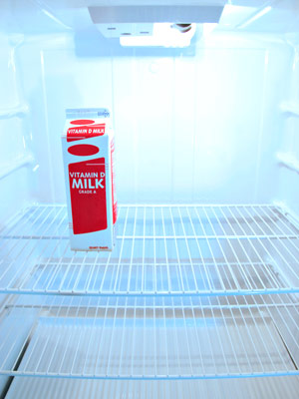
NEGLECT
RCS NOTIFICATION: IMMEDIATE
THERAP APPROVAL: 24 HRS
LEVEL OF HARM (1-4)
The failure to carry out a duty through carelessness, inattention, or disregard of duty whereby the person supported is exposed to harm or risk of harm. Neglect includes, but is not limited to:
Failing to appropriately supervise people;
Failing to ensure the person’s basic needs for safety, nutrition, medical care and personal attention are met;
Failing to provide supports in accordance with Person-Centered Plan;
Utilizing treatment techniques, e.g., restraints, seclusion, etc., in violation of the ADMH Administrative Code, regardless of whether an injury results.

Slide 15
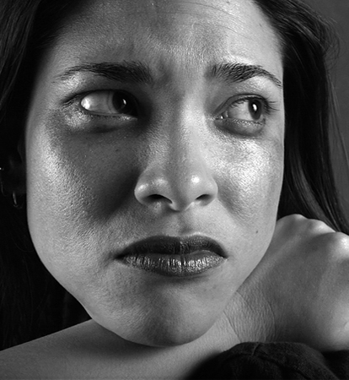
MISTREATMENT
Any act or threat of intimidation, harassment, or similar deed. Mistreatment includes, but is not limited to, active verbal aggression or intimidation, use of physical or non-verbal gestures as a means of intimidation, withholding of, or the threat of withholding, physical necessities or personal possessions as a means of intimidation for control of the person, and making false statements as a means of confusing, frightening, or badgering the person.
RCS NOTIFICATION: IMMEDIATE
THERAP APPROVAL: 24 HRS
LEVEL OF HARM (1)

Slide 16
EXPLOITATION
Utilizing the position of employment to take advantage of person supported for personal benefit. Exploitation includes, but is not limited to, improperly requesting a person supported to perform employee’s work responsibilities, services or tasks for the employee, requesting, taking or receiving money, gifts, or other personal possessions from a person, utilizing persons to engage in conduct with other persons that would be prohibited if performed by an employee.
RCS NOTIFICATION: IMMEDIATE
THERAP APPROVAL: 24 HRS
LEVEL OF HARM (1)

Slide 17
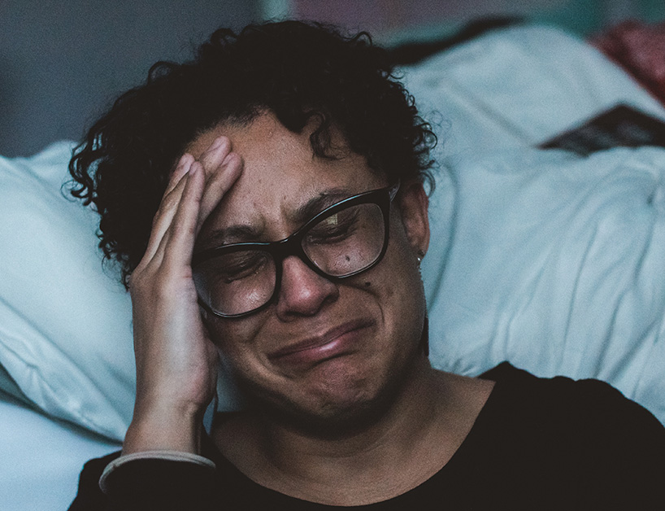
PHYSICAL ASSAULT
Any assault by a person supported upon another person supported. Physical assault includes, but is not limited to, hitting, kicking, slapping, throwing objects, striking another person which causes, or may have caused, injury. A physical assault results from planned, intentional behavior from agitation or other behavior where there is specific intent to inflict harm, or potential harm to another person.
RCS NOTIFICATION: IMMEDIATE
THERAP APPROVAL: 24 HRS
LEVEL OF HARM (1-4)

Slide 18
SEXUAL ASSAULT
RCS NOTIFICATION: IMMEDIATE
THERAP APPROVAL: 24 HRS
LEVEL OF HARM (1-4)
Any touching of the sexual or intimate parts of a person supported by another person supported. Sexual assault includes, but is not limited to, intercourse, deviant sexual intercourse, involving a person under the age of sixteen, or who is coerced, or who does not otherwise have the capacity to consent. Capacity may be either mental or physical, or the person may be mentally incapacitated as assessed by the person’s team.

Slide 19
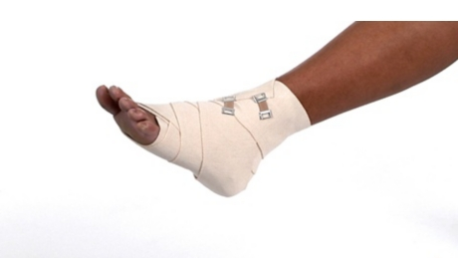
MODERATE INJURY
RCS NOTIFICATION: IMMEDIATE
THERAP APPROVAL: 24 HRS
LEVEL OF HARM (2-3)
An injury, explained or unexplained, requiring medical treatment that is not considered major. For example, a wound requiring five or less sutures, or a feeding tube that must be reinserted. Bruises and contusions are considered moderate if they require treatment. Sprains, as well as, suspected injuries, are considered moderate if an x-ray is ordered and there is no fracture.

Slide 20
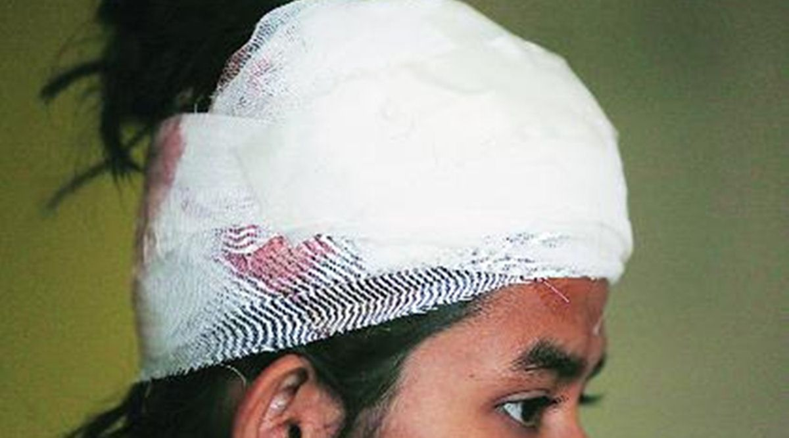
SEVERE INJURY
RCS NOTIFICATION: IMMEDIATE
THERAP APPROVAL: 24 HRS
LEVEL OF HARM (3-4)
A serious injury, explained or unexplained, requiring medical treatment, including any fracture, head injury, or wound requiring more than five sutures.

Slide 21
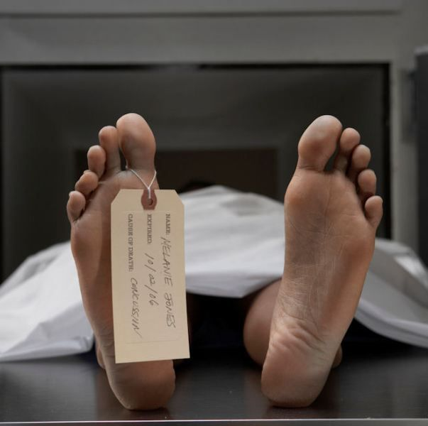
DEATH
All mortalities, in any setting, are to be reported immediately by the provider or person notified of the mortality to RCS. RCS office is to report the mortality immediately to the DDD. An Initial GER Death Report and a Comprehensive Mortality Review will be required. If the death occurred while the person was not in the provider’s care or, if the person lives in a relative’s home, it is understood certain information may not be readily available.
RCS NOTIFICATION: IMMEDIATE
THERAP APPROVAL: 24 HRS
LEVEL OF HARM (4)

Slide 22
AWOL/MISSING PERSON
Any time a person is found to be missing and cannot be located within thirty (30) minutes, regardless of location, the provider staff must immediately report to police and RCS. The notification shall include the suspected time of departure, where the person possibly went, what the person was wearing, a description of the person's behavior/attitude prior to disappearance, and what actions were taken to locate the person.
RCS NOTIFICATION: IMMEDIATE
THERAP APPROVAL: 24 HRS
LEVEL OF HARM (1-4)

Slide 23
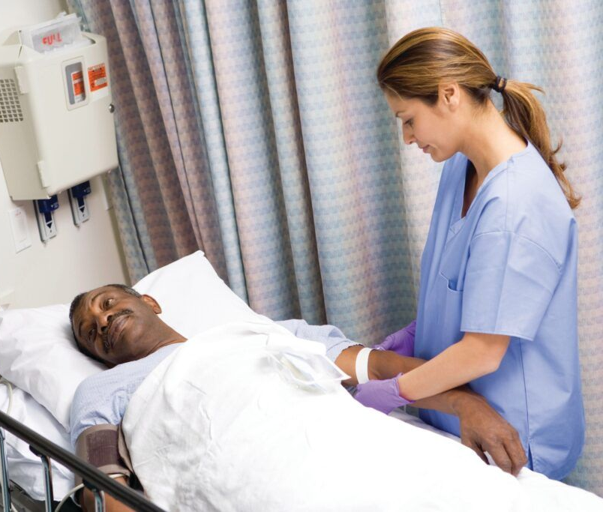
OTHER: HOSPITAL ADMISISION
A medical occurrence that cannot be characterized by any other medical emergency category above that requires an unscheduled hospital admission.
RCS NOTIFICATION: IMMEDIATE
THERAP APPROVAL: 24 HRS
LEVEL OF HARM (3)

Slide 24
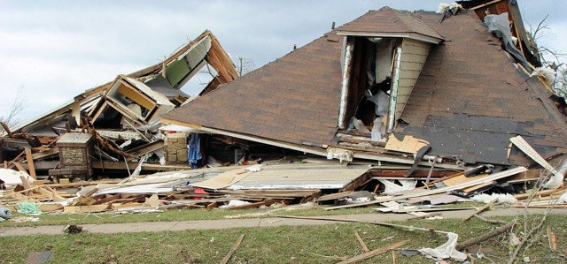
OTHER: NATURAL DISASTER
(i.e., tornado, flood, wind damage, hurricane). Providers must be familiar with disaster procedures in the home and be prepared to evacuate to a shelter if needed. Notify RCS after evacuation is completed and safety of person is ensured.
RCS NOTIFICATION: 24 HRS
THERAP APPROVAL: 48 HRS
LEVEL OF HARM (1-4)

Slide 25
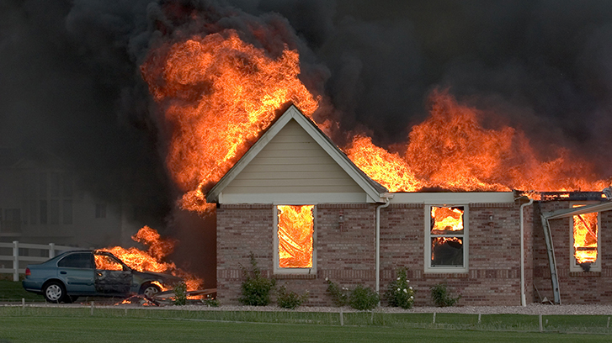
OTHER: FIRE
Flames resulting from the combination of heat, fuel, and oxygen, or the unplanned, inappropriate or hazardous burning of a combustible substance where injuries and/or structural damages occur.
RCS NOTIFICATION: 24 HRS
THERAP APPROVAL: 48 HRS
LEVEL OF HARM (1-4)

Slide 26
FALLS
Tripping, stumbling, or collapsing in a sudden and involuntary drop to a lower surface or the ground, resulting in a moderate or severe injury.
RCS NOTIFICATION: 24 HRS
THERAP APPROVAL: 48 HRS
LEVEL OF HARM (1-3)

Slide 27
SEIZURE
An unexpected or uncharacteristic seizure of any duration, regardless of whether an injury occurs.
RCS NOTIFICATION: 24 HRS
THERAP APPROVAL: 48 HRS
LEVEL OF HARM (2-3)

Slide 28
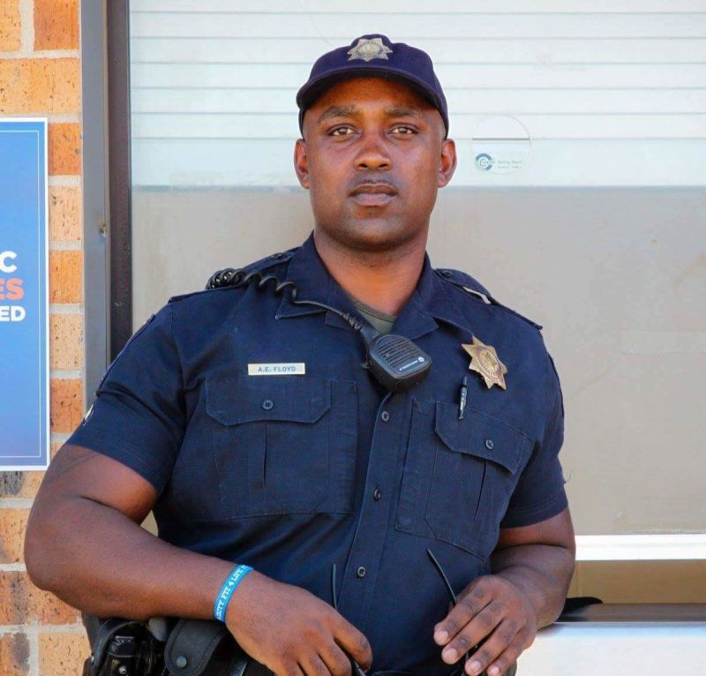
OTHER
Any other occurrence requiring local law enforcement intervention, temporary displacement from the home, ER visits, or anything that could reflect negatively on the image of DDD and is not otherwise defined by another category.
RCS NOTIFICATION: 24 HRS
THERAP APPROVAL: 48 HRS
LEVEL OF HARM (1-4)

Slide 29
MEDICATION ERROR LEVEL 1
A medication error occurs when a recipient receives an incorrect drug, dose, form, quantity, route, concentration, or rate of administration. A medication error is also defined the variance of the administration of a drug on a schedule other than intended. Therefore, a missed dose or a dose administered one hour before or after the scheduled time constitutes a medication error.
Severity Level 1: Incidents in which the person experienced no or minimal adverse consequences and no treatment or intervention other than monitoring or observation was required.
RCS NOTIFICATION: 24 HRS
THERAP APPROVAL: 48 HRS
LEVEL OF HARM (1)

Slide 30
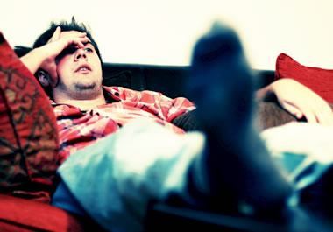
MEDICATION ERROR LEVEL 2
Incidents in which the person experienced short term, reversible adverse consequences and treatment or intervention was needed in addition to monitoring and observation.
RCS NOTIFICATION: 24 HRS
THERAP APPROVAL: 48 HRS
LEVEL OF HARM (2)

Slide 31
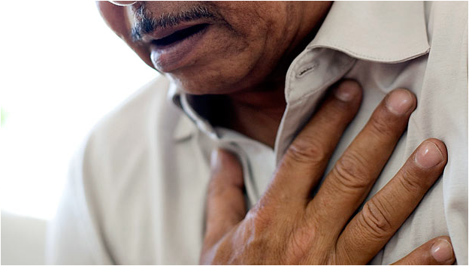
MEDICATION ERROR LEVEL 3
RCS NOTIFICATION: IMMEDIATE
THERAP APPROVAL: 24 HRS
LEVEL OF HARM (2-4)
Incidents in which the person experienced life- threatening or permanent adverse consequences.

Slide 32
CHARTING/DOCUMENTATION ERROR
A documentation error occurs when a MAR is not initialed after medication assistance is provided to a person. Evidence of a documentation error is denoted by blank space(s) on the MAR following the scheduled administration time of medication(s).
RCS NOTIFICATION: 24 HRS
THERAP APPROVAL: 48 HRS
LEVEL OF HARM (1)

Slide 33
CHOKING
Gagging or choking on food, liquid, foreign object, or material that requires the Heimlich maneuver or other method of dislodging object. Evaluation and/or assessment by nurse or medical personnel is required.
RCS NOTIFICATION: 24 HRS
THERAP APPROVAL: 48 HRS
LEVEL OF HARM (2-4)

Slide 34
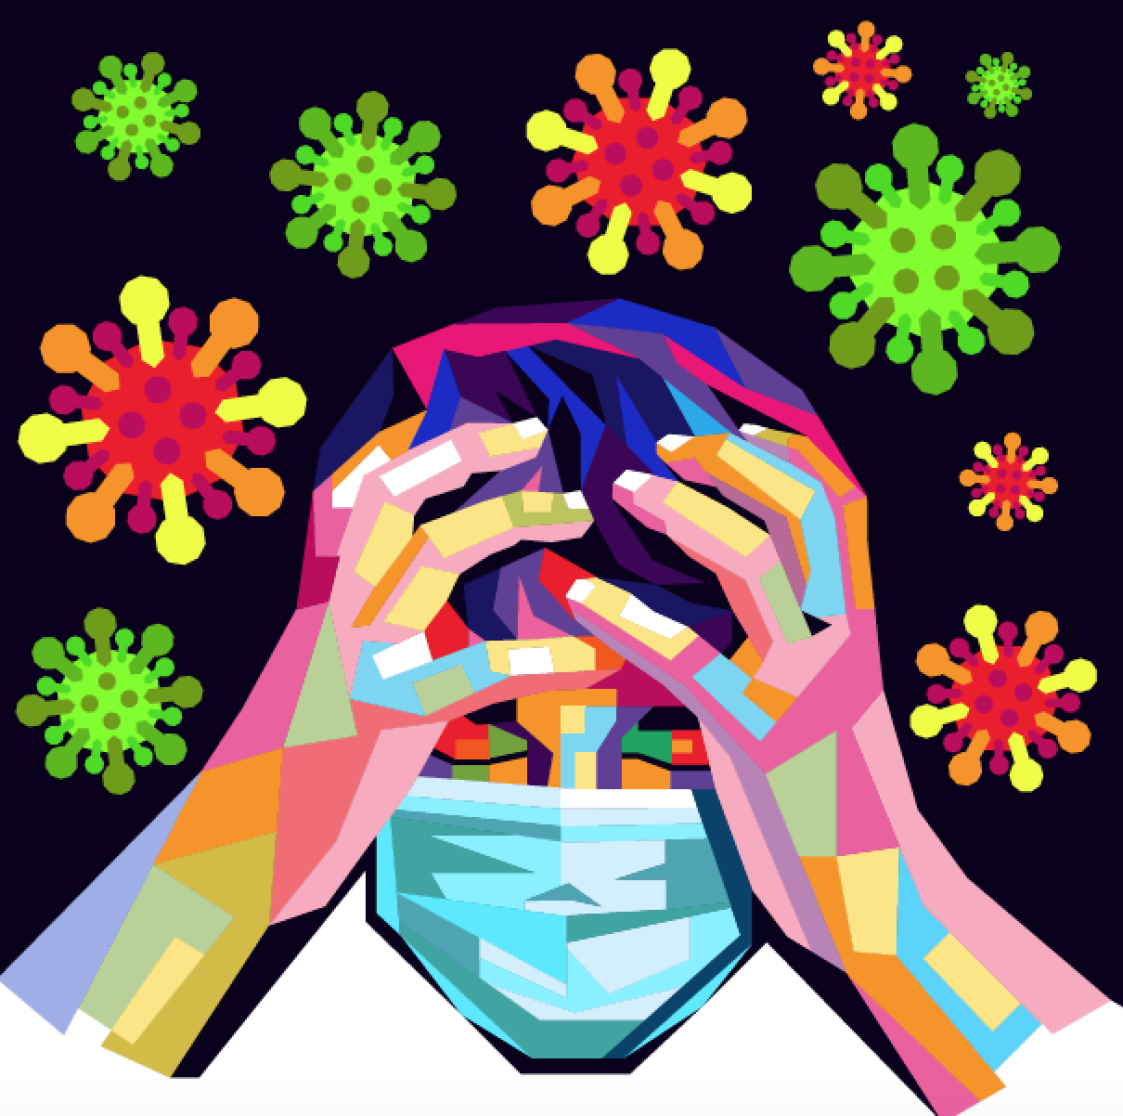
OTHER: BEHAVIORAL ISSUE
Behavior problems, such as physical aggression resulting in injury, self-injurious behavior requiring medical attention, suicide threats or attempts, or property damage resulting in injury or significant destruction shall be reported to RCS by the provider with information on how the situation was/is being addressed. Incidents resulting from such problems may or may not require follow-up.
Incident reports are also required for behavioral issues outlined in approved behavioral support plans.
RCS NOTIFICATION: 24 HRS
THERAP APPROVAL: 48 HRS
LEVEL OF HARM (2-4)

Slide 35
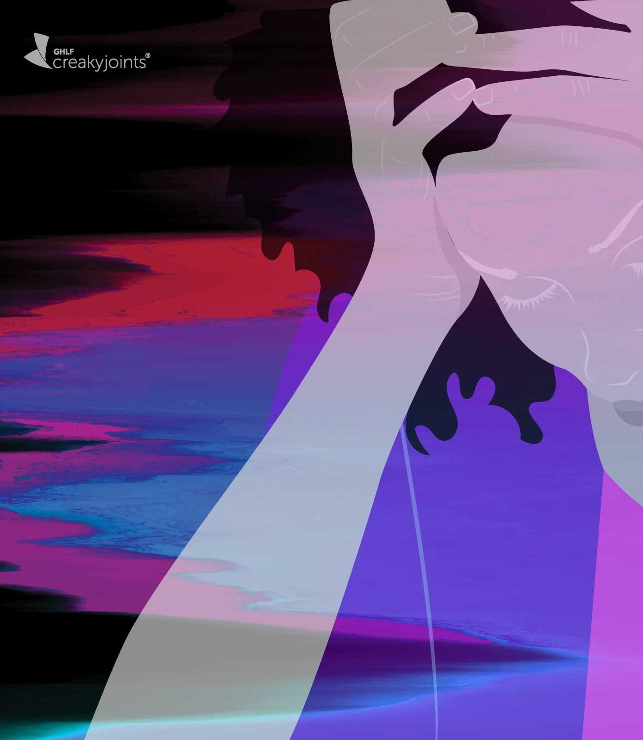
MANUAL RESTRAINT
The use of physical holding to involuntarily restrain movement of the whole or a portion of person’s body as a means of controlling physical activities to protect the person or others from injury.
Incident reports are also required for restraints that have been approved in behavioral support plans.
RCS NOTIFICATION: 24 HRS
THERAP APPROVAL: 48 HRS
LEVEL OF HARM (1)

Slide 36
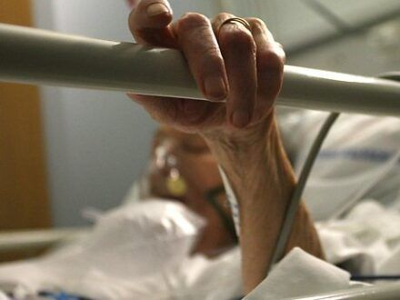
MECHANICAL RESTRAINT
The use of commercial devices to involuntarily restrain movement of the whole or a portion of a person’s body as a means of controlling physical activities to protect the person or others from injury.
Incident reports are also required for restraints that have been approved in behavioral support plans.
RCS NOTIFICATION: 24 HRS
THERAP APPROVAL: 48 HRS
LEVEL OF HARM (1)

Slide 37
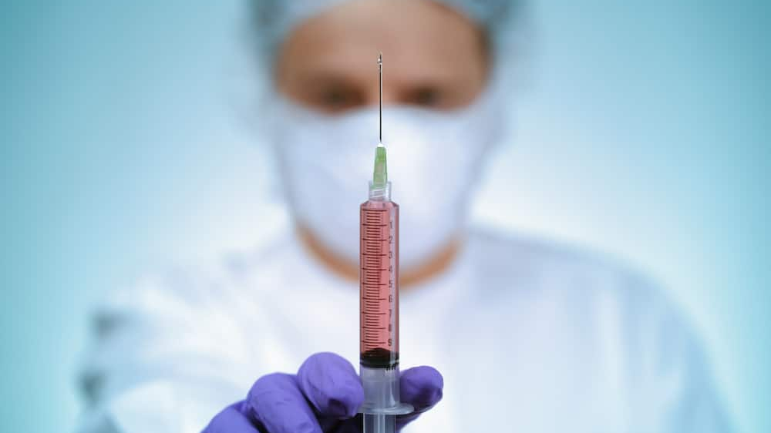
CHEMICAL RESTRAINT
The use of medication to control behavior or restrict the person’s freedom of movement.
Incident reports are also required for restraints that have been approved in behavioral support plans.
RCS NOTIFICATION: 24 HRS
THERAP APPROVAL: 48 HRS
LEVEL OF HARM (1)

Slide 38
APPROPRIATE SUPPORT FOR AFFECTED PEOPLE

Slide 39
PROVIDER INCIDENT REVIEW AND OVERSIGHT

Slide 40
DD INCIDENT REVIEW AND OVERSIGHT

Slide 41
MONTHLY QUALITY MEETINGS

Slide 42
IDENTIFYING TRENDS & PATTERNS
INCIDENT REPORTS
FINDINGS AND RECOMMENDATIONS OF IRC
FINDINGS AND RECOMMENDATIONS FROM INVESTIGATIONS
STATUS OF CORRECTIVE ACTION

Slide 43
PROVIDER COMPLIANCE
INCIDENT REPORTS
INVESTIGATIONS
FOLLOW-UP ACTION
IMPLEMENTATION & REMEDIATION

Slide 44
THERAP ACCESS
https://help.therapservices.net/app/alabama-idd-providers

Slide 45
RCS IPMS CONTACTS
RCS Offices | Office Hours Contact Number | After Hours Contact Number
Region 1 | 256-552-3720 | 256-566-5730
Region 2 | 205-554-4307 | 205-393-3103
Region 3 | 251-478-2774 | 251-591-9896
Region 4 | 334-676-5578 | 334-332-8680
Region 5 | 205-916-7760 | 205-901-1323

Slide 46
ADDITIONAL IPMS RELATED TRAININGS

Slide 47
QUESTIONS

