Slide 1
Community Waiver Program
ID/LAH Wavier Support Coordinator
Data Collection to Support Evaluation
ADIDIS Tutorial for Data Entry to Support Evaluation
October 28, 2021

Slide 2

Evaluation Overview
Evaluation required by CMS
External, independent evaluator must be used (HMA: Health Management Associates)
Certain measures require data collection and reporting by Support Coordinators

Slide 3
Evaluation Measures Requiring ID/LAH Support Coordinator Data Collection
How many waiver participants are living in settings that are not owned/controlled by residential providers?
How many waiver participants are working in competitive integrated employment?
How much use of non-waiver supports and services occurs to address individual goals and outcomes?

Slide 4
Residence Type
How many waiver participants are living in settings that are not owned/controlled by residential providers?
Support Coordinators will verify “residence type” when a person enrolls in ID/LAH and then verify at each QUARTERLY Face-to-Face (F2F) visit with the enrollee.

Slide 5
Residence Type (continued)
Residence type is a field in ADIDIS with drop-down menu from which SC’s select the correct option.
There is also a field for SC to enter the date the residence type is updated (verified as accurate) by the SC
After each QUARTERLY Face-to-Face visit, the Support Coordinator must update the date for the “residence type” in ADIDIS. Enter the date of the F2F visit you did.
The residence type would also be changed IF the residence type has changed. If the residence type hasn’t changed, don’t change this field.

Slide 6
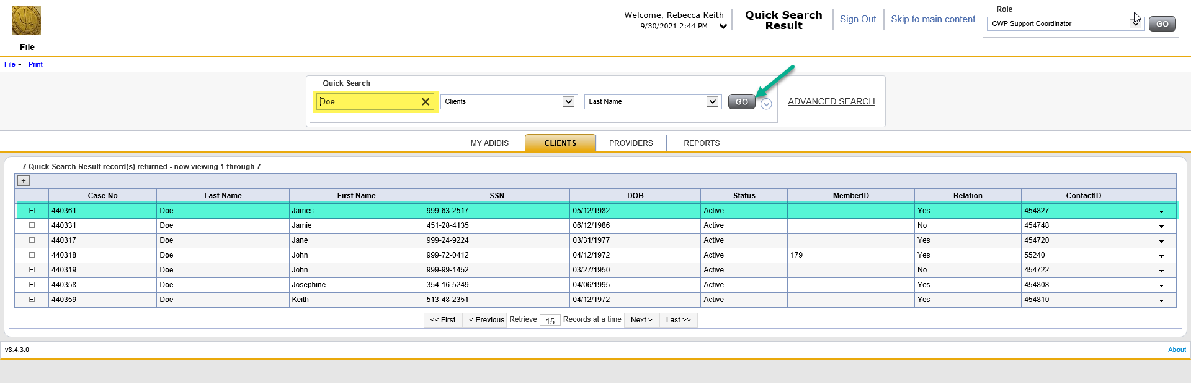
Residence Type
Step 1: Search for Client using either Quick Search or Advanced Search and click Go.
If multiple Clients are returned, click on the Client you need

Slide 7
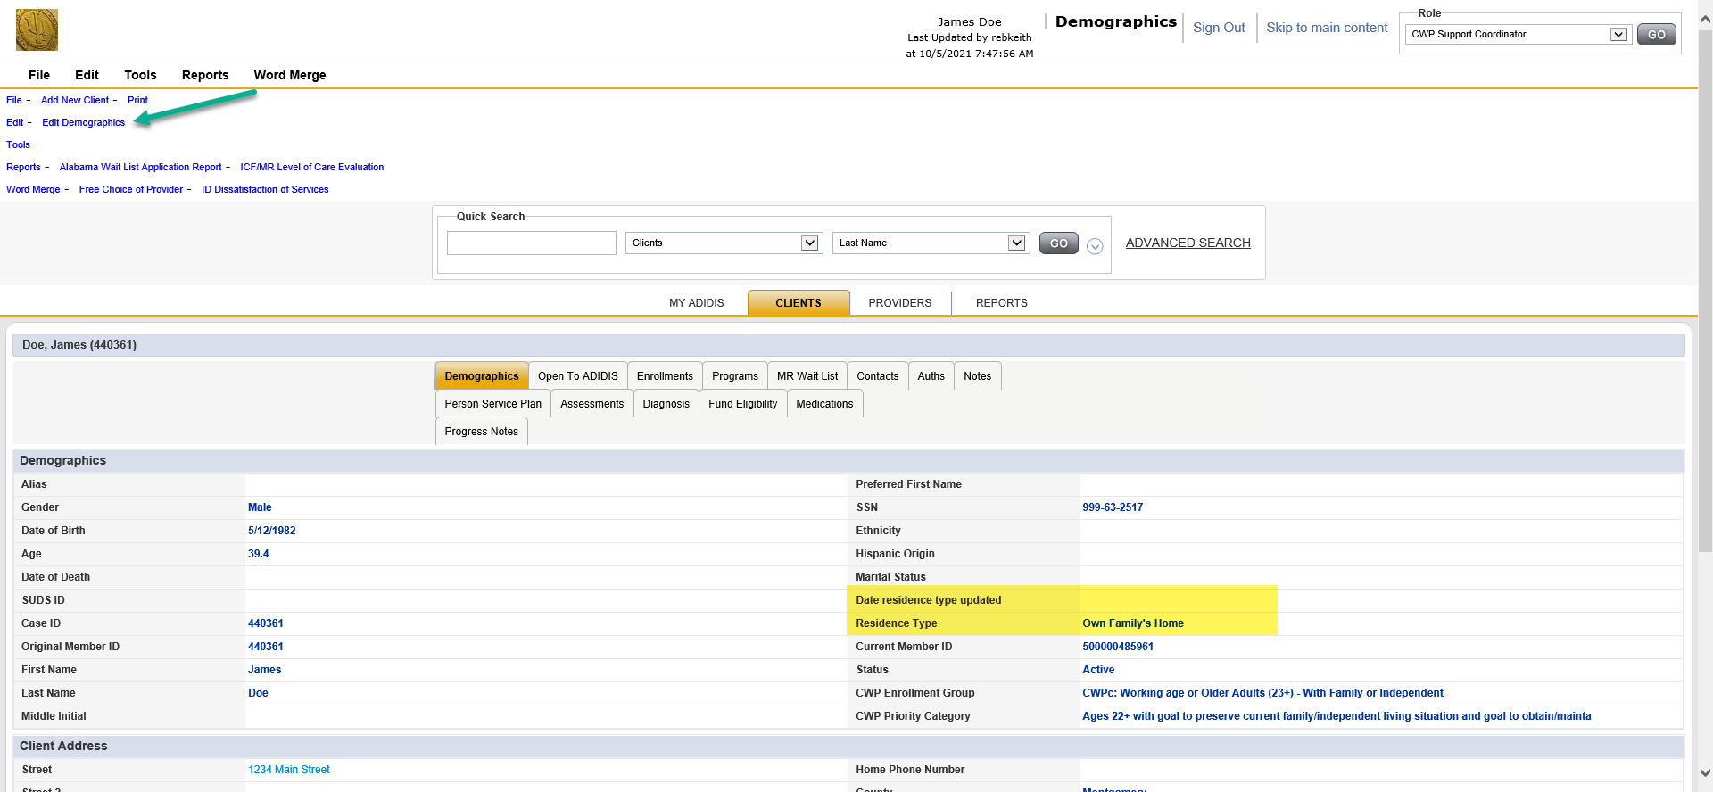
Residence Type
Step 2: To Edit the “Date residence type updated” and “Residence Type” fields on the Client Demographics screen, select ‘Edit Demographics’ link in the upper left

Slide 8
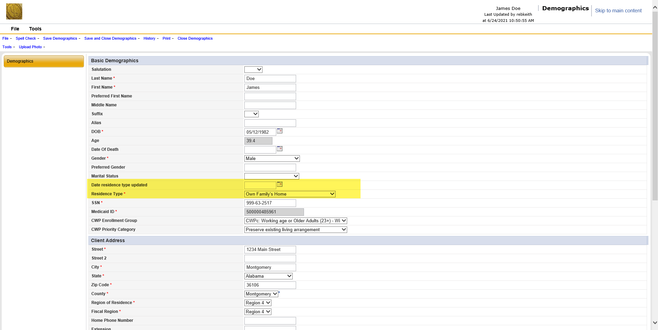
Residence Type
Step 3: The “Date residence type updated” and “Residence Type” fields are located under the Basic Demographics section of the Edit Demographics screen

Slide 9
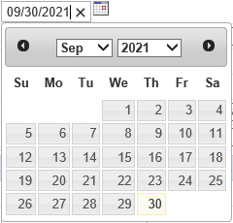
Residence Type
Step 4: The “Date residence type updated” is a date selection field, or you can manually enter a date in the MM/DD/YYYY format

Slide 10
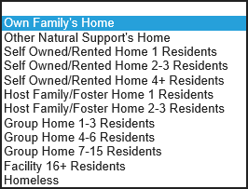
Residence Type
Step 5: Residence Type is a drop-down list.
Select the appropriate Residence Type for the Client.

Slide 11
Measure #2: Residence Type
Step 6: Once the fields have been updated, select the Save and Close Demographics link at the top of the screen.

Slide 12
Choosing the Correct Residence Type (1 of 2)
Residence Type Drop-Down Menu Options | Definition and Examples
Own Family’s Home | A residence where a person with a disability lives with at least one related family member who owns or rents the residence. The related family member is not paid to provide HCBS to the person in the home. Must be related by blood, marriage, common-law marriage or adoption.
Other Natural Support’s Home | A residence where a person with a disability lives with at least one non-related natural support who owns or rents the home. The natural support is not paid to provide HCBS to the person in the home. Not related by blood, marriage, common-law marriage or adoption.
Self-Owned/Rented Home 1 Resident | A home owned or rented from a landlord that is not an HCBS provider by 1 person with a disability who has free choice of provider if they require in-home HCBS supports. This means the person is not obligated to choose a certain provider of in-home HCBS supports and is free to change in-home HCBS provider at any time. “Home” can include single-family home, condominium, mobile home, tiny home, apartment, duplex, triplex. “Owned” means the person with a disability (or legal guardian if applicable) is named on the title. “Rented” means the person with a disability (or legal guardian if applicable) is named on the lease.
Self-Owned/Rented Home 2-3 Residents | A home owned or rented from a landlord that is not an HCBS provider by 2 or 3 individuals with a disability who have free choice of provider if they require in-home HCBS supports. This means the individuals is not obligated to choose a certain provider of in-home HCBS supports and are free to change in-home HCBS provider at any time. “Home” can include single-family home, condominium, mobile home, tiny home, apartment, duplex, triplex. “Owned” means the person with a disability (or legal guardian if applicable) is named on the title. “Rented” means the person with a disability (or legal guardian if applicable) is named on the lease.
Self-Owned/Rented Home 4+ Residents | A home owned or rented from a landlord that is not an HCBS provider by 4 or more individuals with a disability who have free choice of provider if they require in-home HCBS supports. This means the individuals is not obligated to choose a certain provider of in-home HCBS supports and are free to change in-home HCBS provider at any time. “Home” can include single-family home, condominium, mobile home, tiny home, apartment, duplex, triplex. “Owned” means the person with a disability (or legal guardian if applicable) is named on the title. “Rented” means the person with a disability (or legal guardian if applicable) is named on the lease.

Slide 13
Choosing the Correct Residence Type (2 of 2)
Residence Type Drop-Down Menu Options | Definition & Examples
Host Family/Foster Home 1 Resident | A home owned or rented by an individual or family in which they live and provide paid care and support for 1 person with disabilities who is not related to the paid caregivers.
Host Family/Foster Home 2-3 Residents | A home owned or rented by an individual or family in which they live and provide paid care and support for 2 or 3 persons with disabilities who are not related to the paid caregivers.
Group Home 1-3 Residents | A residence owned, co-owned, rented or managed/operated by: The residential services provider; or Another entity in which the residential service provider has some type of ownership or management interest; or An HCBS provider that is not the residential service provider. The residence provides housing for 1-3 persons with disabilities in which staff provide care, instruction, supervision, and other supports.
Group Home 4-6 Residents | A residence owned, co-owned, rented or managed/operated by: The residential services provider; or Another entity in which the residential service provider has some type of ownership or management interest; or An HCBS provider that is not the residential service provider. The residence provides housing for 4-6 persons with disabilities in which staff provide care, instruction, supervision, and other supports.
Group Home 7-15 Residents | A residence owned, co-owned, rented or managed/operated by: The residential services provider; or Another entity in which the residential service provider has some type of ownership or management interest; or An HCBS provider that is not the residential service provider. The residence provides housing for 7-15 persons with disabilities in which staff provide care, instruction, supervision, and other supports.
Facility 16+ Residents | A residence owned, co-owned, rented or managed/operated by: The residential services provider; or Another entity in which the residential service provider has some type of ownership or management interest; or An HCBS provider that is not the residential service provider. The residence provides housing for 16 or more persons with disabilities in which staff provide care, instruction, supervision, and other supports.
Homeless | An individual who lacks stable, permanent housing, including: An individual who lives on the streets, in an abandoned building or in a vehicle. An individual whose primary residence during the night is a supervised public or private homeless shelter or similar setting (E.g., mission) that provides temporary living accommodations. An individual who is a resident in transitional housing.

Slide 14
Employment Status for Waiver Enrollees Ages 18 and Older
How many waiver participants are working in competitive integrated employment?
Support Coordinators will verify “employment status” when person enrolls in ID/LAH and then verify at each QUARTERLY Face-to-Face visit with waiver enrollee.

Slide 15
Employment Status for Waiver Enrollees Ages 18 and Older (Continued)
Employment Assessment is an assessment in ADIDIS with multiple fields to be completed by the SC.
After each QUARTERLY Face-to-Face visit, the Support Coordinator must update the date for the Employment Assessment
The other Employment Assessment fields would also be changed/updated IF the employment data has changed.

Slide 16
Employment Status
Step 1: Search for Client using either Quick Search or Advanced Search and click Go.
If multiple Clients are returned, click on the Client you need

Slide 17
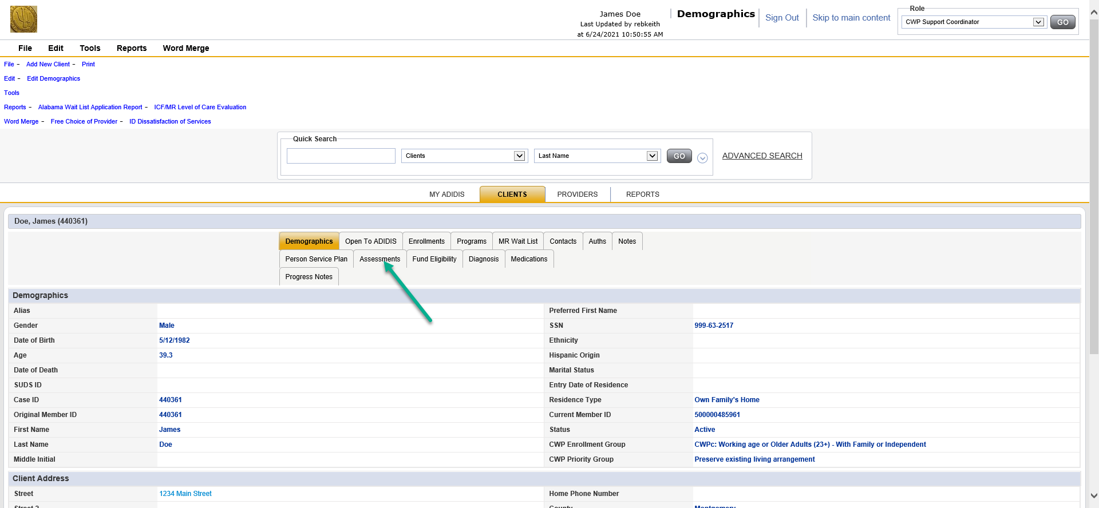
Employment Status
Step 2: From the Client Demographics screen, click on the Assessments Tab.

Slide 18
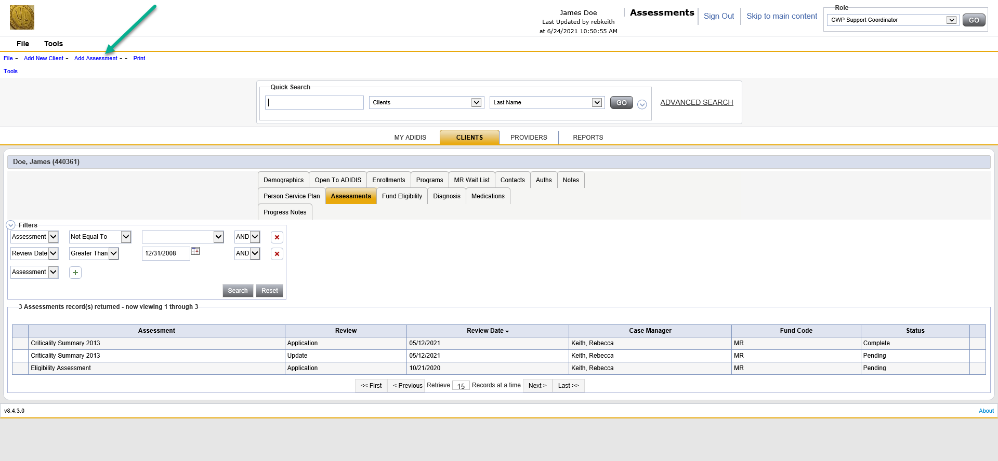
Measure #6: Employment Status
When on the Assessments tab:
Select Add Assessment at top left if entering employment data for the first time.
If updating employment data, select “Duplicate Previous Assessment” or “Add Assessment”.
If duplicating a previous assessment, don’t forget to change the date.

Slide 19
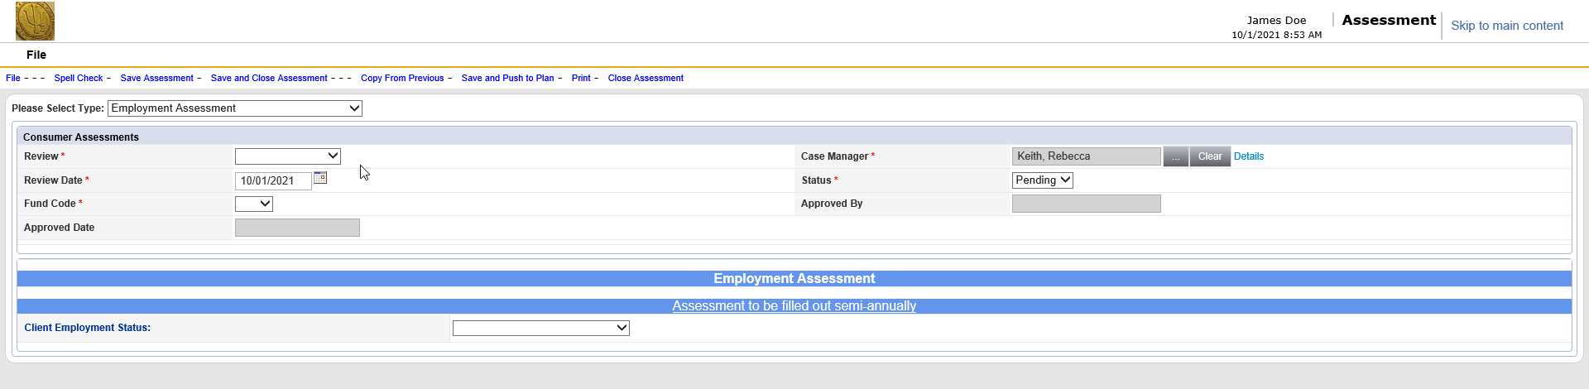
Employment Status
Step 4: On the next screen, select Employment Assessment from drop-down at top.

Slide 20
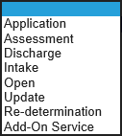
Employment Status
Step 5: Populate the fields at the top of the assessment accordingly
Review: Always choose Assessment
Review Date: Select date of quarterly Face-to-Face visit.
Fund Code: Select “MR” Status: Leave as “Pending”

Slide 21
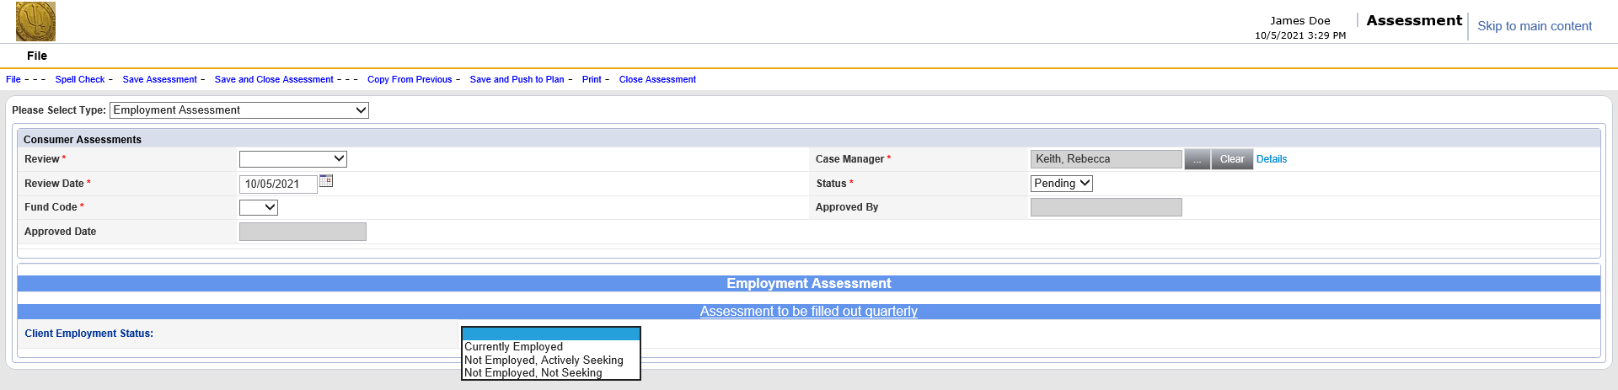
Employment Status
Step 6: Body of Employment Assessment
At Client Employment Status select from drop-down menu

Slide 22
Client Employment Status (Ages 18+)
Drop-Down Menu Option | Definition | Examples
Currently Employed | Receiving wages or cash payment for work done for someone other than people living with the ID/LAH waiver enrollee. | Paid job at any wage or for cash. Does not include volunteering or internship for no pay.
Not Employed, Actively Seeking | Does not meet definition of Currently Employed; but using available agencies/services to locate job and/or applying for jobs in other ways. | Drop-Down Menu Options: Seeking employment with ADRS involvement Seeking employment without ADRS involvement Can include: applying for own jobs; using waiver-funded Job Development service Exploring option of employment Must be *actively* exploring which typically will include receiving Discovery services, ADRS career exploration/job shadowing services
Not Employed, Not Seeking | Does not meet definition of Currently Employed or Not Employed/Actively Seeking as defined above. | Drop-Down Menu Options: Health or Medically-Compromised Legal Representative not Supportive Enrollee Lack of Exposure/Interest Not receiving any type of employment services

Slide 23
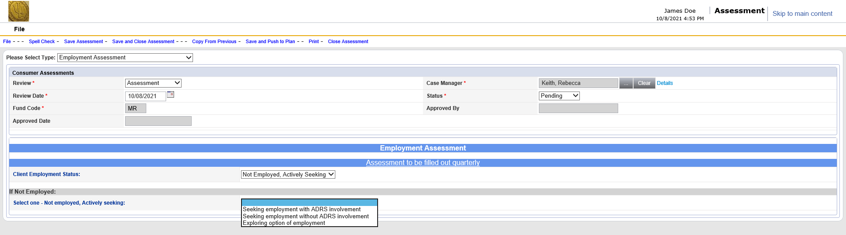
Employment Status
Step 7: Body of Employment Assessment
If “Not Employed, Actively Seeking” is selected, choose the correct option from the drop-down

Slide 24
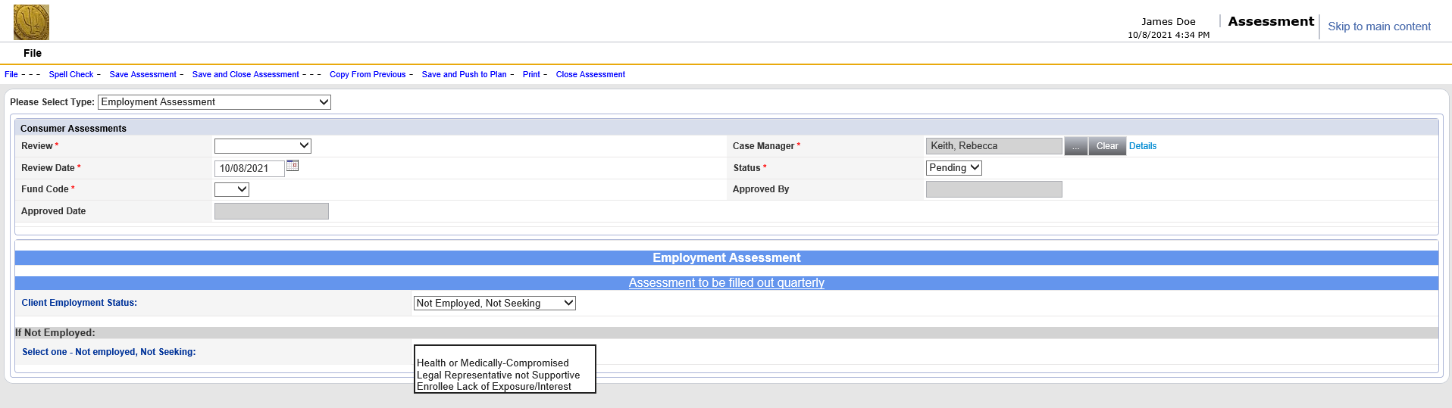
Employment Status
Step 7: Body of Employment Assessment
If “Not Employed, Not Seeking” is selected, choose the correct option from the drop-down.

Slide 25
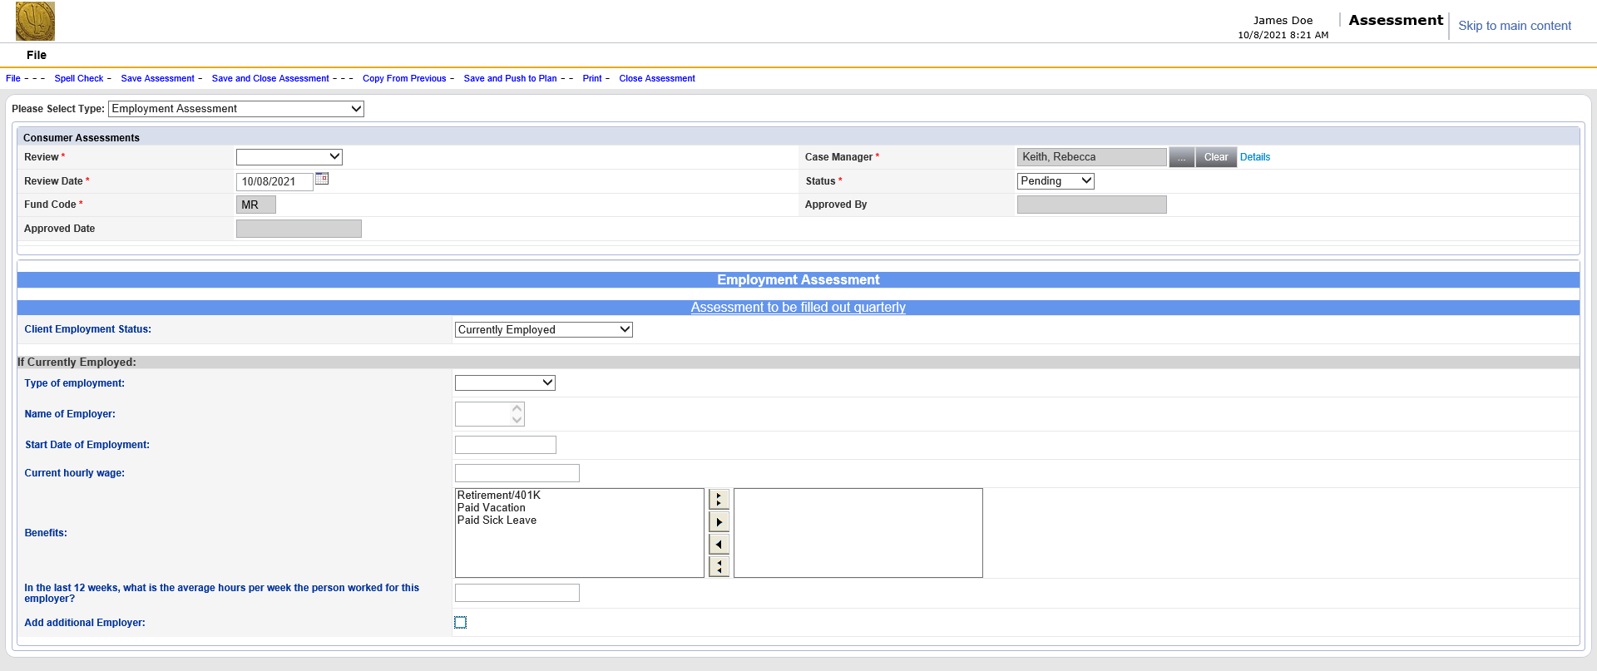
Employment Status
Step 7: Body of Employment Assessment
If “Currently Employed” is selected, these fields appear.

Slide 26

Employment Status
Step 8: Body of Employment Assessment
If “Currently Employed”, select “Type of employment” from drop-down menu.

Slide 27
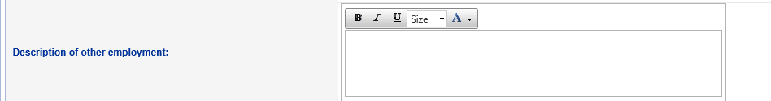
Type of Employment
Drop-Down Menu Option | Definition | Examples
CIE | Pay is minimum wage ($7.25 or higher); AND Place of employment is integrated community setting not owned/operated by disability service provider; AND Person working in a job that is not directly alongside another person or people with disabilities being supported as a small group; AND Employer of record is not the employment service provider supporting the person or another waiver service provider. | Individual employed at and by a local grocery store, earning $9/hour. Not side-by-side or in team with other person(s) with a disability. Individual working at manufacturing company for $10/hour, employed by Adecco Staffing Agency. Not side-by-side or in team with other person(s) with a disability.
Group SE | Pay at any hourly rate (could include sub-minimum wage); AND Place of employment is integrated community setting not owned/operated by disability service provider; AND Person working in a group of two to four people with disabilities being supported as a small group by single employment service provider; AND Employer of record may or may not be the employment service provider supporting the small group. | Group of 4 individuals with disabilities working at Polaris factory with support from a Group SE provider. Group of 3 individuals with disabilities and 1 person without disabilities on a cleaning crew cleaning offices. Group of 2 people with disabilities working together (side-by-side; as a team) at Hardees
Other (describe) | If “Other” is selected, enter a description in the text box that appears.

Slide 28



Employment Status
Step 9: Body of Employment Assessment
If “Currently Employed”, enter Name of Employer.

Slide 29
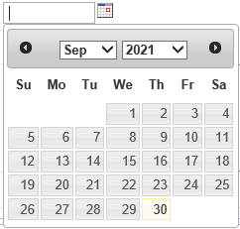


Employment Status
Step 10: Body of Employment Assessment
If “Currently Employed”, enter “Start Date of Employment”.
Select or manually enter date in the MM/DD/YYYY format

Slide 30


Employment Status
Step 11: Body of Employment Assessment
If “Currently Employed”, enter Current Hourly wage
Must be formatted with only 2 places after decimal (example $10.50)

Slide 31



Employment Status
Step 12: Body of Employment Assessment
If “Currently Employed”, select any Benefits the person is receiving.
Left Box: Click to highlight benefits; then use arrow buttons to move to Right Box.
Correct list of benefits for person needs to appear in Right Box

Slide 32
Employment Status Step 13: Body of Employment Assessment
If “Currently Employed”, fill in average hours worked per week over the last 12 weeks as reported by the Waiver enrollee or involved family/guardian/friend
Always round up to next whole number (E.g., 12.5 = 13)

Slide 33


Employment Status
Step 14: Body of Employment Assessment
If person has an additional job, check the “Add additional Employer” box.

Slide 34
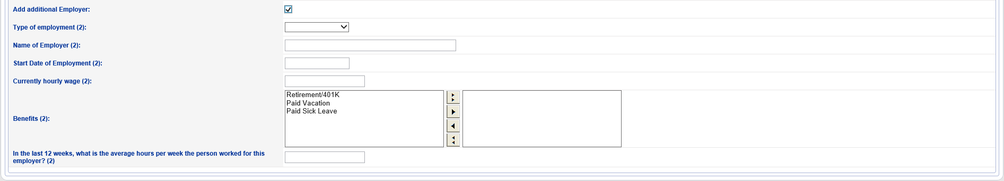


Measure #6: Employment Status
Step 15: Body of Employment Assessment
Fill in the information on the additional employer.
Repeat Steps 8-13.

Slide 35
Use of Non-Waiver Services/Supports to Meet Outcomes
How much use of non-waiver supports and services occurs to address individual goals and outcomes?
In the “Person-Centered Planning Assessment and Documentation” fields in ADIDIS, you are identifying “Selected Strategies” that will be implemented to enable the person to achieve an identified outcome(s).
Just below the field for “Description of Strategy”, a field has been added for “Strategy Type”
There is a drop-down menu to select the “Strategy Type”

Slide 36
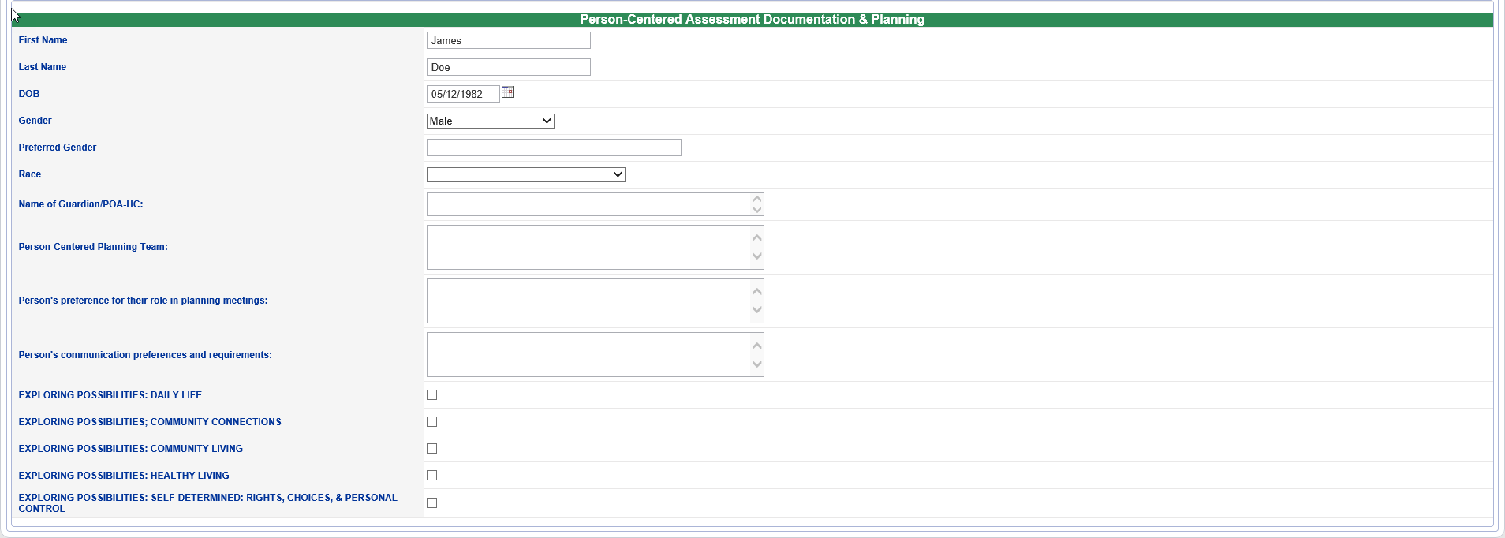
Use of Non-Waiver Services and Supports to Meet Outcomes
Step #1: Fill out the Person-Centered Assessment Documentation & Planning section as you would today

Slide 37
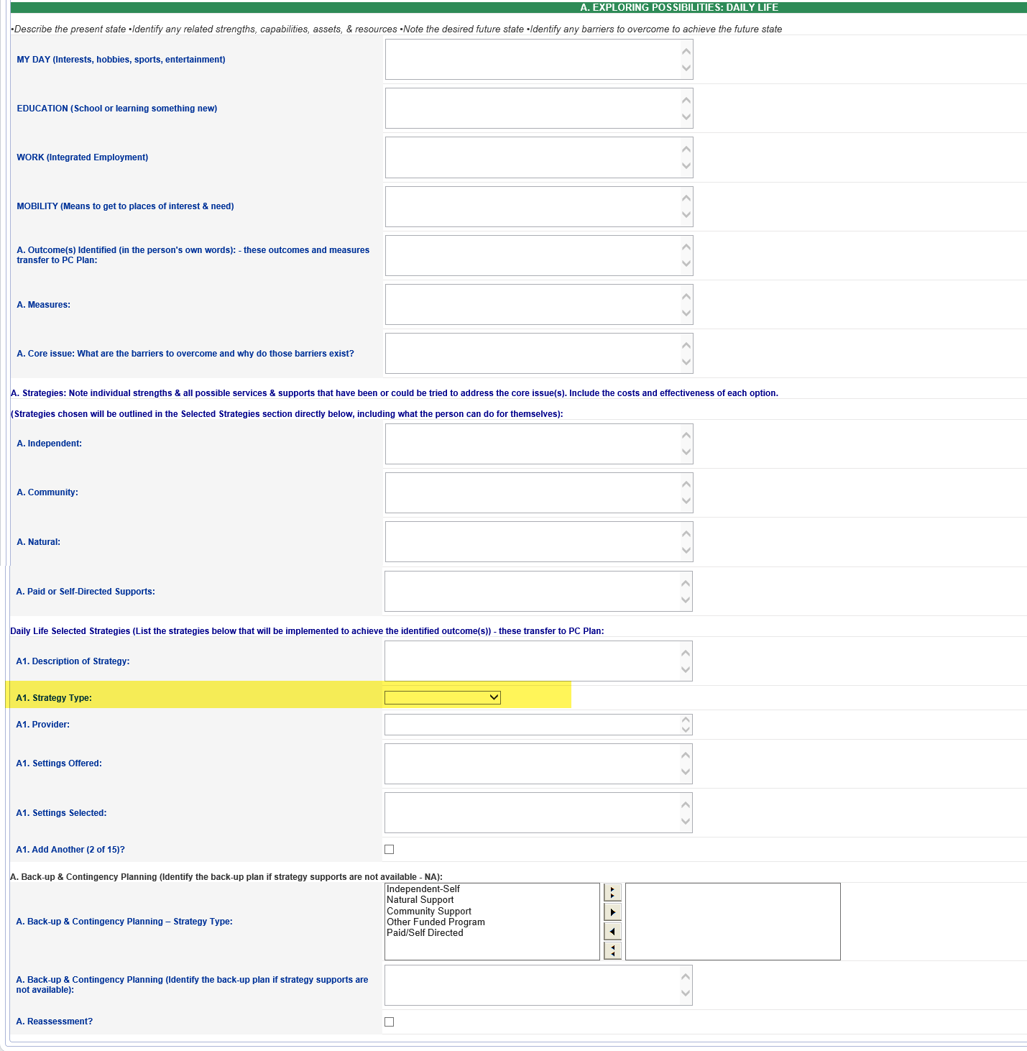
Use of Non-Waiver Services and Supports to Meet Outcomes
Step #2: For each Selected Strategy you add, the new “Strategy Type” field will appear under the “Description of Strategy” field
This will be the case in all Exploring Possibilities sections

Slide 38

Use of Non-Waiver Services and Supports to Meet Outcomes
Step #3: Click on the “Strategy Type” field and
Select the correct option from the drop-down menu

Slide 39
Select the correct option from the drop-down menu (1 of 2)
Drop-Down Options | Definition | Examples
Independent / Self | Strategy where primary implementer is the Waiver enrollee, acting independently or with assistance that is not human support funded through Waiver. Examples: assistive technology; adaptive aid; natural support; financial resources belonging to Waiver enrollee (e.g., income; savings; ABLE account; supplemental needs trust; etc.) | Waiver enrollee stays healthy by monitoring their blood sugar and remembering to take diabetes medication using assistive technology. Waiver enrollee achieves outcome of learning to cook by using savings to pay for cooking lessons. Waiver enrollee develops connections with their neighbors by using their skill to tell jokes at the local community open mic night. Waiver enrollee improves their mobility through physical therapy covered by their family’s health insurance.
Natural Support | Strategy where primary implementer is a natural support that is not being paid for implementing this strategy. | Waiver enrollee stays healthy by having their sister help with monitoring their blood sugar and remembering to take diabetes medication. Waiver enrollee achieves outcome of learning to cook by exploring new recipes & making healthy meals with a friend from church each week. Waiver enrollee develops community connections by attending their local faith services with their neighbor Jane who provides weekly transportation. Waiver enrollee improves mobility by implementing their physical therapy home program with help from their parent.
Community Support | Strategy where primary support for Waiver enrollee comes from a community group, organization or place of business/employer that is not paid to provide disability-specific supports/services. | Waiver enrollee stays healthy by participating in a diabetes self-management course offered at the local senior center. Waiver enrollee achieves outcome of learning to cook by participating in a restaurant internship arranged through a partnership with the community college. Waiver enrollee develops community connections by attending their local faith services with transportation and logistics organized by the members of the group. Waiver enrollee improves mobility by attending a yoga class at the local gym with assistance from other class attendees if needed.

Slide 40
Select the correct option from the drop-down menu (2 of 2)
Drop-Down Options | Definition | Examples
Other Funded Program | Strategy where primary implementer is a publicly-funded, eligibility-based program providing paid, non-Waiver services to the Waiver enrollee. | Waiver enrollee stays healthy by seeing a nurse practitioner specializing in diabetes management at the local public health clinic; and using SNAP benefits to purchase healthy food. Waiver enrollee achieves outcome of learning about restaurant work and cooking through community-based work assessment arranged and paid by vocational rehabilitation. Waiver enrollee develops community connections by attending their local faith organization using a county aging/disability transportation service. Waiver enrollee improves mobility by attending a special education physical course designed for students with disabilities.
Paid/Self Directed | Strategy that is Waiver service/support, whether self-directed or not. | Waiver enrollee stays healthy by seeing with Waiver-funded Skilled Nursing RN specializing in diabetes management and by using Waiver-funded assistive technology to monitor blood sugar and manage medication. Waiver enrollee learns to cook with paid assistance through Residential Habilitation or Day Habilitation service. Waiver enrollee develops community connections by attending their local faith organization with support from a paid Personal Care DSP. Waiver enrollee improves mobility by participating in Waiver-funded physical therapy.

Slide 41
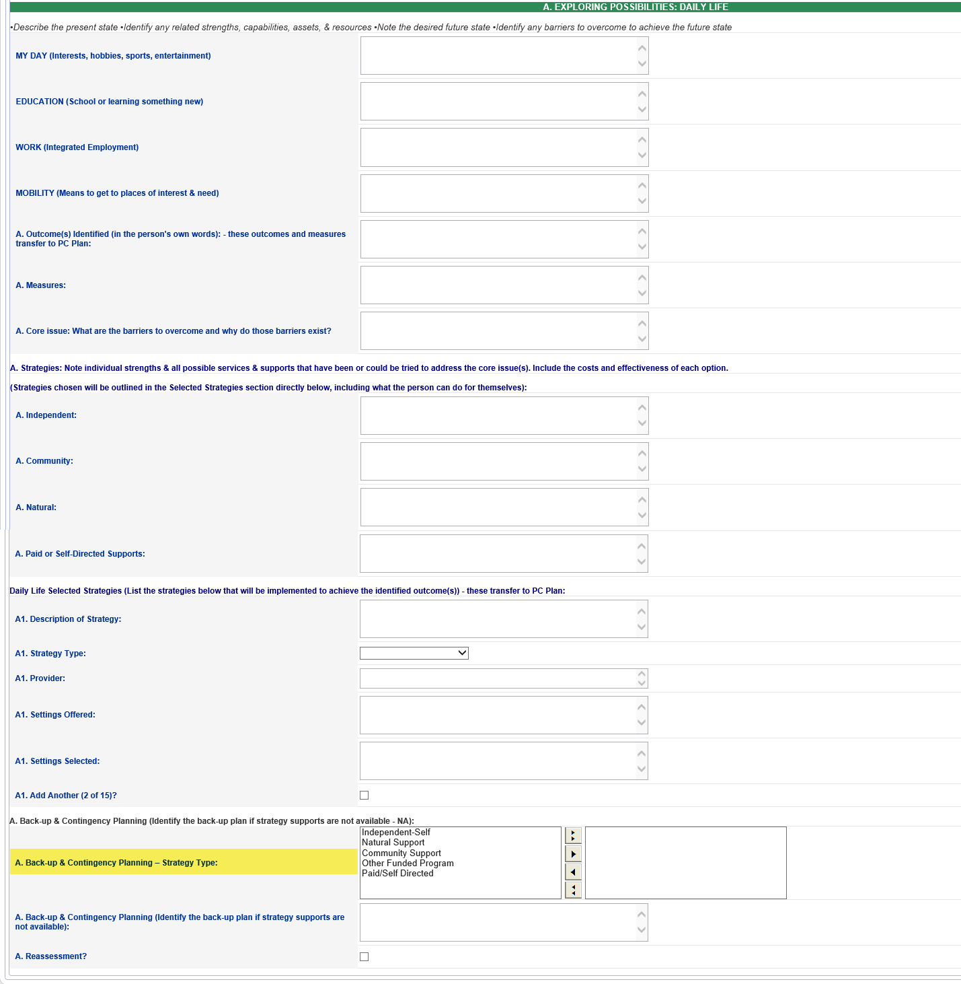

Use of Non-Waiver Services and Supports to Meet Outcomes
Step #4: When Entering a “Back-up & Contingency Plan”, you will see a “Back-up & Contingency Planning-Strategy Type” field appear.

Slide 42
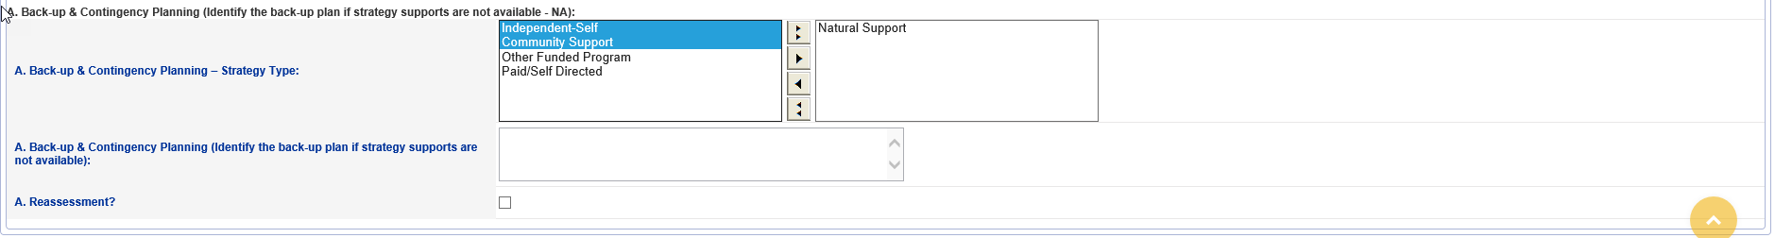
Step #5: Select the “Back-up & Contingency Plan” Strategy Type(s).
Note: The Back-up & Contingency Planning – Strategy Type field is a multi-select field.
**You can select 1, more than 1, or all Strategy Types.**
Click on (to highlight) all of the Strategy Types that are part of the Back-up Plan.
If all Strategy Types are selected, click on the double arrow to move all.
If not all Strategy Types are selected, click on single arrow to move each Strategy Type selected.
Double Arrows
Single Arrows
Use of Non-Waiver Services and Supports to Meet Outcomes

Slide 43

Questions?
Questions After Today:
Send to
Byron White
CWP Director
Byron.White@mh.alabama.gov

