Slide 1
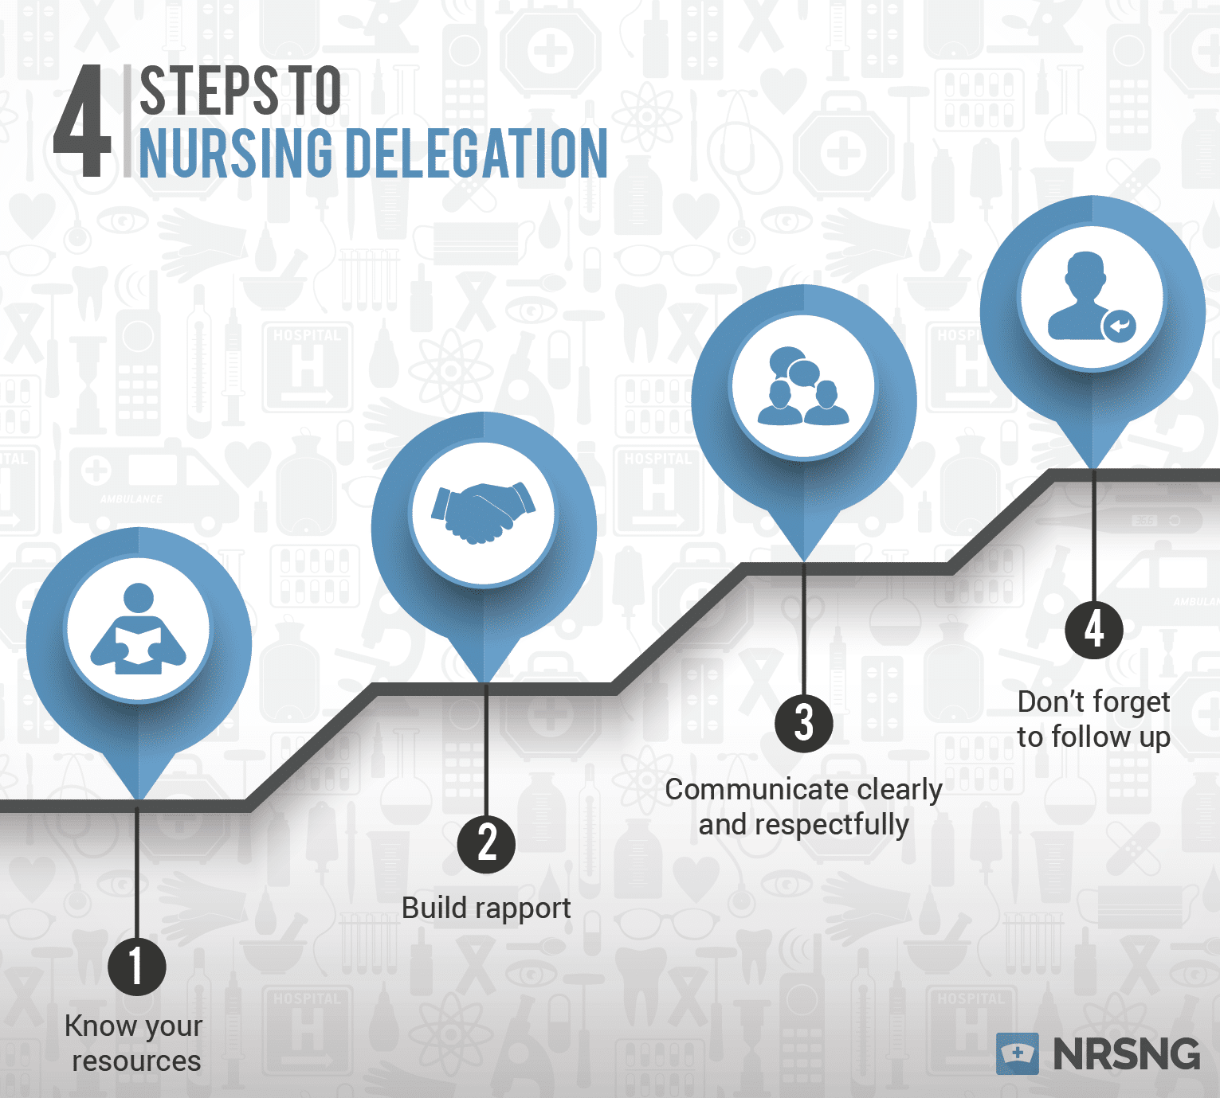
The Nurse Delegation Program
MAC II
Competency Verification
Medication Assistance Certification Training
2023

Slide 2
MAC II
This phase of MAC Training is when the MAS Nurse begins to build a rapport with the MAC Worker.
CALLED
The MAS –MAC CONNECTION
During this class, the computer training will be turned into HANDS ON applications that will be used as you provide care for the people served at your agency

Slide 3
Introduction
The MAC Training Program consists of two parts:
MAC I = 6 modules on the eLearning system
MAC II = a minimum of 8 hours face-to-face with MAS Nurse
With a skills check/demonstration completed on all tasks to be delegated
Notes:
MAC II requires a review of MAC I, Agency NDP policy and procedure review, a skills competency checklist completed, the delegation form signed by MAC and Nurse

Slide 4
MAC 1 is the E-learning portion of the
training program. The learner must complete the six E-Learning modules and pass each module with a score of 90 or above. The Agency is responsible for supervising the worker and ensuring the creditability of testing.
MAC I

Slide 5
Contents of MAC I
MAC I included the following six courses:
Course 1 Introduction to the Nurse Delegation Program
Course 2 Principles of working with Persons with
Mental Disorders
Course 3 Mental and Physical Disorders
Course 4 Health Status Observations
Course 5 Principles of Assisting with Medications
Course 6 Medication Assistance Guidelines
Notes:
MAS Nurse here is where you describe the NDP program. You talk about the population you work with. Describe some physical ailments/limitations. Talk about mental disorders and what types of behaviors they may see with the population in your agency. Paint a mental picture for the worker on what to look for related to changes in health status. Talk about the decision made by MAS nurse to delegate certain tasks to unlicensed workers. Describe the 7 rights and 3 checks in med administration.

Slide 6
MAC I
Review of Course I Introduction to the NDP
Definitions/Abbreviations
ADMH – 2 Service Divisions (ID/DD & MH/SU
Nursing Profession – RN/LPN
NDP – Allows unlicensed persons to assist with medications
MAS/MAC Connection – STAY CONNECTED TO YOUR MAS NURSE
MAC Worker – Nurse extender, unlicensed worker; must have a MAS Nurse (RN/LPN) supervisor
MAS Nurse – Responsible for the nursing care; must be available to MAC Worker 24/7
Treatment Team Members (person served, QIDP, Provider, guardian, nurse, advocate, MAC worker)
Rights and Responsibilities
Notes:
Nurse a Visual aid to show potential MAC’s the abbreviations your agency uses, and what they mean/definition.
Give a BRIEF description of the populations served through ADMH and how treatment varies
Give an overview of why there are MAC’s. Law requires license to do nurse stuff – ABN made exception with ADMH – allowing MACs to be trained
Brief explanation of MAS-MAC connection
Describe the value of the MAC’s position as the eyes/ears of the nurse
This is where you let them know what you expect from them

Slide 7
MAC I
Review of Course 2
Principles of Working with Persons with Mental Disorders
Privacy and Confidentiality - HIPPA
Review of Agency Policies & Procedures
People First Language
Notes:
Nurse review your HIPPA P & P here.
Discuss privacy, people first language and why

Slide 8
MAC I
Review of Course 3
Mental and Physical Disorders
ID/DD
MI
SU
Physical/Medical Disorders
Common Medications for Mental and Physical Disorders
Notes:
Nurse describe the population the MAC will be working with
What are the common problems associated with the population
What are common medications used to help this population -Briefly

Slide 9
MAC I
Review of Course 4
Health Status Observations
Possible Physical Changes
Possible Changes in Mental Status
Possible Behavioral Changes
Signs/Symptoms of a Potential Problems
Vital Signs
Spasticity and Contractures
Sexual Activity
Notes:
Nurses describe some physical change that may occur with the population
Any mental changes that may occur
Possible behaviors especially for those that lack the ability to communicate through speech
What are normal vital signs
Explain spasticity and contractures- remember many potential MACs have no health care experience
Explain what to expect with the population you care for regarding sex – ID/DD may have minds of children but have body and physical urges of the adult age. MI and SU do not always make good choices when comes to sex relationships.

Slide 10
MAC I
Review of Course 5
Principles of Assisting with Medications
General Principles
7 Rights
Effects of Medication
Medication Errors
Notes:
Overview
Wash hands, gather supplies,
Locate meds and MAR, check against each other, call person to med area, respectfully, Id person, check medications on Mar, Pop meds out of packet and check them 3rd time label against MAR while stating what the medications is for the persons’ benefit. Ask name once more administer medications, wash down with 6 oz of water, check for cheeking, thank the person for their cooperation, document the medication.
Repeat as needed.

Slide 11
MAC I
Review of Course 6
Medication Assistance Guidelines
Procedure for Assisting with Medications
Oral
Eye
Ear
Nose
Topical
Inhalant
Rectal/Vaginal
Notes:
Nurse demonstrates how to correctly use/administer any forms of medication your MAC’s use or may potentially use in your agency. YOU WILL NEED PROPS here fake meds, delivery devices, can use Utube videos if you can find them.
You have reviewed MAC I (great break time)

Slide 12
MAC II
MAC II is the skills competency part of the MAC Training Program. Only a Medication Assistance Supervising (MAS) nurse (RN/LPN) can teach MAC II and verify that a Direct Care Worker is competent to work as a Medication Assistance Certified (MAC) Worker
Notes:
MAS Nurse can be RN or LPN
610-X-7-.06 Alabama Department Of Mental Health Residential Community Programs.
Alabama Department of Mental Health shall train licensed nurses by the Alabama Department of Mental Health approved nurse delegation programs: Program (NDP) and the Medication Administration Supervisor (MAS).
(a) The licensed nurse identifies the appropriate individual(s) to assist in providing prescribed medications who has:
1. Completed the ADMH Medication Assistance Certification (MAC) Training Program Part I with a score of at least 90% on the test for each of the six modules, via a computerized ELearning System/Program.
2. Completed a minimum of eight hours of ADMH and MAC Training Program Part II, taught by a MAS trained licensed nurse.
3. Successfully demonstrated all nursing tasks delegated.

Slide 13
The MAS-MAC Connection

Slide 14
The MAS-MAC Connection
The MAS Nurse is accountable and responsible for the nursing care provided in ADMH Residential Community Programs
The MAS Nurse is the knowledge base for the MAC Worker
A MAS Nurse must be available to the MAC worker 24/7
The MAC Worker is an extension of the MAS Nurse
Notes:
Great opportunity to explain the process of care …..Nurse completes assessment- develops plan of care- plan of care directs what is delegated to the MAC (give meds, vitals, I & O’s, weight, assist with special diet)
The MAC is the extension of Nurse, Eyes, ears, hands
Importance of communication
Availability of MAS nurse

Slide 15
The MAS-MAC Connection
MAC Workers must
MAC Workers must
MAC Workers must
Call your MAS Nurse prior to assisting with any PRN medication. Document on MAC Worker Call Log (NDP6)
Call your MAS Nurse anytime you have a question or concern
Document all contact with the MAS Nurse
Follow your agency’s policies and procedures
Notes:
Nurse explain the Do’s and don’t’s of PRN medication
Time to explain the MAC call log or your agency’s documentation process NDP 6

Slide 16
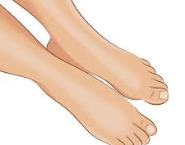
The MAS-MAC Connection
Notes:
Nurse to recognize a status change
What is likely with your population you can add in slides to fit your population

Slide 17
Potential status changes with residential care
Fungus nail Healthy nail
Thick nail Normal nail
Notes:
Onychogryphosis or ram s horn nails. Nail disease, when toenails grow thicker and faster, than the normal toenails. These nails require checking, clipping and filing frequently

Slide 18
Potential Status Changes
Physical Health Changes
Skin Changes
Notes:
When we live together we tend to share everything
People who take multiple medication have a higher chance of affecting their liver

Slide 19
Potential Status Changes
Oral Hygiene is important to Health
The Scoop on Poop
Notes:
It is important for nutritional purposes to have and maintain good teeth/oral hygiene.
Nurses here is your chance to explain healthy poop

Slide 20
Potential Status Changes
Confused VS Calm
Mental Health Problems

Slide 21
The MAS-MAC Connection
REMEMBER Call your MAS Nurse:
Anytime a change in the person served status (mental or physical) is noted
Anytime the MAR does not match the label on the medication container
Anytime you discover a medication error

Slide 22
The MAS-MAC Connection
How to Contact Your MAS Nurse
MAS NURSE NAME:__________________
PHONE #: ( )_____________________
EMAIL(if relevant):_____________________
If your MAS Nurse does not call back within 15-30 minutes call________________
(name)
@ ( ) ______________________
(phone #)
The MAS Nurse # should be available in all locations where Delegation occurs. If a MAC Worker cannot reach a MAS Nurse then they contact the Nursing supervisor
Notes:
Nurses there should be some version of contact information posted/available for the MAC to call you
Nurse should specify here how to contact you- agency P & P for call (It is NOT acceptable for the MAC to call the house manager/agency provider and that person determine when to call nurse)
Agency’s are responsible for having a nurse available for call 24/7

Slide 23
The MAS-MAC Connection
When a MAC Worker calls a MAS Nurse use the following process:
State your name and location
The person’s vital signs
If indicated
The person’s name you are calling about
Person’s allergies
Current problem/
situation
HAVE THE MAR’s IN HAND
Notes:
Nurse must educate the MAC on the information they need to have readily available when the call nurse
Many potential MAC’s have no Medical experience/training

Slide 24
The MAS-MAC Connection
REMEMBER
The MAC Worker must call the MAS Nurse prior to assisting with a PRN medication AND inform him/her after the PRN whether or not the medication has produced the desired effect
Notes:
Nurse give examples of a call, how to correctly present the information – address how you will be notified of the PRN follow up
Teach MAC’s to describe behaviors

Slide 25
The MAS-MAC Connection
REMEMBER
Your MAS Nurse is available 24 hours/day; 7 days/week for direction, consultation and collaboration
STAY CONNECTED TO YOUR MAS NURSE
Notes:
Nurse reiterate that MAC’s should call whenever they are concerned, or confused about a delegated task
MAC’s call Nurses about Medication and Medical problems – not house managers

Slide 26
Assisting with Medications

Slide 27
Assisting With Medications
REVIEW MEDICATION ASSISTANCE GUIDELINES FROM MAC I COURSE 6
Hand washing
Oral Meds
Eye
Ear
Nose
Topical
Inhalant
Rectal/Vaginal (MUST BE TAUGHT IN MAC II)

Slide 28
Assisting With Medications
After review of procedural steps for all types of medications :
Provide a demonstration of all skills to be delegated
Allow practice time, including documentation on the MAR
Review medication administration skills check list
Notes:
Setting up a practice lab saves time for the Nurse and provides the Potential MAC with time to get a routine in place. Allows

Slide 29
Assisting With Medications
MAC II COMPETENCY VERIFICATION
Return demonstration of skills by MAC Worker
Completion of skills check list by MAS Nurse

Slide 30
Assisting With Medications
THERE MUST BE RETURN DEMONSTRATION OF ALL DELEGATED SKILLS PRIOR TO SUCCESSFUL COMPLETION OF MAC II

Slide 31
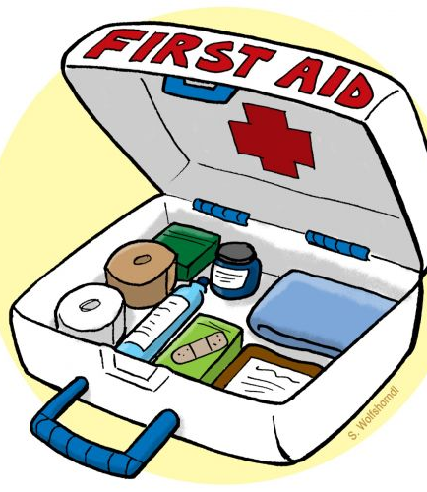
Principles of First Aid
Notes:
Nurse approves content of first aid kit
P & P should support this in the process, how kits are stored, restocked, available to the MAC’s but secure from people served.

Slide 32
Principles of First Aid
First Aid is usually used in minor emergency situations – falls, accident, injury, etc
The performance of First Aid does not require an order from a legally authorized prescriber
Notes:
MAC’s should handle the situation- make sure the person is safe and secure
Then make the appropriate phone calls and documentation

Slide 33
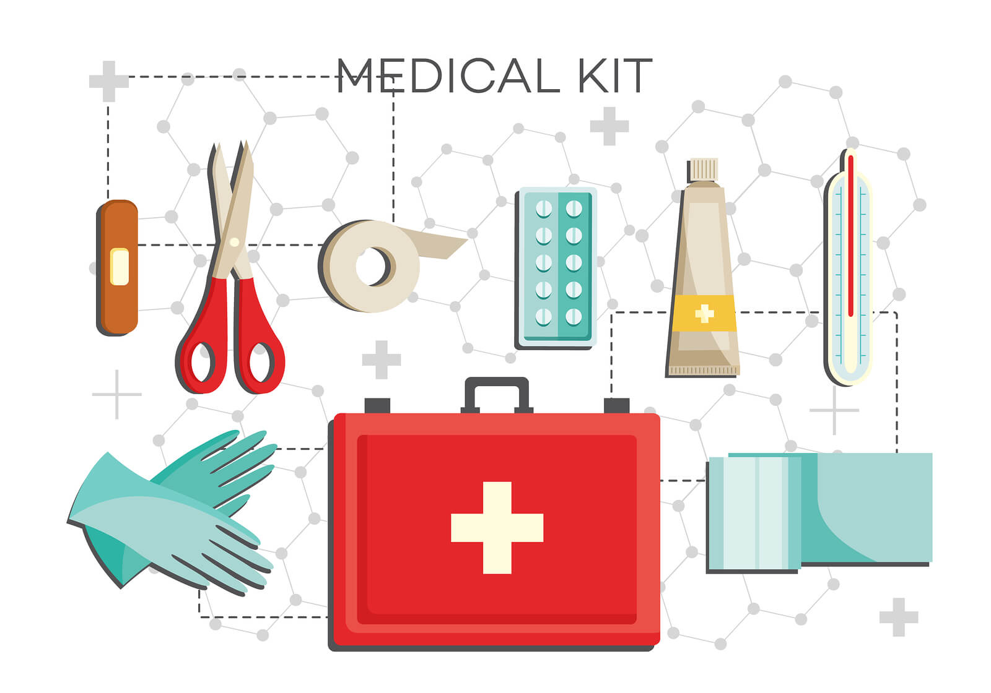
Principles of First Aid
The contents of First Aid kits are approved by the MAS RN/LPN. No items included in the First Aid Kits are considered PRN medications
Any item in the First Aid kit, including antibiotic ointments and/or anti-itch creams, may be used by the MAC Worker as directed by the MAS Nurse during First Aid training.
ALWAYS BE AWARE OF ALLERGIES
Notes:
Nurse the first aid kit does not contain PRN or standing orders- it can have OTC comfort medications such as Neosporin or TAO, Sun Burn spray or cream, anti itch creams for bee sting or bug bites
Nurses this is a one and done issue– ointments should be a one time use for two reasons- If the person needs it more than that they may need to see a physician/or a call to their primary for an order. 2nd is cross contamination and infection control.

Slide 34
Principles of First Aid
From this
Anytime the principles of First Aid are used, some CHANGE in the status has occurred for the person served. Report all changes in status to your MAS Nurse ASAP.
Call “911” as directed and/or in accordance with the agency policy
To this
Notes:
Nurse good rule to teach MAC’s When in doubt-send them out

Slide 35
Principles of First Aid
When a fall, accident, illness or injury occurs, DO NOT LEAVE THE PERSON ALONE
Never attempt skills that exceed your training
ALWAYS NOTE THE TIME
DO NOT move the person if they cannot move without assistance
When in doubt call your MAS Nurse!!!

Slide 36
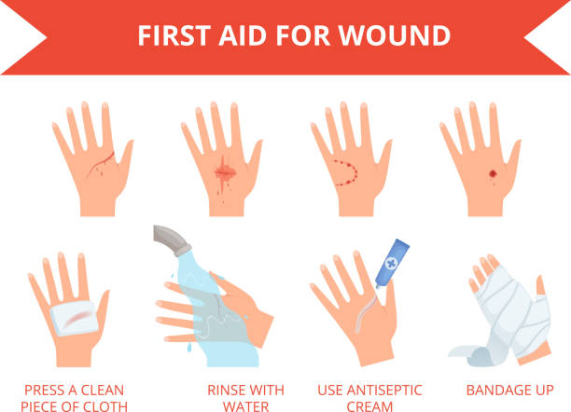
Principles of First Aid
Minor Cuts or Abrasions (scraps)
Gently wash area with soap and water
Use a clean gauze pad to pat dry
If bleeding is present, apply pressure for at least 2-3 minutes
Apply antibiotic ointment from First Aid Kit as appropriate (CHECK MAR FOR ALLERGIES)
Cover with band aid/bandage
Contact MAS Nurse
Notes:
Nurses be mindful of people who have history of suicide attempts-- you may not want items such as gauze or ace bandages in the first aid kit

Slide 37
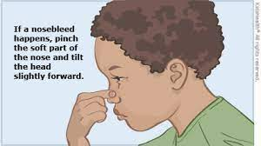
Principles of First Aid
Common Situations
Can happen without warning Help person to sit down Have person lean FORWARD not backward Pinch sides of nose for at least 5 minutes Ask person to breathe through mouth Ask person not to blow nose Contact MAS Nurse
N
O
S
E
B
L
E
E
D

Slide 38
Principles of First Aid
B u r n s
Rinse with cold water for at least 5 minutes.
DO NOT PUT ICE ON BURN
DO NOT PUT ANYTHING ON BURN EXCEPT WATER
For further instructions call your MAS Nurse

Slide 39
Principles of First Aid
Excessive Heat Exposure
Possible signs and symptoms
Sweating
Thirst
Fatigue
Cramps
Headache
Dizziness
Nausea/vomiting
Move the person to a cool place
Loosen clothing
Encourage to drink water
Call MAS Nurse

Slide 40
Principles of First Aid
Other possible situations to be discussed:
Sprains
Diarrhea
Nausea/Vomiting
Lice
Bug bites
Other

Slide 41
Emergency Management
Be sure to follow the Agency’s Emergency Management Plan
Get to know the people you work with and potential problems that may create an emergency (choke risk, seizures, brittle diabetic)
Anytime an unusual situation occurs, CONTACT YOUR MAS NURSE
Notes:
Nurse choking is very common in the Mental Health population
Teach the first aid related to choking
Remember if the staff have to do the abdominal thrusts on a person, they are evaluated outside the agency for possible internal injuries

Slide 42
Emergency Management
When to Call “911” (Refer to agency policy and procedure) ! Allergic reaction ! Chest pain ! Unresponsiveness ! Shortness of breath ! Uncontrolled bleeding ! Vomiting blood ! Serious burns ! Broken bones
Notes:
Always better to be safe than sorry

Slide 43
Personal Care vs. Treatments
Treatments
Treatments
are ordered to address a specific problem
Treatments
Treatments are transcribed to the MAR
requires an order from a legally authorized prescriber (Physician)
The MAR must be initialed after the treatment is completed as ordered
Notes:
Personal care is a comfort measure: Example lotion after bathing for dry skin.

Slide 44
Personal Care vs. Treatments
Example: Sunscreen
Personal Care
When sunscreen is used to protect someone’s skin against the negative effects of prolonged exposure to the sun
Treatment
When sunscreen is ordered by a legally authorized prescriber for the person to be used any time they go outside, and the MAR documented
Notes:
Nurse you can instruct MAC’s to carry out personal care instructions Example – Please apply sunscreen prior to all outdoor activities
Nurse if physician order it goes on the MAR

Slide 45
Principles of Infection Control

Slide 46
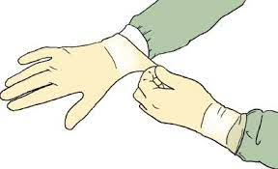
Principles of Infection Control
MAS Nurse Must Review:
Standard/Universal Precautions
Personal Protective Equipment (PPE)
Handling of the person’s personal items/linens
Procedure for washing a person’s clothes and disinfecting washer and dryer
Notes:
Clothes not washed together- wipe out washer after laundry
Be aware of people returning from pass or home visits-----

Slide 47
Principles of Infection Control
HANDWASHING
Handwashing is the #1 defense against the spread of disease and infections
Wash your hands after using the bathroom
Wash your hands before and after any task AND after each person contact
Notes:
Give examples of contact situations
Get time to have them check off do a handwash in front of you 20seconds – Happy Birthday

Slide 48
Principles of Infection Control
Infections are caused by germs
Germs live inside us and all around us
Most germs do not cause illness in healthy people
OR
4. Most illness caused by germs in healthy people are mild, like the
common cold
5. A communicable or infectious disease can be passed from one
person to another
Hi! I am Germy George
Ewww they tickle
Whew I am glad we got out of there
hullabaloo
Notes:
Explain transference of germs

Slide 49
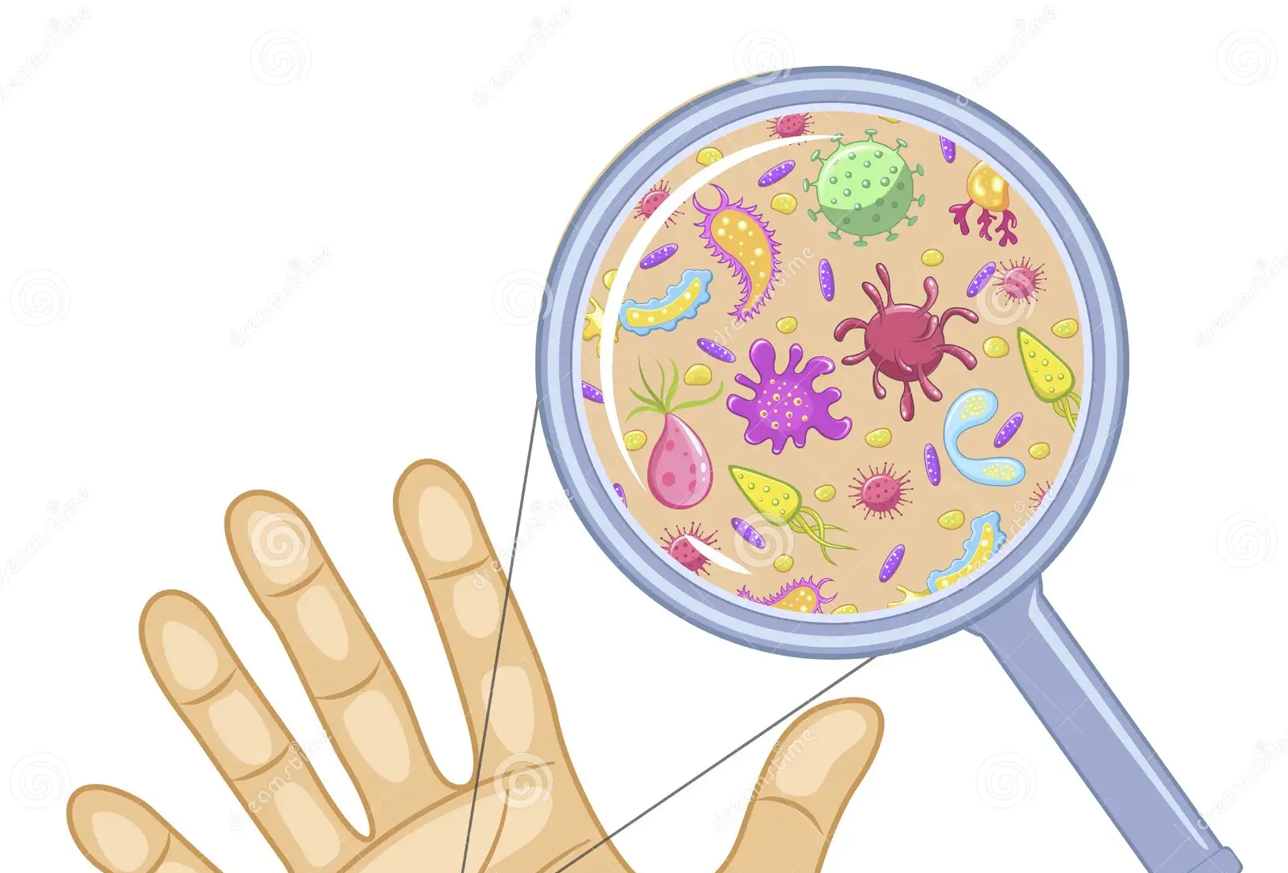
Principles of Infection Control
For a communicable or infectious disease to be passed from one person to another, four things must happen:
A germ must be present Virus or bacteria
The germ must have a place to live & multiply (Person or food)
There must be a susceptible host
There must be a way for the germ to enter the host
Direct contact, indirect contact, droplets, vectors
Notes:
Great places for germs to live every day all day-cell phones, buttons, handles or knobs, toilet seats, remote control

Slide 50
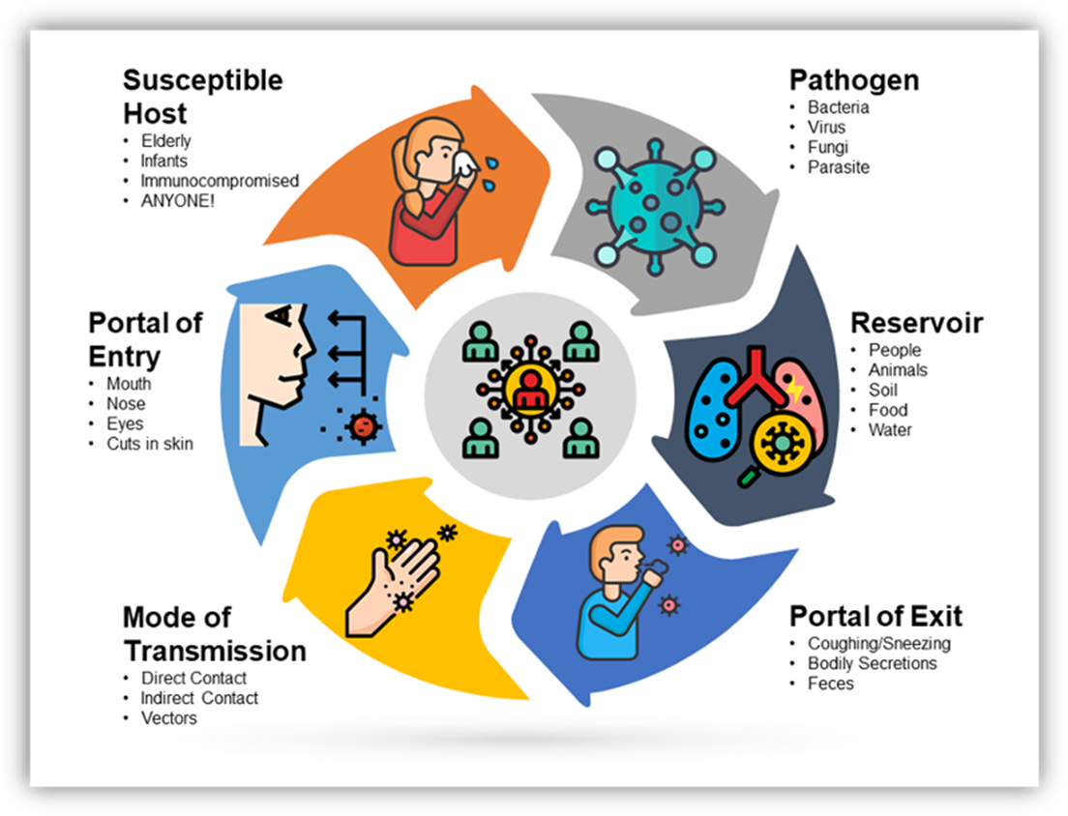
Chain of Infection

Slide 51
Principles of Infection Control
of the links (requirements) in the chain must be removed to prevent the spreading of infection

Slide 52
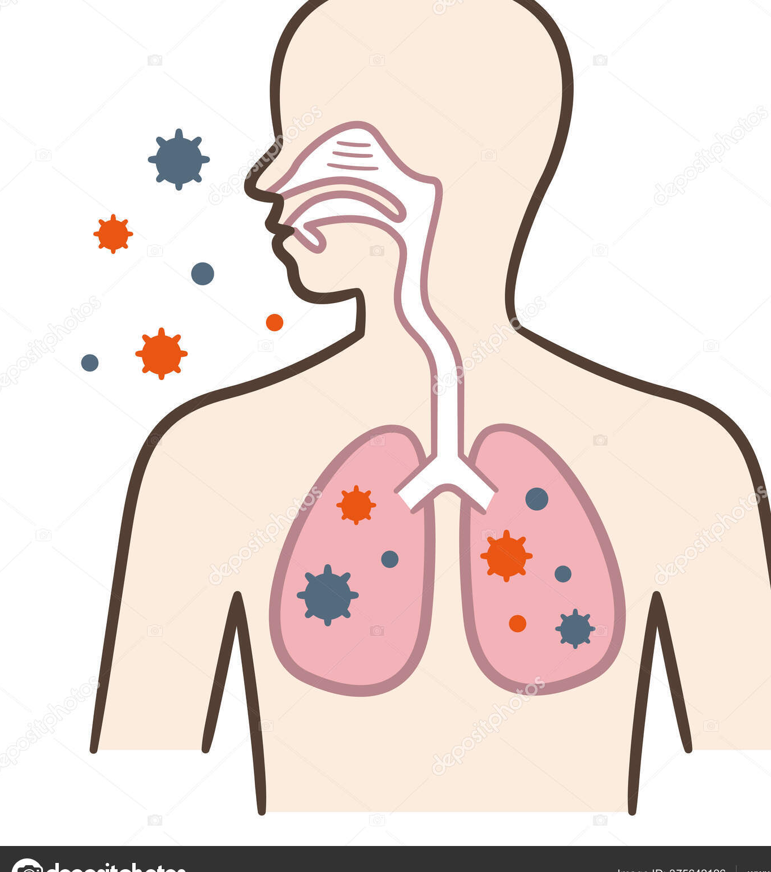
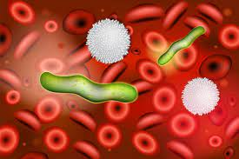
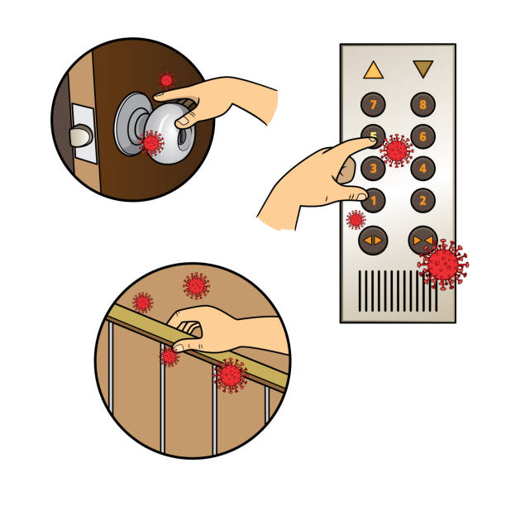
Principles of Infection Control
The air- breathing, sneezing, coughing
Body fluids – saliva, blood, urine, nasal secretions, feces, vaginal fluids, semen, etc
Four Main Methods
of
Transportation for Germs
Direct Contact – Direct contact between the infected person and the non infected person
Indirect Contact – Contact between the infected person and objects in the environment which become contaminated with the germ

Slide 53
Principles of Infection Control Common ways Germs can Spread
Droplets – sneezing, coughing, talking, spitting
Airborne – dust or droplets travel from room to room and stay a long time in the air
Vectors - mosquitoes, flies, rats, roaches
Environment – food, water, contaminated items
Notes:
Ask MACs questions here about how germs can spread, try to get examples from them or give them some examples from your agency

Slide 54
Principles of Infection Control
Blood Borne Diseases
HIV – Human Immunodeficiency Virus causes AIDS
attacks the body’s immune system
HBV – Hepatitis B Virus Infects the liver
May cause cirrhosis or liver cancer
HCV – Hepatitis C Viral liver infection May have no or mild symptoms Usually causes cirrhosis and end stage liver disease

Slide 55
Principles of Infection Control
Blood Borne Diseases are Transported BY:
Sexual contact
Needle sticks, sharing needles
Direct contact with infectious materials – blood or urine enters the body through broken skin
Passed from mother to baby during pregnancy or by breast feeding

Slide 56
Principles of Infection Control
HOW CAN WE BREAK THE CHAIN?
Look at your habits, lifestyles and surroundings for things that may promote infection
Identify things in the infection chain that can be eliminated

Slide 57
Principles of Infection Control
Practice good hand washing and personal hygiene
Treat all body fluids as potentially infectious
Use protective barriers such as gloves, mask and gowns when exposure to infectious agents is possible
Maintain a clean environment
Store and cook foods at the proper temperature
Properly dispose of wastes, garbage and used medical supplies
Get protective vaccines and immunizations

Slide 58
Principles of Infection Control
Personal items should not be shared
EVERYONE should be encouraged to wash hand after using the bathroom and before eating
Notes:
Nurses need to make sure the staff understand the importance of not sharing personal items

Slide 59
Medical/Nursing Equipment

Slide 60
Medical/Nursing Equipment
In this section all medical/nursing equipment used at your agency will be reviewed
Prior to the delegation of any task, a skills check sheet must be completed

Slide 61
Medical/Nursing Equipment
Glucometer/strips
BP Cuff
Thermometer
Epi-pen
Oxygen
CPAP
Nebulizer
O2 Sat
Other

Slide 62
Medication Errors

Slide 63
Medication Errors
ALL Medication Errors by MAC Worker and Nurses must be reported to ADMH
The ADMH Divisional Incident Prevention and Management Policies and Procedures must be used to report ALL incidents, including medication errors to ADMH
Therap is the IPMS system used to report Incidents

Slide 64
Medication Error Types
Wrong Person- Wrong person got the medication (Johnny took Suzie’s Meds)
Wrong Medication – Meds that person is allergic to, discontinued, expired, contaminated
Wrong Dose- Too much or too little of a medication(MAR has give 2 tabs =1000mg Depakote. Person only took one)
Wrong Route- Medication ear drops. Drops put in the eyes
Wrong Time- MAR has medication scheduled at 8am, can be given an hour before and an hour after 8am
Wrong Reason- Tylenol ordered for knee pain, CAN NOT be given for Headache
REVIEW MEDICATION ERROR REPORTING, THERAP IPMS SYSTEM AND AGENCY POLICY & PROCEDURE (Related to Health & NDP)
Notes:
Anyone who enters into the IPMS has to know how to classify the types and level of medication errors

Slide 65
Medication Error Levels
The severity of medication errors is noted by Levels – There are three levels.
A Level I error is a monitoring error
A Level I error is an incident in which the person experienced no or minimal adverse consequences AND no treatment or intervention other then monitoring or observation is required.
Lack of appropriate documentation on the MAR after medication administration is a Level I medication error
A Level II error is a treatment/intervention error.
A Level II medication error is an incident in which the person experienced short term, reversible adverse consequence AND treatment or intervention in addition to monitoring is required.
Sending a person to the emergency room in response to a medication error is a Level II medication error.
A Level III medication error is a sentinel event.
A Level III medication error is an incident in which the person experienced life threatening and/or permanent adverse consequence.
Hospital admission in response to a medication error is a Level III medication error.

Slide 66
Documentation

Slide 67
Documentation
Basic Principles of Documentation
Documentation must be:
Legible
Accurate
Complete
Timely
Properly corrected
Basic principles of documentation must be followed regardless of the documentation format – paper or electronic medical record
Notes:
610-X-6-.06 Documentation Standards.
(1) The standards for documentation of nursing care provided to patients by licensed nurses are based on principles of documentation, regardless of the documentation format.
(2) Documentation of nursing care shall be:
(a) Legible.
(b) Accurate.
(c) Complete. Complete documentation includes reporting and documenting on appropriate records a patient's status, including signs and symptoms, responses, treatments, medications, other nursing care rendered, communication of pertinent information to other health team members, and unusual occurrences involving the patient. A signature of the writer, whether electronic or written, is required in order for the documentation to be considered complete.
(d) Timely.
1. Charted at the time or after the care, to include medications. Charting prior to care being provided, including medications, violates principles of documentation.
2. Documentation of patient care that is not in the sequence of the time the care was provided shall be recorded as a “late entry,” including a date and time the late entry was made, as well as the date and time the care was provided.
(e) A mistaken entry in the record by a licensed nurse shall be corrected by a method that does not obliterate, white-out, or destroy the entry.
(f) Corrections to a record by a licensed nurse shall include the name or initials of the individual making the correction.

Slide 68
Principals of Documentation
Legible – Someone other than yourself must be able to read what is written
Accurate – State the facts; describe what happened. Do not chart opinions or feelings

Slide 69
Principals of Documentation
Complete
Use of appropriate record or form
Signs/symptoms
Response to medications or treatments
Communications with others
Unusual occurrences
Signature of the writer and their credentials or title

Slide 70
Principals of Documentation
Timely
Charted at the time or after the care, including medications, is provided
Charting prior to care being provided, including medications, violates principles of documentation
Documentation of care that is not in the sequence of the time the care was provided shall be recorded as a “late entry”, including the date and time the late entry was made as well as the date and time the care was provided

Slide 71
Principals of Documentation
Corrections
A mistaken entry in the record shall be corrected by a method that does not obliterate or destroy the entry
White out CANNOT be used in any medical record
Corrections shall have the date and name or initials of the person making the correction

Slide 72
FORMS

Slide 73
Forms
NDP Standard Forms can be found on the NDP webpage
www.mh.alabama.gov
This will get you to the ADMH webpage
Click on the Forms library located on the top ribbon
NDP will be in the right-hand column of forms for Nurse Delegation.
Type nurse in the search box and all NDP forms will be visible

Slide 74
Paper VS EHR
ADMH Certification Surveyors will be looking for the standardized NDP Forms noted in this section. At agencies where electronic medical records are in place and/or the NDP Forms cannot be mirrored; a comparable form with all the same information may be used.
The agency must have a policy and procedure approved by the agency’s Board of Directors that notes the approved NDP form(s) and how they will be used.
There must be documentation of ALL communication between the MAC Worker and the MAS Nurse.
Notes:
Agency may use HER and mirror standardized forms. P & P should say6 how.
A back up is required if HER goes down - You guessed it the paper form make staff aware of why standardized forms are important, what they are and where the paper is located.

Slide 75
FORMS
MAC Call Log OR other form of documentation to document communication between MAC and Nurse
MAR
Other agency required forms
Medication Error Form
Notes:
Nurses remember there must be a documentation trail for ALL care, medications, communication, and education

Slide 76
MAC EVALUATION MAC Annual Direct Supervision Form NDP-3
THE MAS NURSE MUST PROVIDE AT LEAST ANNUALLY AND AS NEEDED DOCUMENTED SUPERVISON INCLUDING REVIEW OF DELEGATED TASKS
Notes:
Nurse this is where you give the praise/pat on the back for a good job
And if the performance needs improvement – help the MAC to realize why they need to improve and give them a process/plan to help them

Slide 77
MAC UPDATE NDP Skills Checklist NDP-13 and MAC Re-Certification Certificate NDP-7b shall be utilized
EVERY TWO YEARS, EACH MAC WORKER MUST COMPLETE A FOUR-HOUR RECERTIFICATION THAT INCLUDES AT A MINIMUM:
Review of agency policies and procedures related to NDP
Documentation on the MAR
Recognition of medication errors and appropriate reporting
Any specialized equipment used at the agency
Any Emergency medication used at the agency

Slide 78
MAC FILES
ALL MAC TRAINING MUST BE DOCUMENTED ON THE MAC WORKER TRAINING RECORD (NDP 11) WITHOUT EXCEPTION
ALL training records must be maintained for 5 years.
Hint: don’t purge active employees

Slide 79
MAC FILES
The MAC file should contain:
Six certificates obtained from MAC I
Certificate of completion of MAC II
Skills/Competency Checklist
A delegation form signed by the MAC & MAS nurse(s)
After a year, the Annual Supervision form
After two years, a 4-hour Update Certificate, a reviewed Skills check/Competency check list, and another Annual Supervision form

Slide 80
QUESTIONS

