Slide 1
MAS/MATT Meeting
February 20, 2025

Slide 2

Do you know the Cushing Rules?
Many of the people requiring assistance with oral medications have difficulties swallowing pills and capsules.
If the person requires their medication to be crushed, they will have an order from their primary care provider (PCP) to crush the medication.
Only medication that has been ordered by the PCP can be crushed.
The MAS nurse will train on your agency procedure for crushed meds during MAC II.
The MAS nurse will train you on how to recognize meds on the MAR that require crushing during MAC II.
MACs will be required to demonstrate this skill during the competency checkoff.

Slide 3

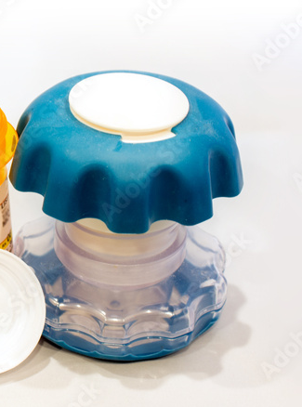



Assisting with Oral Medications (1 of 2)
Meds that require Crushing may ONLY be crushed using the Agency policy.
Crushing is only allowed with the medication crush pouches.
You do not have to label “Do not Crush” medication routinely. Only when the MAR reflects both forms of administration
The Agency will maintain a current “Do Not Crush” medication list.
The MAS nurse will train on this during MAC II.
Medication that require crushing will be labeled “crush” or “Do Not Crush” on the MAR. see example below
Mortar and pestle
Screw down crusher
Name: EX Ample DOB 12-1-1982 Date: March 2024 NKA | Time | 1 | 2 | 3 | 4 | 5 | 6 | 7 | 8 | 9 | 10
Ultram 50mg tablet PO Give one tablet every six hours for pain (CRUSH) | 8:00am
Depakote 500mg capsule PO Give one capsule every eight hours for mood disorder (DO NOT CRUSH) | 8:00am
Hammer and bag
Notes:
The mortar and pestle, plastic screw down pill crusher, and the hammer and a plastic bag do not secure the dosage. Some of the medication may be lost in these procedures making the dosage incorrect and technically a medication error..

Slide 4
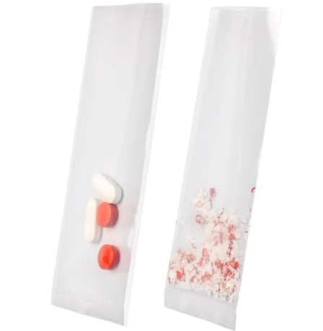

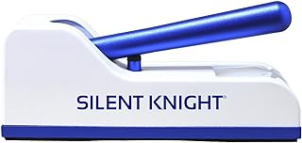
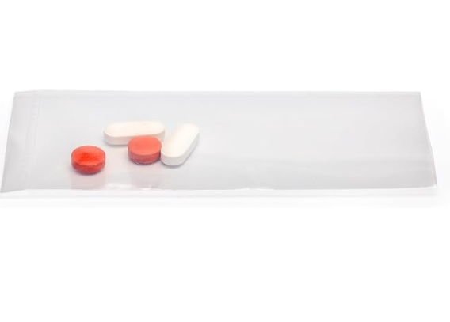






Assisting with Oral Medications (2 of 2)
The approved process to crush medications is to use the medication pouch
Apply gloves
Check MAR using the 7 rights
Check MAR to see if medications can be crushed.
Place medication in the pouch. If you have more than one medication that requires crushing, you may place them in pouch to crush at the same time.
Use a device like picture to crush the meds. Never use tools like a hammer or heavy object to bang on pouch. These can damage the pouch and lose amounts of the medication.
Once the medication is crushed pour the entire content into the medication cup.
Administer the medication promptly as ordered. Do not crush prior to the administration time.
Notes:
The process to crush medications is to use the medication pouch
Apply gloves
Check MAR for the 7 rights
Check MAR to see if medications can be crushed.
Place medication in the pouch. If you have more than one medication that requires crushing, you may place them in pouch to crush at the same time.
Use a device like picture to crush the meds. Never use tools like a hammer or heavy object to bang on pouch. These can damage the pouch and lose amounts of the medication.
Once the medication is crushed pour the entire contents into the medication cup.
Administer the medication promptly as ordered. Do not crush prior to the administration time.

Slide 5

The Types of Medication Errors
Wrong Person -
Medication NOT prescribed/ordered was given to a person
A person was given someone else’s meds
Wrong Med -
Person allergic to med given
Person gave a med that was discontinued
Person gave a med that was past the expiration date
Person gave a med that had been contaminated in some way
Pharmacy dispensed the wrong med

Slide 6

The Types of Medication Errors
3. Wrong Dose - The amount of med given was more/less than what was ordered/prescribed
4. Wrong Time - Med was not given at the ordered/scheduled time
5. Wrong Route - Med was not given the way/route ordered/directed
6. Wrong Reason - Medication is given for a reason other than for which it was prescribed/ordered
7. Documentation - Medication administration was not appropriately documented on the MAR (Prior to the beginning of the next shift)
8. Missed Dose - Medication was not given

Slide 7

Level 1 of Medication Error
Once you have established the type of error that has occurred, the next step is to determine the severity.
Level 1 – Monitoring Error
Person experienced no/minimal adverse consequences AND
Person required no treatment other than monitoring/observation
All documentation errors are level-one errors

Slide 8

Level 2 of Medication Error
Level 2 – Treatment Error
Person experienced short/reversible adverse consequences
Changes to current orders or nursing treatment/intervention is required
Person sent to the ER for further assessment/treatment

Slide 9

Level 3 of Medication Error
Level 3 – Sentinel Event
Person experienced Life-threatening consequence OR
Person experienced a permanent adverse consequence OR
Person was hospitalized for further observation/treatment
EXAMPLE: The person served has glaucoma. MAC did not give eyes drops (consistently missed doses) The patient lost sight in an eye.
ALL MED ERRORS RESULTING IN HOSPITALIZATION (MEDICAL OR BEHAVIORAL)

Slide 10
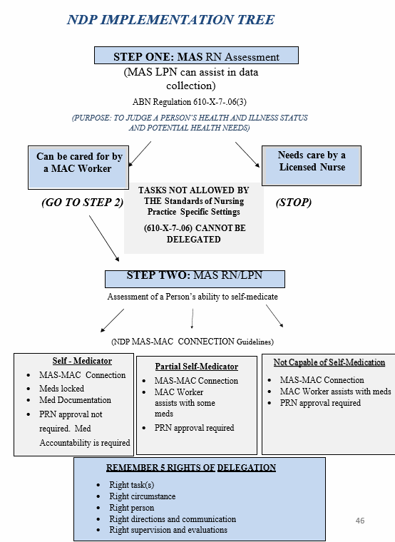
NDP Implementation Tree

