Slide 1
ALABAMA PROVIDER SESSIONS
Thursday, October 15, 2026
8:30 – 10:00 AM
Session 1
WITS Navigation and Workflow Essentials

Slide 2
Provider Session 1
Navigation and Workflow Essentials “101”
This session provides a comprehensive review of WITS functionality, including:
System navigation
Clinical workflow
Billing workflow
Key administrative features (facility, program, staff)
Advanced search techniques
Notes:
Most of this session applies to provider agencies who do not do file upload. I’ll cover some basic navigation and workflow considerations during this session.

Slide 3
Navigation and
Workflow Essentials 101

Slide 4
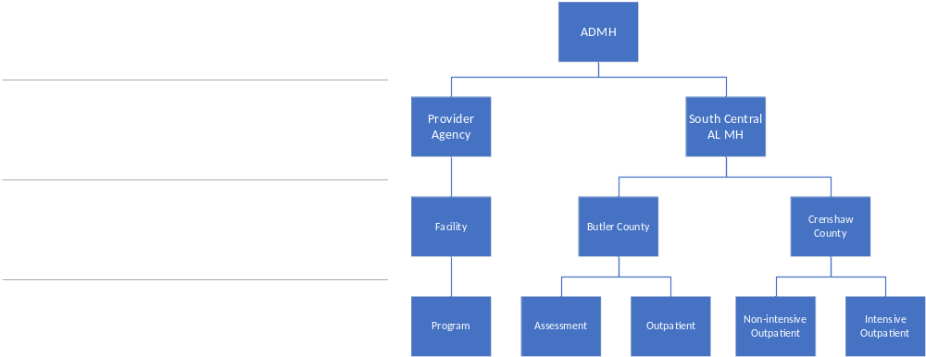
Agencies, Facilities, and Programs
ADMH is the Contractor Agency
Provider Agencies report data to ADMH
Staff members have access to an agency
Agencies have one or more facilities
(usually location-based)
Staff members may have access to one or more facilities
Facilities have one or more programs
Programs represent treatment services or available at the facility
Treatment programs may be setup to report to TEDS
Notes:
We’ll cover TEDS in more detail later

Slide 5
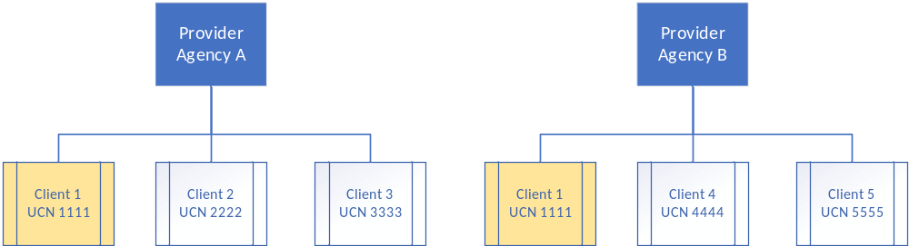
Clients
Clients are created at the agency level
When a client moves between providers, the Unique Client Number (UCN) remains the same

Slide 6
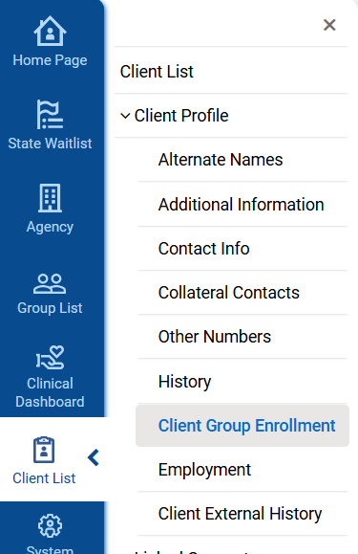
What are Client Group Enrollments (CGEs)?
CGEs represent the client’s eligibility for funding
There are two main types we’ll discuss today
  Government Contract (State Funds/Block Grant)
  Medicaid
Select a Client from the Client List and navigate to
Client Profile → Client Group Enrollment
Notes:
CGEs represent the client’s eligibility

Slide 7
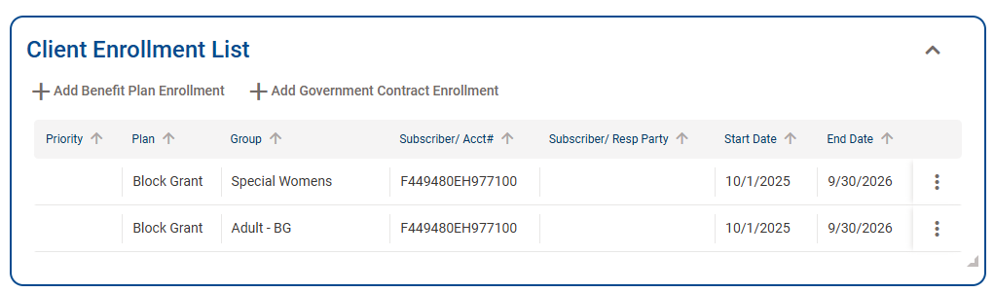
Government Contract CGEs (State Funds/Block Grant)
Created automatically at Intake and at each new Fiscal Year
Created based on fund sources in the provider’s contract
  Adolescent clients get a Children First CGE
  Female clients get a Special Women CGE
  All clients get all other funds (General, Drug Court, etc.)
Notes:
Government Contract CGEs represent the client’s eligibility for state funding during the fiscal year

Slide 8
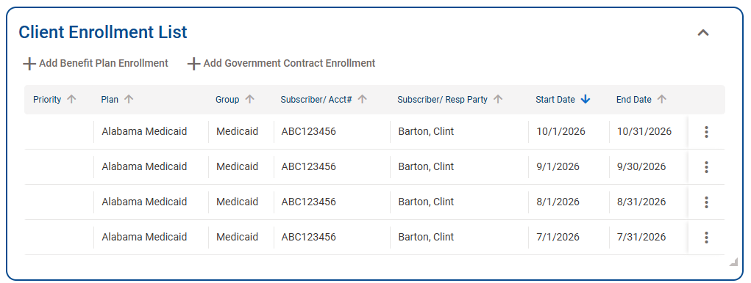
Medicaid CGEs
Medicaid CGEs are created automatically by the 270/271 process
At Intake
Each month for clients with an active program enrollment
Medicaid eligibility may change month-by-month

Slide 9
What is an Episode of Care?
The Episode of Care is the entire duration the client is active in the Facility
It is defined by the Intake Open and Close dates
Over time, clients may have multiple Episodes of Care
Client Profile
Intake
  Screener
  Assessment
  Outcome Measure
  Program Enrollment
  Encounters
Close Intake/Discharge
Episode of Care
Reassessment
Notes:
These items are done in order.
A Screener must be entered before entering an Assessment.
An Assessment must be entered before entering an Outcome Measure.
Etc.

Slide 10
What are some of the requirements in the Clinical Workflow?
At least one address must be entered for the client
A CRAFFT or UNCOPE screener must be entered before an assessment
An assessment must be entered before an outcome measure
An outcome measure must be entered before a TEDS program enrollment
A program enrollment must be entered before an encounter
Notes:
These rules ensure that required data are collected for each client in a Treatment Level of Care such as Outpatient or Residential

Slide 11
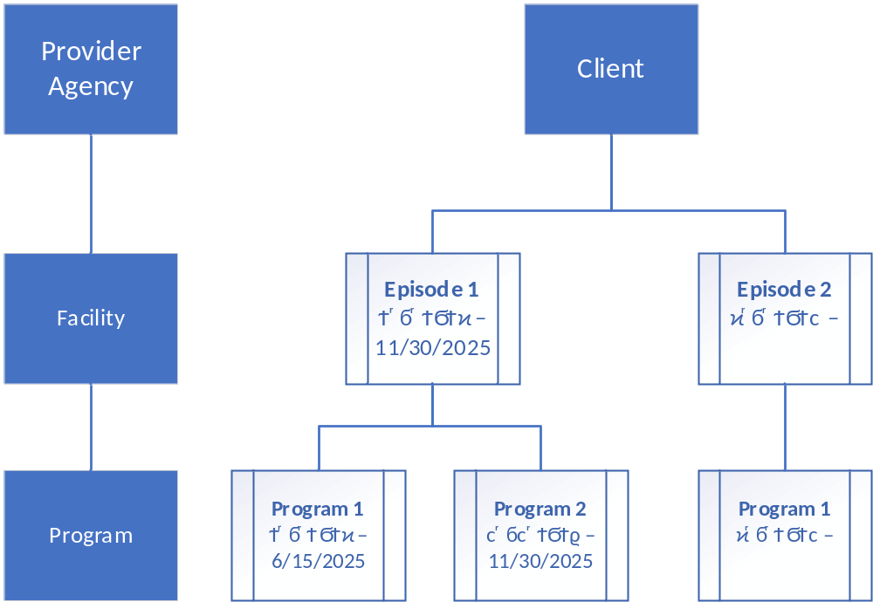
Episodes of Care and Program Enrollments
Episodes of Care are tied to a Facility
Clients may have multiple program enrollments within an EOC
In general, the Program Enrollment represents the client’s Level of Care.
Your agency may have additional programs such as “Assessment”
TEDS reporting requires enrollment in
a treatment program and uses program start and end dates
Notes:
We’ll discuss TEDS in more detail in the upcoming slides

Slide 12
What does it mean to discharge a client?
A discharge means the client is no longer receiving services at the facility
Discharges happen when the client:
  Completed treatment
  Refused services
  Is referred to another facility
  Moved away
  Is deceased
  Etc.

Slide 13
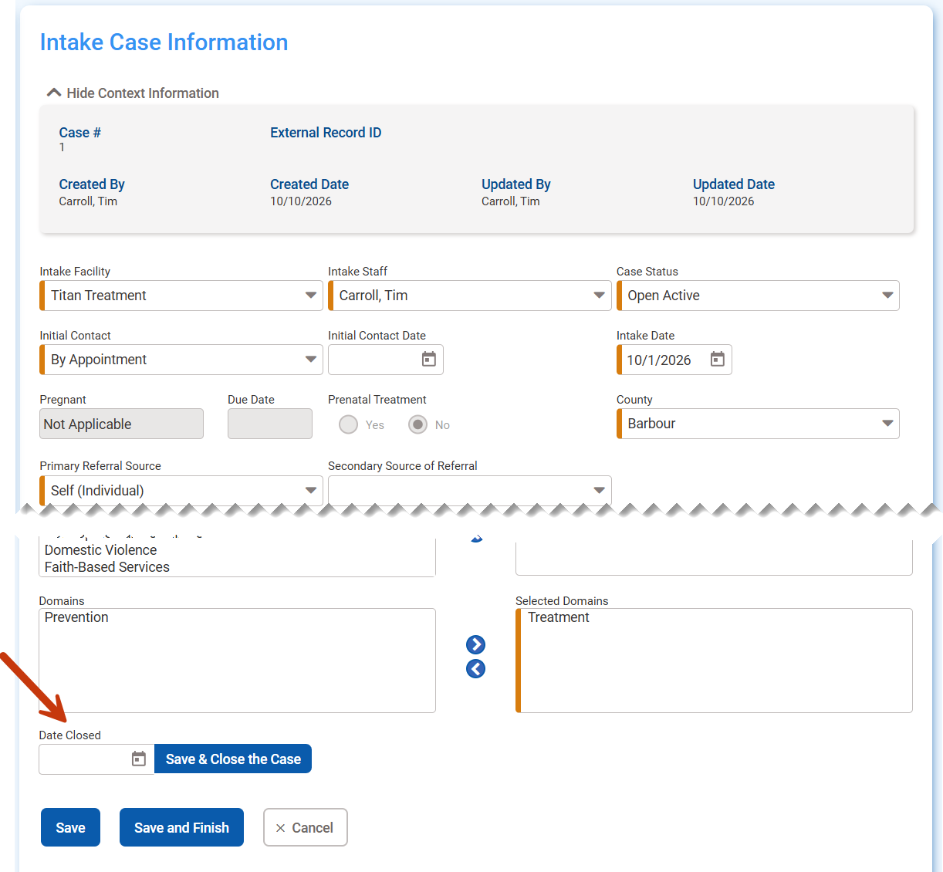
How do I discharge a client?
Quickest way:
  Open the Intake
  Enter the Date Closed
  Click Save & Close the Case
Note: All Program Enrollments
must be closed first

Slide 14
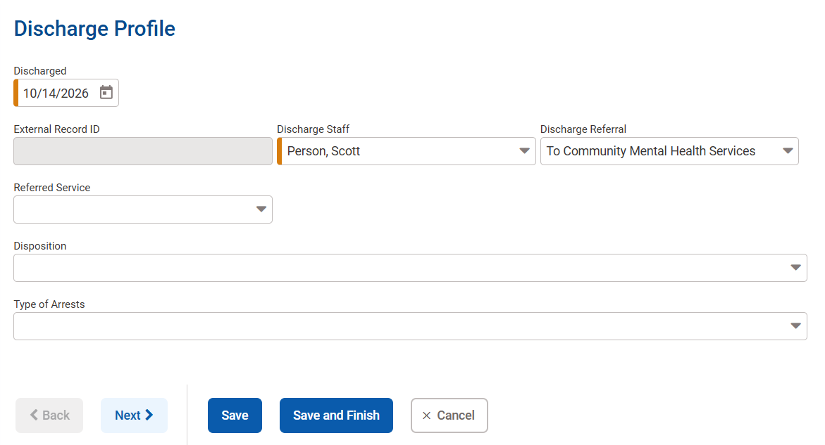
Alternate Client Discharge
Alternate way: Complete the Discharge Profile on the menu and close the case
Note: All Program
Enrollments must be
closed first

Slide 15
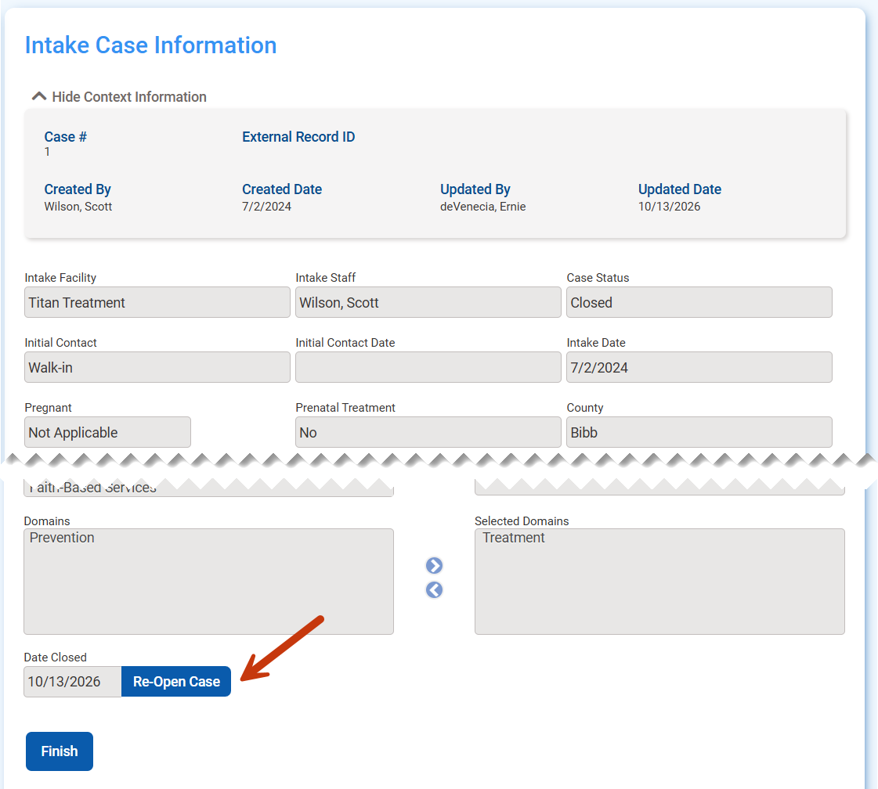
What happens when I discharge a client?
All screens within the Episode of Care become read-only
No new data may be entered
New Encounters cannot be created or Released to Billing
Claim Items may still be Reversed or Adjusted when the case is closed
If needed, you may re-open the case by clicking the “Re-Open Case” button on the Intake

Slide 16
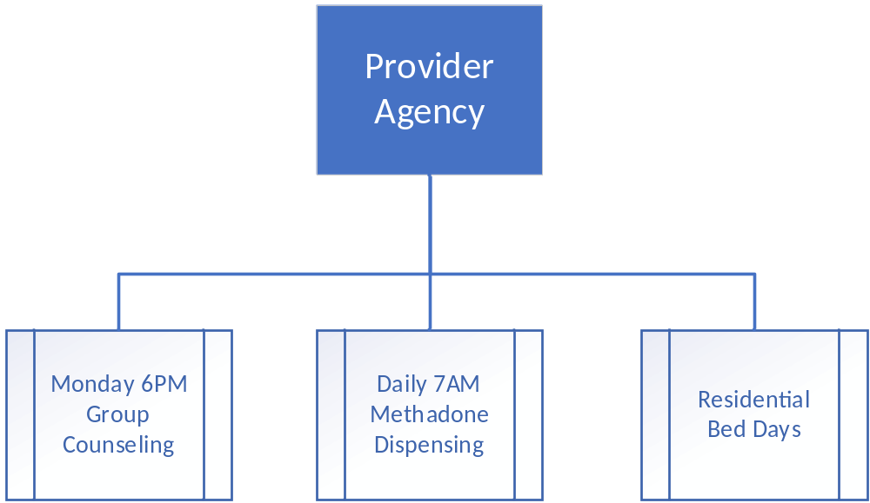
What is the benefit of the Group Module?
Benefit: Quickly create Encounters for each client who attended the group
(multiple clients receiving the same service at the same time)
Examples include:
  Group Counseling
  Methadone Dispensing
  Residential Bed Days
Notes:
I’m going to go over the group module, and then provide a demo.

Slide 17
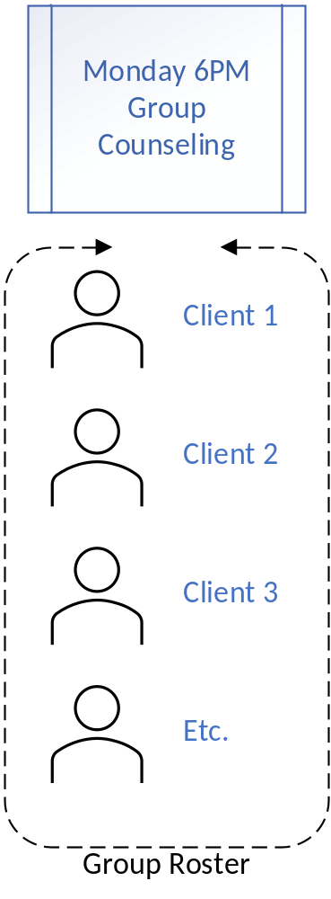
Group Roster
Each group has a roster of clients who attend
The roster is updated as clients move in and out of services
Clients must have a Program Enrollment to be added to the Group Roster

Slide 18
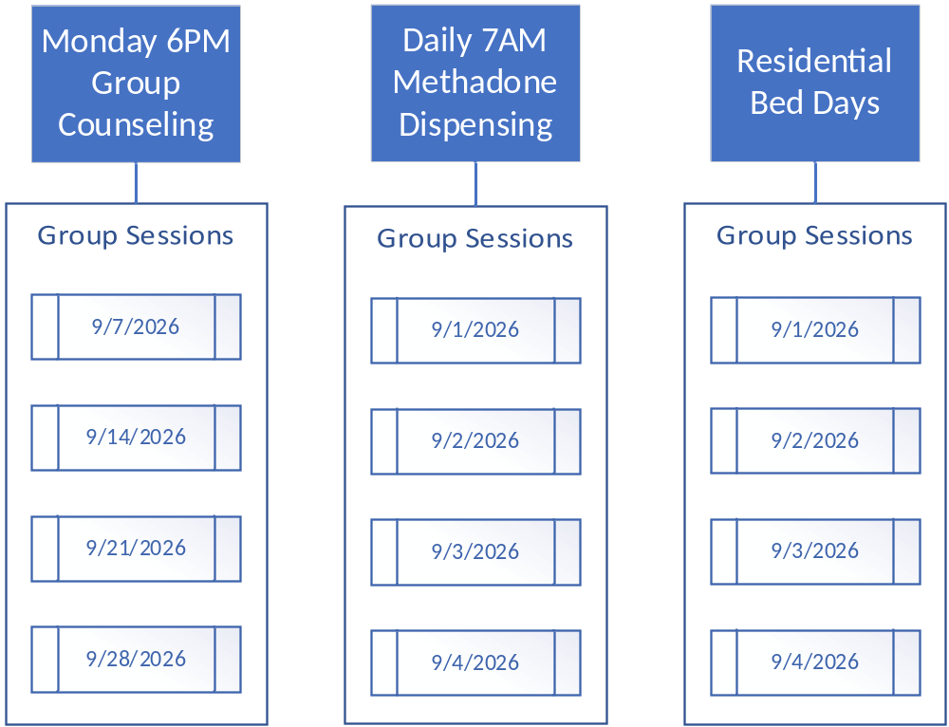
Group Sessions
Sessions represent the dates and times the group met
A new session is added for each group that takes place

Slide 19
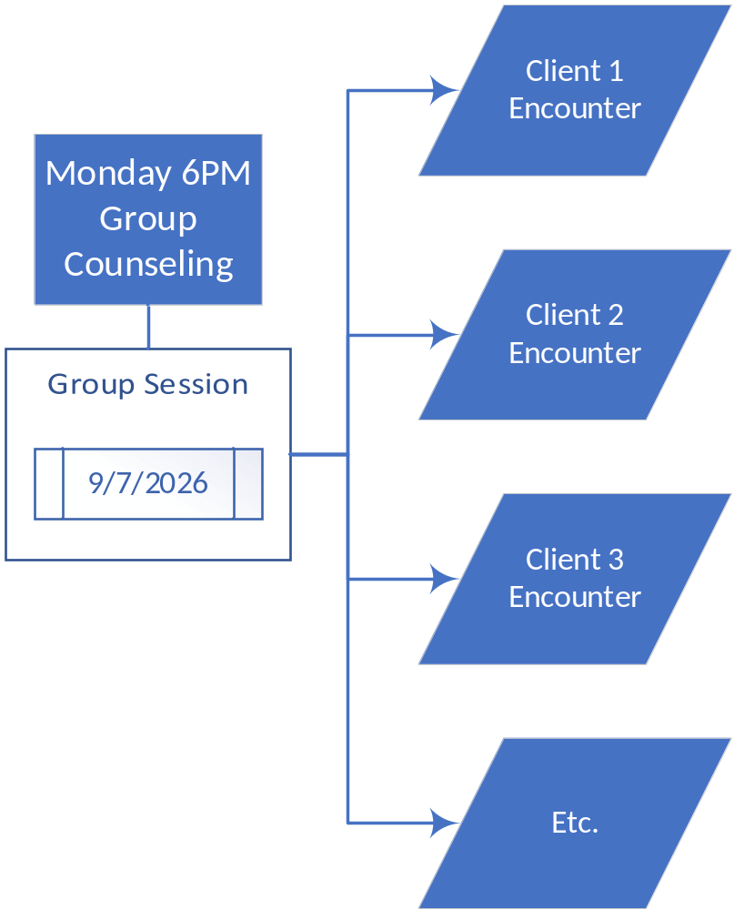
Create Encounters from the Session
Encounters are created and Released to Billing with two clicks
DEMO

Slide 20
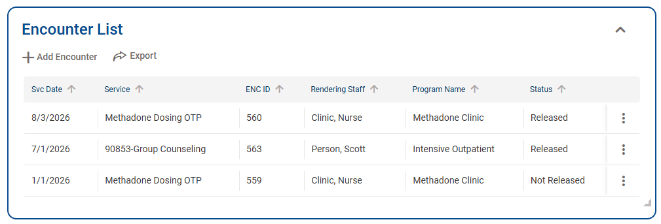
Encounters
Document services delivered to the client under a specific program enrollment
  Example: Group Counseling in an Intensive Outpatient program
Services are filtered based on the client’s Program Enrollment
  Example: Residential Bed Day is only available for Residential Programs.
The Primary Diagnosis prepopulates based on the Encounter Start Date
No longer requires a progress note

Slide 21
Encounter Release to Billing
Claim items are created automatically at Release to Billing
The funding source is selected automatically based on priority
  Medicaid
  Government Contract (state funds)
Prerequisites
  The Encounter must have a valid diagnosis for the client
  The Client must have one or more CGEs that cover the Encounter Start Date
  The Service must have an active rate for the plan/group for the CGE

Slide 22
Treatment Episode Data Set (TEDS)
What is it?
  Used to track substance use disorder (SUD) treatment admissions and discharges.
  ADMH reports TEDS data to the Substance Abuse and Mental Health Services Administration (SAMHSA)
Why does it matter?
  TEDS reporting is required for states receiving public substance use treatment funding (block grants)
  Data is used to measure treatment outcomes:
  Was there improvement between the client’s
  Program Enrollment Start Date (Admission) and
  Program Enrollment End Date (Discharge)?

Slide 23
Treatment Episode Data Set (TEDS)
What information is reported? Where is it collected?
  Demographics (age, sex, race, ethnicity) and ID Client Profile
  Primary, secondary, and tertiary substances used Assessment/Outcome Measure
  Route of administration and frequency of use Assessment/Outcome Measure
  Age at first use Assessment/Outcome Measure
  Treatment setting and service type Program Enrollment
  Employment and housing status Assessment/Outcome Measure
  Criminal justice involvement Assessment/Outcome Measure
  Admission and discharge information Program Enrollment
  Treatment outcomes and retention measures Assessment/Outcome Measure

Slide 24
Claim Life Cycle
Future sessions will provide an in-depth review of billing
Billing is largely automated
Medicaid
  Claim Items are batched and billed to Medicaid on the 837P
  Medicaid adjudicates claims and returns an 835
  Payments/ Denials are applied to claim items
Government Contract (State Funds/Block Grant)
  Claim Items are batched and billed to ADMH
  ADMH adjudicates claims
  Payments/Denials are applied to claim items
Claim payments are included in the next Payment Voucher

Slide 25
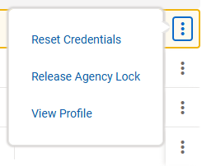
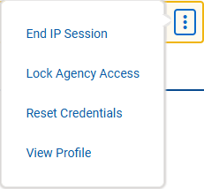
Managing Staff Accounts
Disabled – occurs when a user has 3 incorrect login attempts
Locked – an Administrator locked the account and prevented login. This can be used if a staff is on long term leave. An administrator must unlock before the staff can login.
End IP Session – This occurs if someone closes the browser or their session becomes interrupted before they fully logout.
Go to Agency -> staff review the profile of the staff member

Slide 26
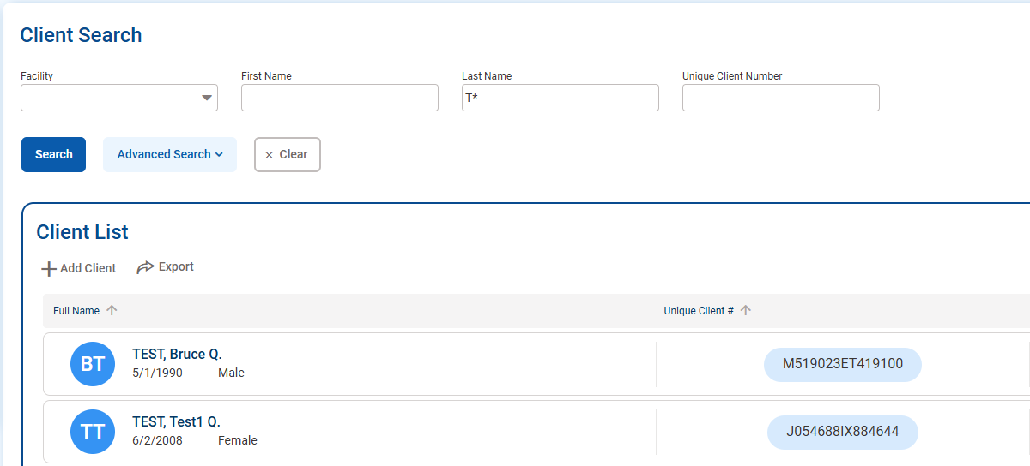
Wildcard Search
The asterisk (*) can be used as a wild card search.
This facilitates quicker searches by requiring less to be typed on the search screen.
The Start of a last name or Unique Client Number could be typed followed by the * to find any matches.

Slide 27
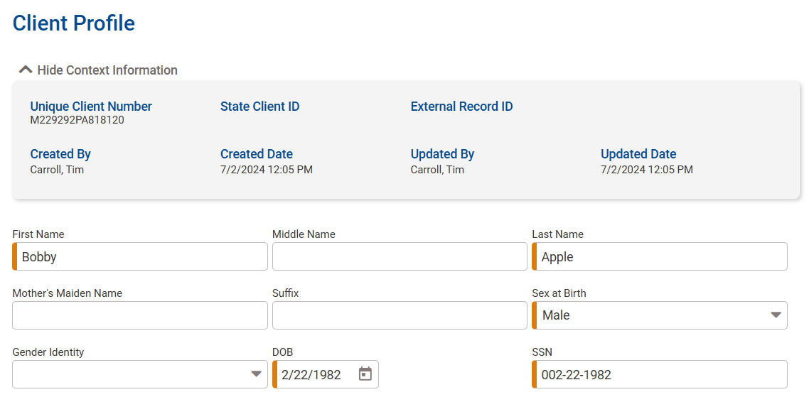
Required Fields
Fields with the solid orange line on the left are required
You must enter these fields to save the record.

Slide 28
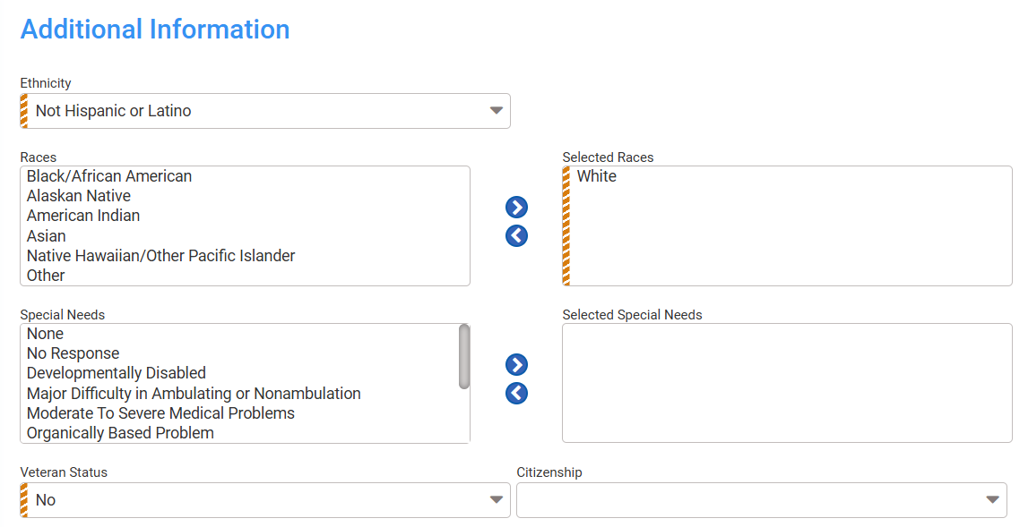
‘Soft’ Required Fields
Fields with the banded orange line on the left are not required to save the record
These fields are required to complete the record

Slide 29
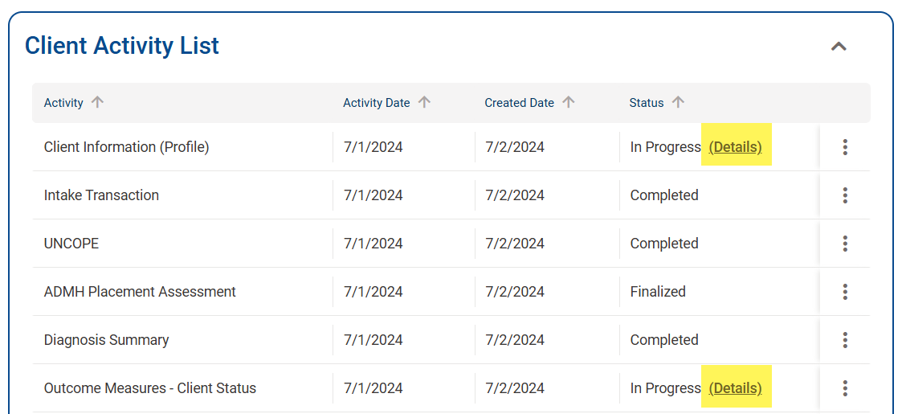
Activity List Status
Click the “Details” button to see what fields are missing
Records must be Completed or Finalized

Slide 30
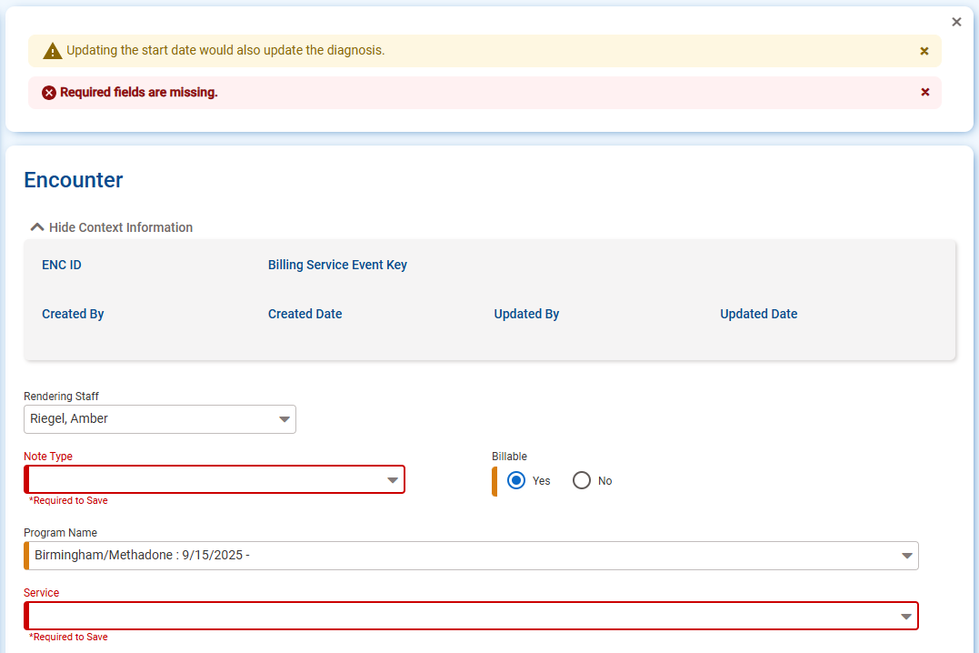
Warning / Error messages
Yellow messages with the triangle and Exclamation mark are Warning messages. These provide information and/or notify you of automatic behavior.
Red messages with a red X are Error messages. Until these are addressed, Save will not be possible.

Slide 31
Notices of new/updated functionality (ADMH)

