Slide 1
ALABAMA PROVIDER SESSIONS
Thursday, October 15, 2026
10:30 AM – 12:00 PM
Session 2
Claims and Clinical File Error Management

Slide 2
Provider Session 2
Claims and Clinical File Error Management
This session focuses on the identification, analysis, and resolution of claim-level and clinical file processing errors. The session will cover:
Common error scenarios and error messages
Underlying causes of submission errors
Best practices for correcting and resubmitting data.

Slide 3
837P Claims
Error Management

Slide 4
General File Upload Considerations
If your agency wants to submit 837P files:
  First test in the UAT environment with fake clients
  Submit real 837P files to Production only after you have success in UAT
What do the Statuses mean?
  Failed: The entire file is rejected
  Processed with Errors: The file was accepted, but one or more claims were rejected
  Processed: All claims in the file were accepted

Slide 5
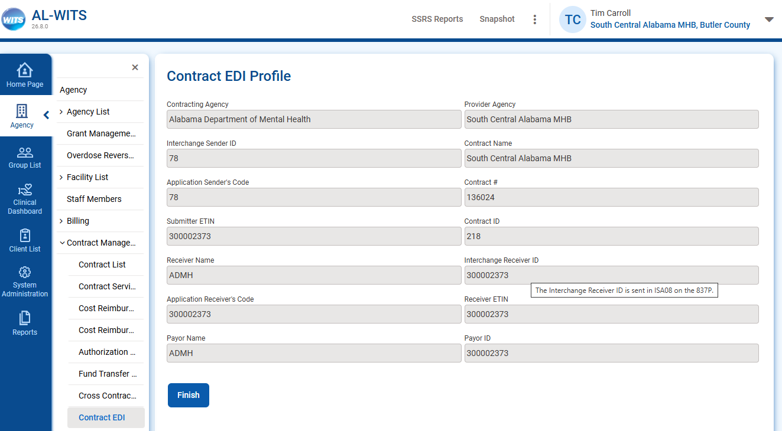
837P File-Level Errors
Mismatch in Sender/Receiver IDs Status = Failed
Find your IDs under Agency → Contract Management → Contract EDI

Slide 6
How do I reduce the number of claim errors?
Before submitting claims, verify:
The client has been created in your agency.
Note: The Subscriber ID should match the client’s UCN in WITS
The client has an Intake that covers the claim service date
Example: The Intake is 5/1/2026 and the claim date is 6/15/2026
The client has a Program Enrollment that covers the claim service date
Example: The Program Enrollment date is 5/15/2026 and the claim date is 6/15/2026

Slide 7
How do I reduce the number of claim errors?
Before submitting claims, verify:
The procedure code is valid for the client’s Program Enrollment
Example: 90832 Individual Counseling is valid for the Intensive Outpatient Program
The diagnosis is valid for the service provided
Example: The diagnosis is F10.10 - Alcohol abuse, uncomplicated

Slide 8
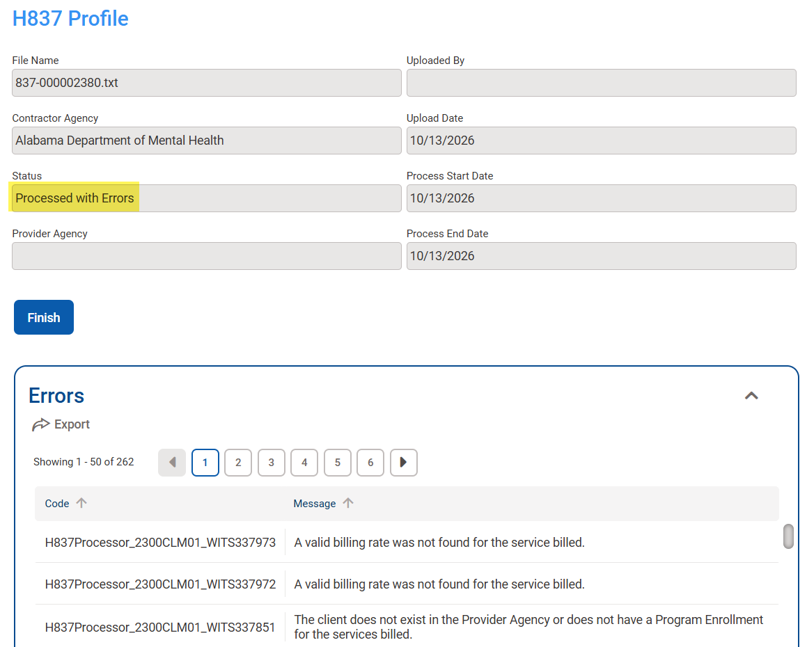
Where do I find the claim errors?
Navigate to
Agency → Billing →
H837 Management
Select a file with a status of Failed or
Processed with Errors
View the Error list at the bottom of the Profile

Slide 9
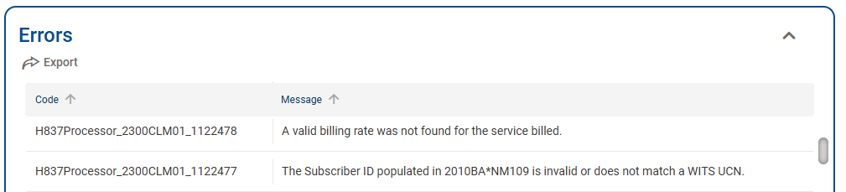
How do I read the Claim-Level Errors?
Most error messages are in the format:
[Processor Name] [Loop and Segment] [Claim ID] [Message]

Slide 10
Invalid UCN
Code | Message
H837Processor_2300CLM01_123456 | The Subscriber ID populated in 2010BA*NM109 is invalid or does not match a WITS UCN.
Review claim 123456 in your EHR.
Verify the subscriber ID used for the client matches the UCN for the client in WITS.
Correct the Subscriber ID and resubmit.
Notes:
Review the value reported in Loop 2010BA NM109.
Fix: Verify the subscriber ID on the claim matches the UCN for the client.
Correct and resubmit.
‘ZZZ999YYY888XXX’ is an invalid UCN for the provider agency:
NM1*IL*1*Client*Example****MI*ZZZ999YYY888XXX~
N3*1234 5th St~
N4*Montgomery*AL*36101~
DMG*D8*19950905*M~
NM1*PR*2*ADMH*****PI*630506021~
N3*100 North Union St~
N4*Montgomery*AL*36130~
CLM*123456*25***11:B:1*Y*A*Y*Y~

Slide 11
Invalid Gender Code
Code | Message
H837Processor_2300CLM01_ABC321 | Gender code is invalid; must be 'F' or 'M'.
Review claim ABC321 in your EHR.
The gender code must be Female or Male.
Correct the gender code to ‘F’ or ‘M’ and resubmit.
Notes:
Review the value reported in Loop 2010BA DMG03.
Fix: ADMH accepts only ‘F’ or ‘M’ (not ‘U’). Correct and resubmit.
NM1*IL*1*Client*Example****MI*M229292PA818120~
N3*1234 5th St~
N4*Montgomery*AL*36101~
DMG*D8*19950905*U~
NM1*PR*2*ADMH*****PI*630506021~
N3*100 North Union St~
N4*Montgomery*AL*36130~
CLM*ABC123*25***11:B:1*Y*A*Y*Y~

Slide 12
Invalid Diagnosis
Code | Message
H837Processor_2300CLM01_876WXYZ | The claim diagnosis does not match a valid ICD-10 diagnosis in WITS.
Review claim 876WXYZ in your EHR.
The diagnosis must be a valid ICD-10 code.
Correct the diagnosis and resubmit.
Notes:
Review the value reported in Loop 2300 HI01-2. Fix: The diagnosis must be a valid ICD-10 code. Correct and resubmit.
‘F113’ and ‘F10152’ are invalid ICD-10 codes
CLM*876WXYZ*25***11:B:1*Y*A*Y*Y~
REF*EA*A1B2C3D~
HI*ABK:F113*ABF:F10152~

Slide 13
No Intake for Claim Service Date
Code | Message
H837Processor_2300CLM01_987987 | The client does not exist in the Provider Agency or does not have an Intake for the services billed.
Review claim 987987 in your EHR.
The Service Date must be on or after the Intake Date.
If the Intake Date is wrong, submit a new clinical file or edit it (depending on your agency type. Then resubmit.
If the claim service date is wrong, correct it and resubmit.
Notes:
Review the value reported in Loop 2400 DTP03.
Fix: The Service Date must be on or after the Intake Date. Correct and resubmit.
In the example below, claim date is 7/31/2026, but Intake date is 8/1/2026.
CLM*987PQRST*25***11:B:1*Y*A*Y*Y~
REF*EA*A1B2C3D~
HI*ABK:F111*ABF:F10151~
NM1*82*2*Example Provider*****XX*9999999999~
PRV*PE*PXC*251S00000X
LX*1~
SV1*HC:H0007*25*UN*1***1:2~
DTP*472*RD8*20260731-20260731~

Slide 14
No Program Enrollment for Claim Service Date
Code | Message
H837Processor_2300CLM01_8765432 | The client does not exist in the Provider Agency or does not have a Program Enrollment for the services billed.
Review claim 8765432 in your EHR.
The Service Date must be between the Program Enrollment Dates.
If the Program Enrollment Dates are wrong, submit a new clinical file or edit it (depending on your agency type. Then resubmit.
If the claim service date is wrong, correct it and resubmit.
Notes:
Review the value reported in Loop 2400 DTP03.
Fix: The Service Date must be between the Program Enrollment Dates. Correct and resubmit.
In the example below, claim date is 8/1/2026, but the Program Enrollment ended on 7/31/2026.
CLM*987PQRST*25***11:B:1*Y*A*Y*Y~
REF*EA*A1B2C3D~
HI*ABK:F111*ABF:F10151~
NM1*82*2*Example Provider*****XX*9999999999~
PRV*PE*PXC*251S00000X
LX*1~
SV1*HC:H0007*25*UN*1***1:2~
DTP*472*RD8*20260801-20260801~

Slide 15
Invalid Service
Code | Message
H837Processor_2300CLM01_256894 | The service billed does not match an active WITS service.
Review claim 256894 in your EHR.
The procedure code and modifiers must match an ADMH covered service from the
Billing Manual.
If the procedures and modifiers are correct, report the error to ADMH. ADMH may need to update the service list in WITS.
If the procedures and modifiers are wrong, correct and resubmit.
Notes:
Review the values reported in Loop 2400 SV101-2 through SV101-5.
Fix: The procedure code and modifiers must match an ADMH covered service.
Correct and resubmit.
CLM*E4R5T6Y7*25***11:B:1*Y*A*Y*Y~
REF*EA*C2F4H6Y~
HI*ABK:F111*ABF:F10151~
NM1*82*2*Example Provider*****XX*9999999999~
PRV*PE*PXC*251S00000X
LX*1~
SV1*HC:99999:HA*25*UN*1***1:2~

Slide 16
Invalid Service for the Client’s Program Enrollment
Code | Message
H837Processor_2300CLM01_549348 | The claim service does not contain an approved service for the Program Enrollment.
Review claim 549438 in your EHR.
The procedure code and modifiers must match an ADMH covered service from the
Billing Manual and be appropriate for the client’s Program Enrollment/Level of Care.
If the procedures and modifiers are correct, report the error to ADMH. ADMH may need to update the service list in WITS.
If the procedures and modifiers are wrong, correct and resubmit.
Notes:
Review the values reported in Loop 2400 SV101-2 through SV101-5.
Fix: The procedure code and modifiers must match an ADMH covered service for the client’s Program Enrollment. Correct and resubmit.
In the example below, a residential claim H0019 was submitted for a client enrolled in Outpatient.
CLM*E4R5T6Y7*25***11:B:1*Y*A*Y*Y~
REF*EA*C2F4H6Y~
HI*ABK:F111*ABF:F10151~
NM1*82*2*Example Provider*****XX*9999999999~
PRV*PE*PXC*251S00000X
LX*1~
SV1*HC:H0019:HF*25*UN*1***1:2~

Slide 17
Invalid Rate
Code | Message
H837Processor_2300CLM01_763984 | A valid billing rate was not found for the service billed.
Review claim 763984 in your EHR.
The procedure code and modifiers must match an ADMH covered service from the Billing Manual.
If the procedures and modifiers are correct, report the error to ADMH. ADMH may need to update the rates in WITS.
If the procedures and modifiers are wrong, correct and resubmit.
Notes:
Review the values reported in Loop 2400 SV101-2 through SV101-5.
Fix: If the procedure code/modifiers match an ADMH covered service that is appropriate for the client’s program enrollment, report the error to ADMH.
CLM*E4R5T6Y7*25***11:B:1*Y*A*Y*Y~
REF*EA*C2F4H6Y~
HI*ABK:F111*ABF:F10151~
NM1*82*2*Example Provider*****XX*9999999999~
PRV*PE*PXC*251S00000X
LX*1~
SV1*HC:H0019:HF*25*UN*1***1:2~

Slide 18
Invalid Place of Service
Code | Message
H837Processor_2300CLM01_F6G5H4I3 | The service location type is not valid. Correct and resubmit.
Review claim F6G5H4I3 in your EHR.
The place of service code must be valid.
Correct and resubmit.
Notes:
Review the value reported in Loop 2400 SV101-2 through SV101-5.
Fix: The place of service code must be valid. Correct and resubmit.
In the example below, ’98’ is not a valid place of service for ADMH.
CLM*F6G5H4I3*25***98:B:1*Y*A*Y*Y~

Slide 19
Facility not under Contract
Code | Message
H837Processor_2300CLM01_100643 | The contract does not cover the program's facility.
Review claim 100643 in your EHR.
This error means the claim service date(s) match to an Intake in a Facility that is not included in the contract with ADMH.
If the claim service dates are accurate and the Intake is in a contracted Facility, report the error to ADMH. ADMH may need to update the contract.
Notes:
Review the value reported in Loop 2400 DTP03. This date matched to an existing Intake for a Facility that is not included in the contract.
Fix: If the claim service dates are accurate and the Intake is in a contracted Facility, report the error to ADMH.
In the example below, service date of 7/31/2025 must match to an Intake for a facility that is included in the contract
CLM*100643*25***11:B:1*Y*A*Y*Y~
REF*EA*A1B2C3D~
HI*ABK:F111*ABF:F10151~
NM1*82*2*Example Provider*****XX*9999999999~
PRV*PE*PXC*251S00000X
LX*1~
SV1*HC:H0007*25*UN*1***1:2~
DTP*472*RD8*20260731-20260731~

Slide 20
Invalid PCCN
Code | Message
H837Processor_2300CLM01_268713 | The claim cannot be found in our system, or it is not eligible for adjustment. Please correct and resubmit.
Review the void or replacement claim 268713 in your EHR.
The Payer Claim Control Number (PCCN) must match to an adjudicated claim in WITS.
In the PCCN was wrong, correct it and resubmit the claim.
If the PCCN is accurate, report the error to ADMH for investigation.
Notes:
Note: This error may occur when submitting Replacement or Void claims.
Compare the Payer Claim Control Number (PCCN) reported on the 837P in Loop 2300 REF*F8
to the PCCN from the 835 in Loop 2100 CLP07.
Fix: Correct and resubmit.
If the PCCN accurately reflects the ID from the 835, report the error to ADMH.
In the example below, the ‘7’ represents a Replacement claim.
The PCCN ‘9999999’ does not match any record in WITS.
CLM*268713*25***11:B:7*Y*A*Y*Y~
REF*F8*9999999~
REF*EA*A1B2C3D~

Slide 21
Clinical File Uploads
&
Error Management

Slide 22
Clinical File Upload: Accessing files through SFTP

Slide 23
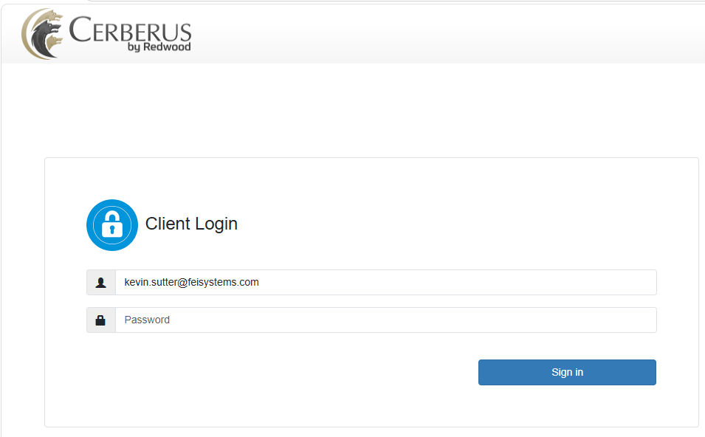
Clinical File Upload: Access through SFTP
To access SFTP folders, you must send a request to DMH.WITS@mh.alabama.gov with the user’s full name, role, email, and what agencies they should have access to.
After approval, they will receive an email with credentials to log into the SFTP site.

Slide 24

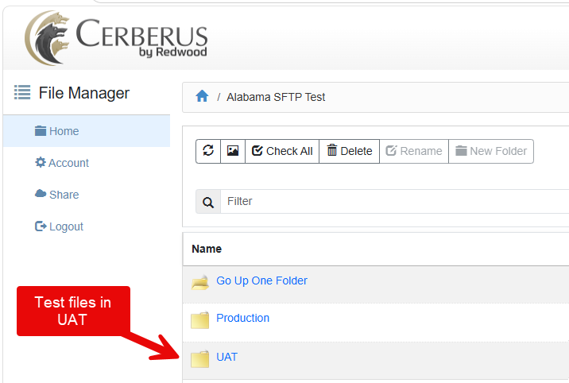
Clinical File Upload: SFTP directories
After logging in, users will see Production and UAT folders.
Test files should be submitted through UAT

Slide 25
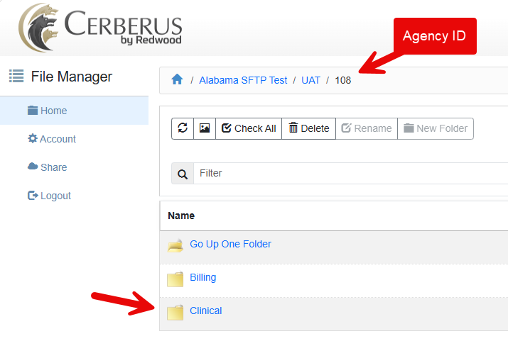
Clinical File Upload: SFTP directories (cont.)
In the correct environment directory (UAT or Prod), a user will see a folder with their agency ID (not name). Click on that.
The Billing and Clinical folders will display.
Use the Clinical directory to submit clinical files.

Slide 26
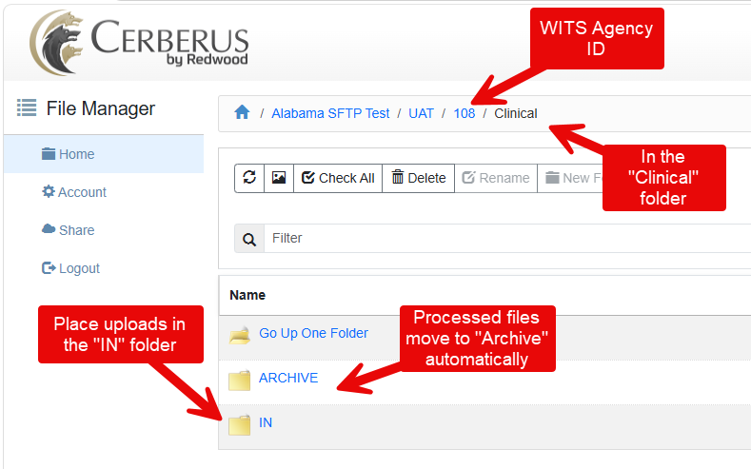
Clinical File Upload: SFTP directories (cont.)
In the “Clinical” folder, place files for submission in the “IN” folder.
Processed files move to “ARCHIVE” automatically.

Slide 27
Clinical File Upload: Accessing files through the UI

Slide 28
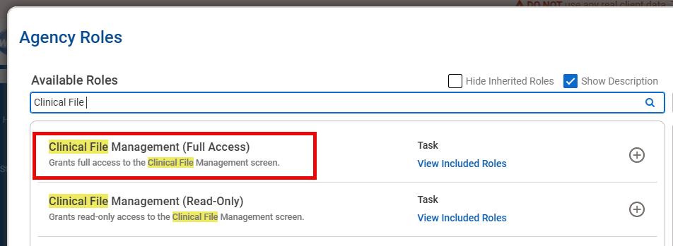
Clinical File Upload: Access in WITS
To see the Clinical File Upload screen in the UI, a user must have the Clinical File Management role

Slide 29
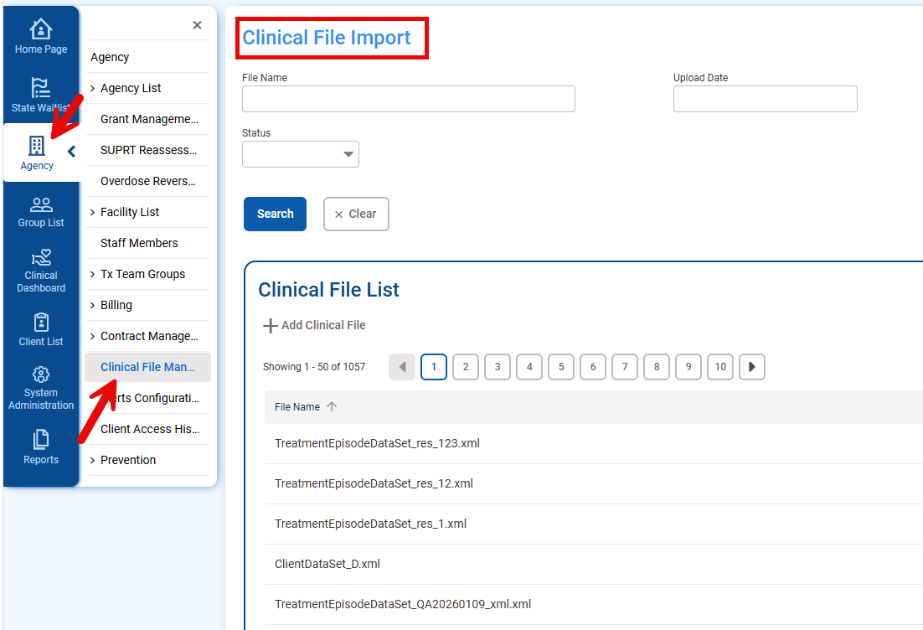
Clinical File Upload: Clinical File Import screen
Access the screen from the Agency → Clinical File Management menus:

Slide 30
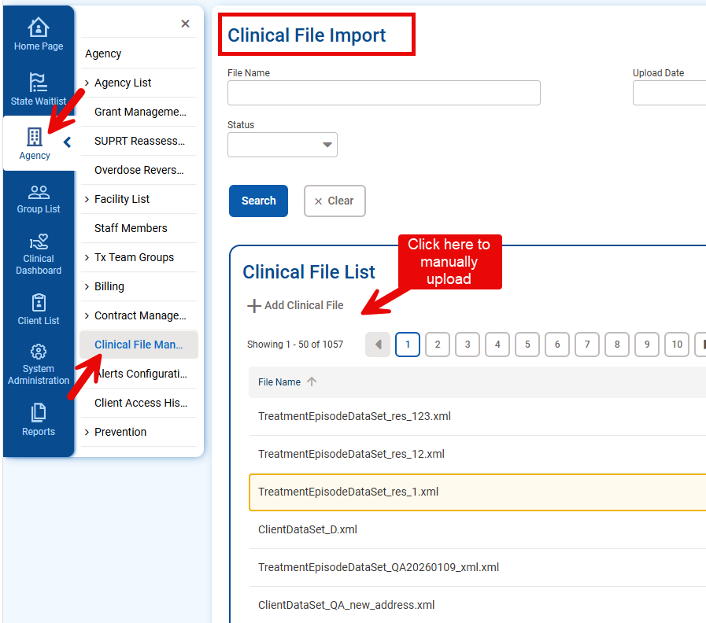
Clinical File Upload: Manually Add files
Click “Add Clinical File” to manually upload files.

Slide 31
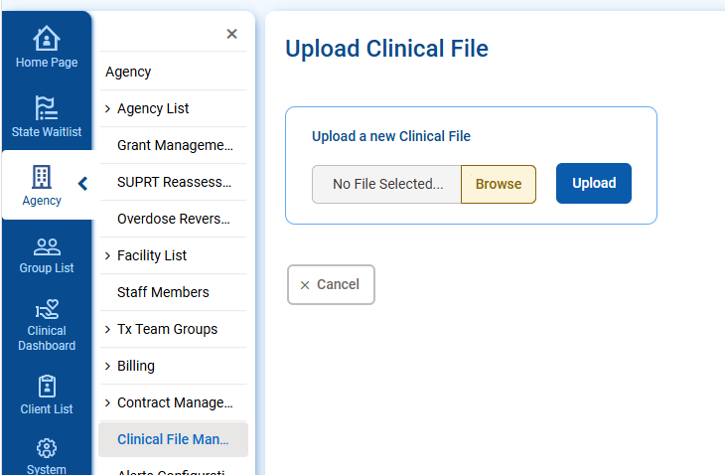
Clinical File Upload: Manually Add files (cont.)
Browse for a file and click “Upload” for manual submission.

Slide 32
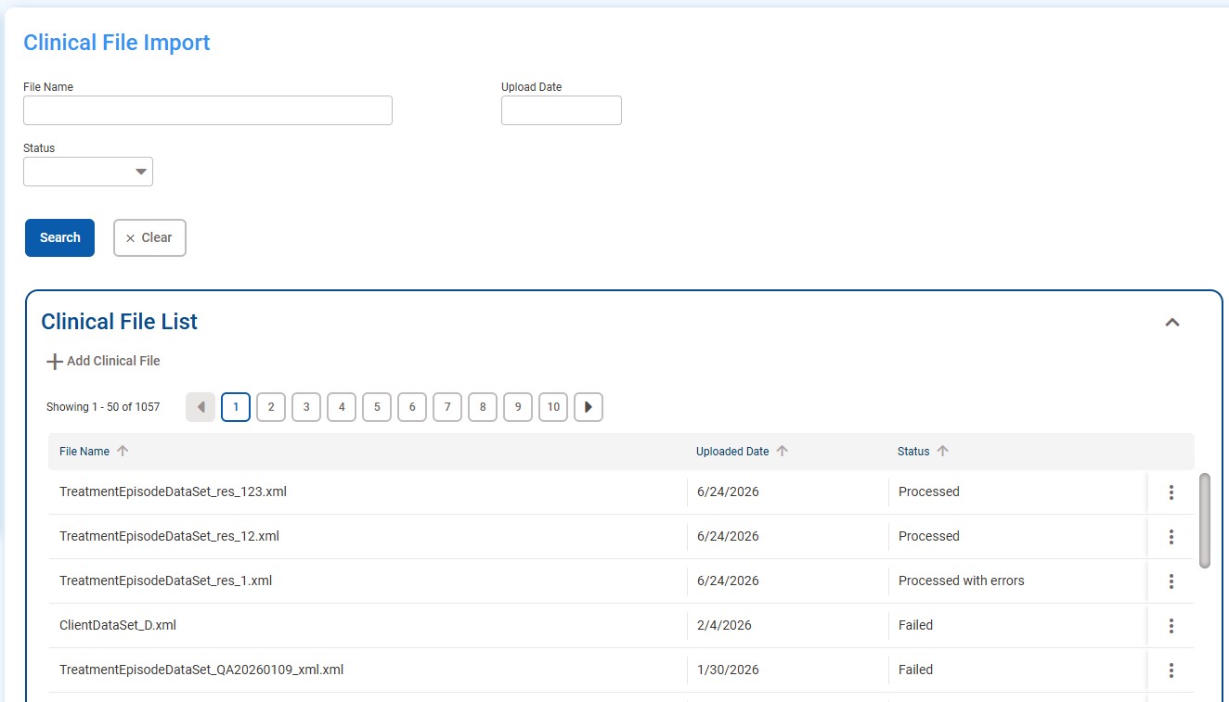
Clinical File Upload: Clinical File List
Processed files will display in the Clinical File List.

Slide 33
Clinical File Upload: File Upload Errors and Troubleshooting

Slide 34
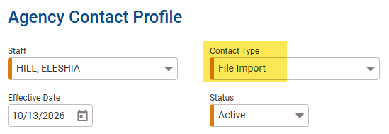
Clinical File Upload: File Upload Error Types
File schema/name/type validation errors:
  For submissions through SFTP, errors will be emailed to any agency contact with the "File Import" contact type.
  For submissions through the Clinical File Import screen in Alabama WITS, the file name/type validation errors will display in the Clinical File Profile "Errors" screen.
Data validation errors for any submission will display on the Clinical File Profile "Errors" screen.

Slide 35
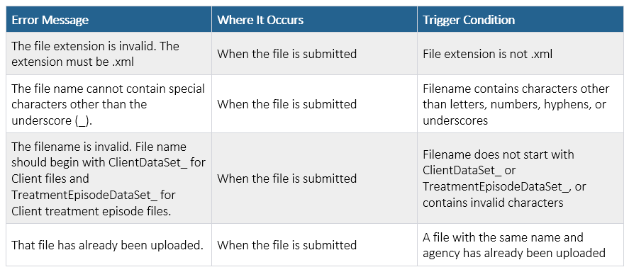
Clinical File Upload: File Schema/Name/Type Errors
Very common when beginning to develop file upload.
If file is submitted via SFTP, errors are emailed to an agency contact assigned the “File Import” contact type and will not display in AL-WITS. A submission via SFTP will only display on the Clinical File Import screen when these are resolved.
If file is submitted through AL-WITS, errors will display in the “Errors” sub-screen.

Slide 36
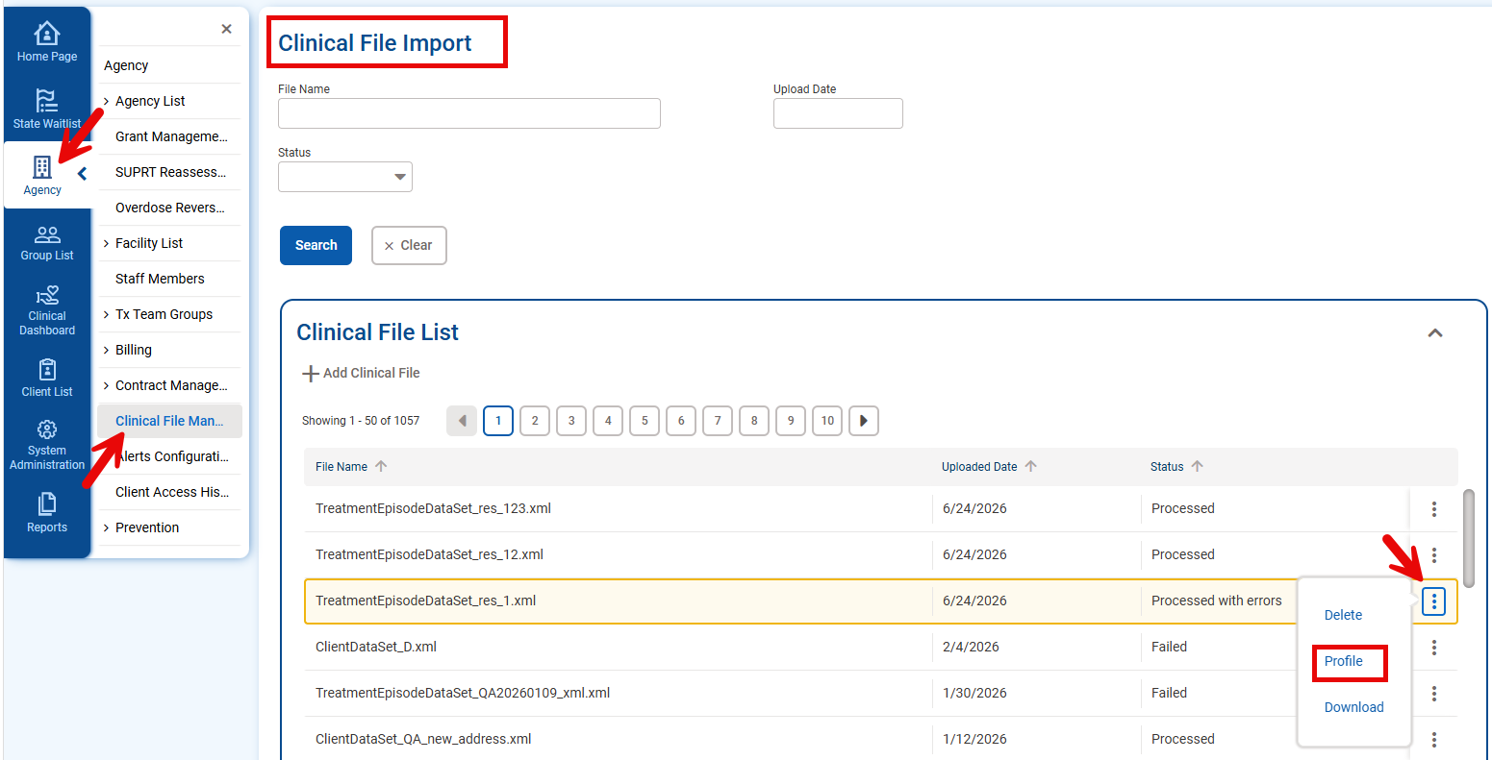
Clinical File Upload: Clinical File List
Submissions that pass File Schema/Name/Type validation will display in the Clinical File List sub-screen.
Click on the three-dot ellipsis icon to access the Profile screen to view errors.

Slide 37
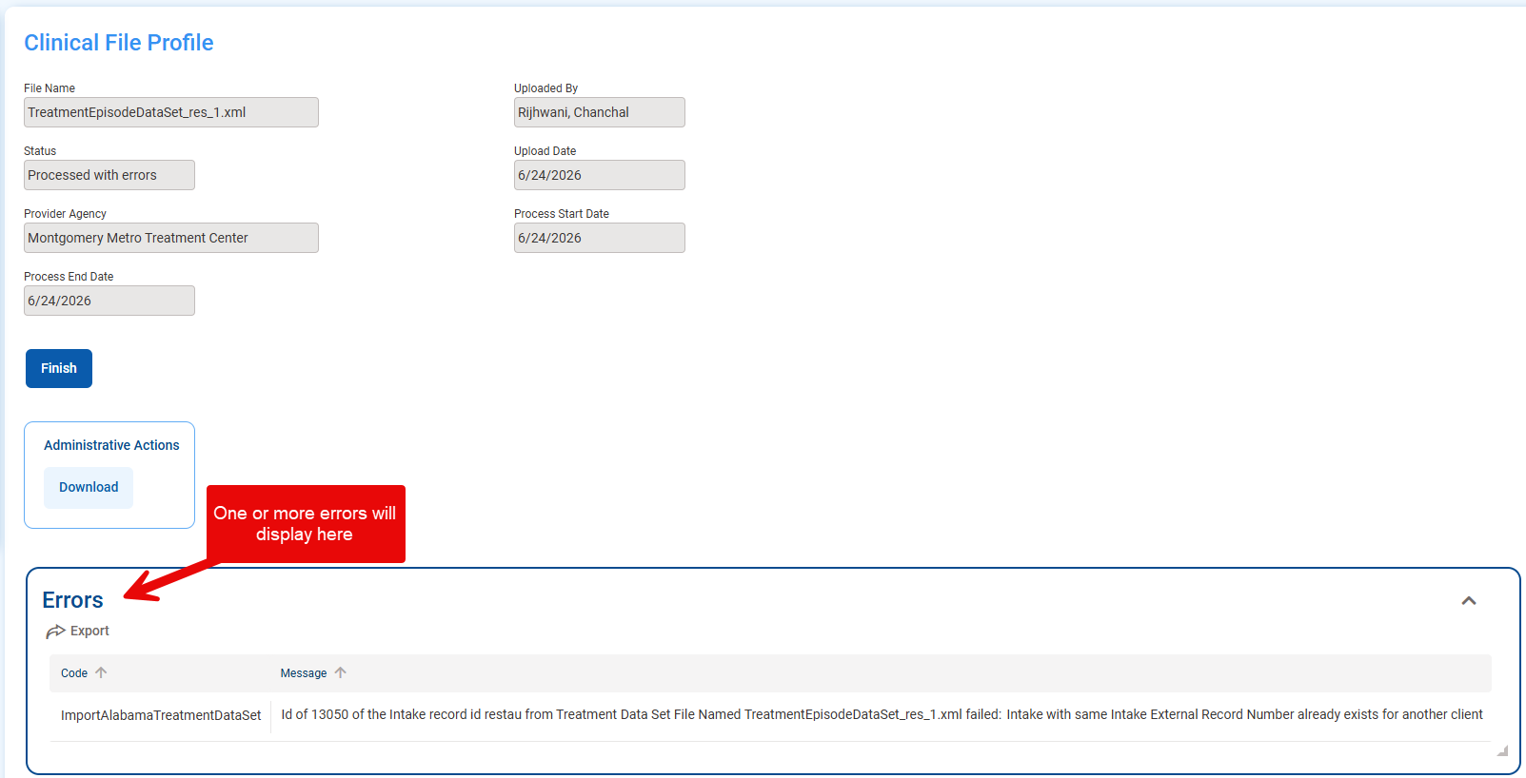
Clinical File Upload: Clinical File Profile
The Clinical File Profile shows submission information in the top.
The Errors sub-screen will show one or more errors for any submission in “Processed with Errors” or “Failed” status.
The message in the “Message” column is used to troubleshoot submissions with errors.

Slide 38
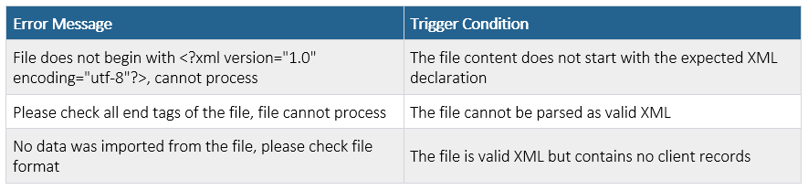
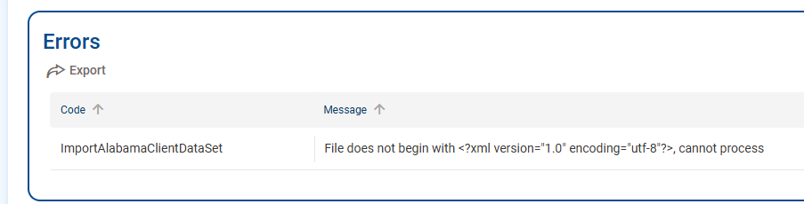
Clinical File Upload: File-Level Errors
Common error type when first developing files and submitting them.
These errors place the entire file submission in “Failed” status when uploaded.

Slide 39
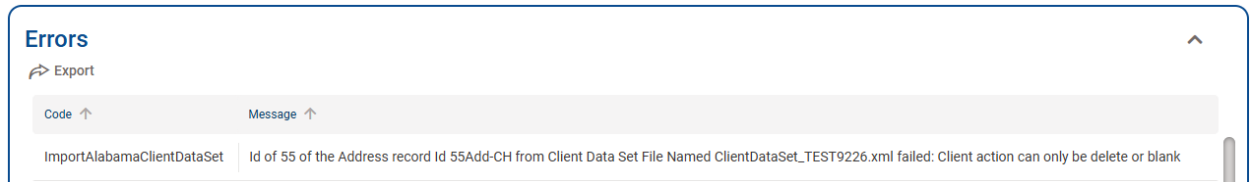
Clinical File Upload: Error Message
Used to troubleshoot a client’s record in the file that caused the error.
Typically has the format:
“ID of [External Client ID] of the [WITS record] record Id [External {WITS Record} Id] from Client/Treatment Episode Data Set File Named [submitted file name] failed: [detailed error message]”
To troubleshoot in a submitted XML file,
  Search for the client’s ID and the associated record ID of the record the error occurred in.
  See how the value referenced in the detailed error message impacts the record.
  Correct in the XML and resubmit with a different filename (see Submission Guide).

Slide 40
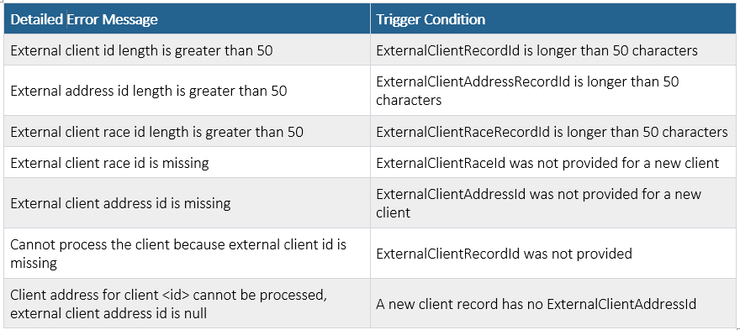
Clinical File Upload: Common Client File Errors
ID/Reference Errors:

Slide 41
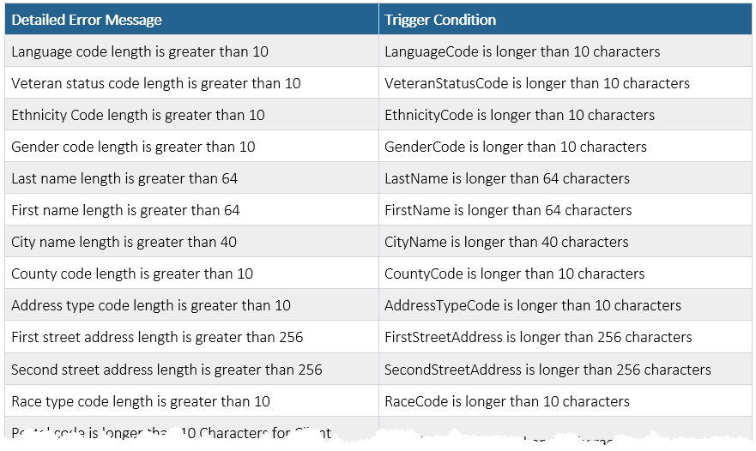
Clinical File Upload: Common Client File Errors (cont.)
Field Length/Format Errors (example):

Slide 42
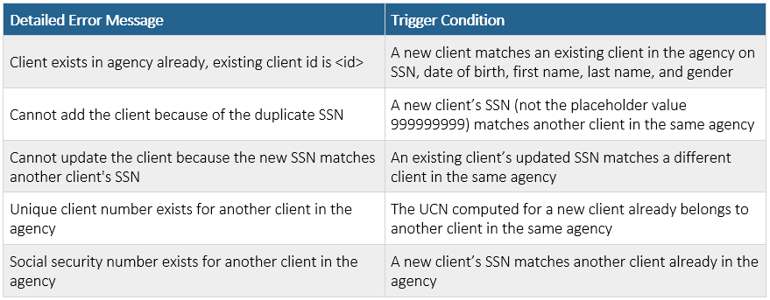
Clinical File Upload: Common Client File Errors (cont.)
Duplicate/Conflict Errors:

Slide 43
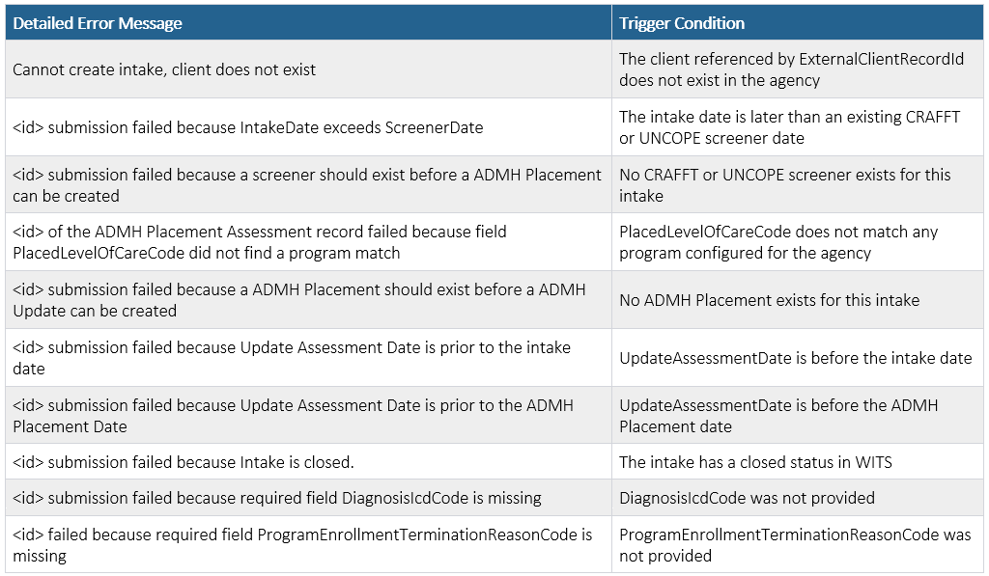
Clinical File Upload: Common Treatment File Errors

