Slide 1
ALABAMA PROVIDER SESSIONS
Thursday, October 15, 2026
1:30 – 3:00 PM
Session 3
WITS Claims Reconciliation
ALABAMA PROVIDER SESSIONS
Thursday, October 15, 2026
1:30 – 3:00 PM
Session 3
WITS Claims Reconciliation

Slide 2
Provider Session 3
Claims Reconciliation
This session provides an overview of the claims reconciliation process, including:
Comparison of submitted claims
Adjudication outcomes
Payment activity
Outstanding balances
The session will also cover common reconciliation challenges and approaches for maintaining alignment between provider records and claims processing results.

Slide 3
Claims Reconciliation

Slide 4
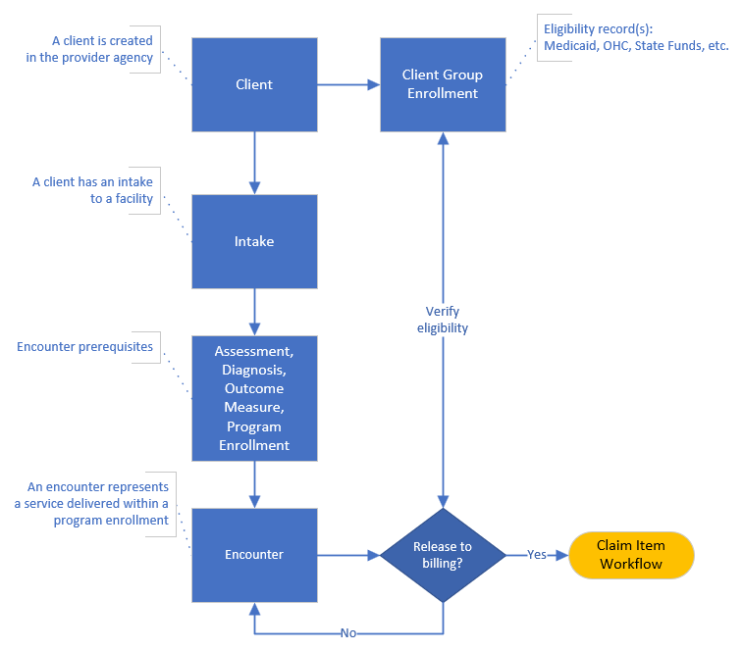
Encounter/Claim pre-requisites

Slide 5
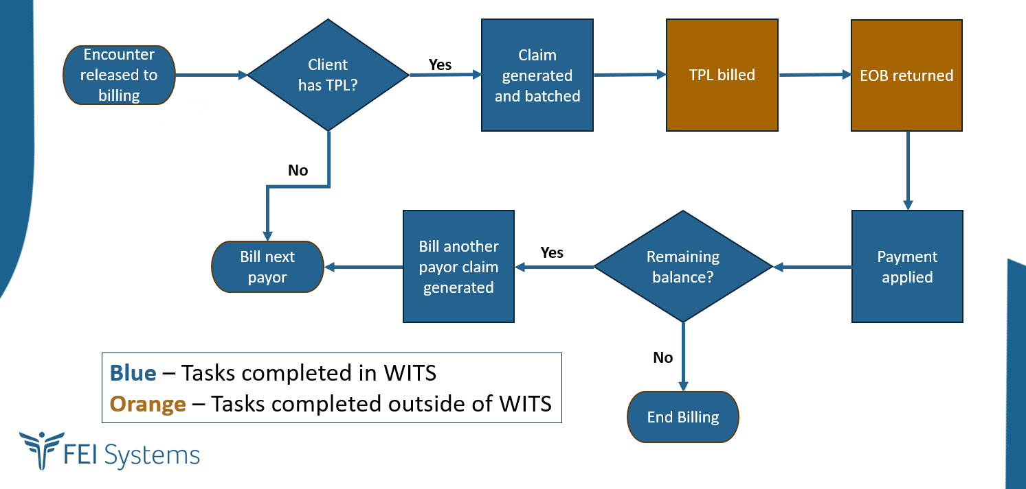
Encounter RTB/Claim Item Creation workflow

Slide 6
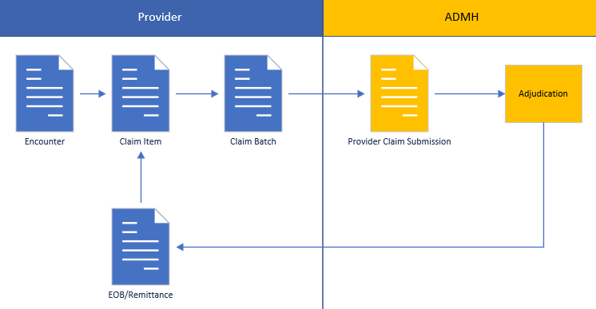
Claim - Government Contract Billing(automated)
Provider batches bill claims to ADMH (block grant and other state funds)
Claims are adjudicated in the ADMH Agency to pay, deny, or pend based on rules
Claims are paid out of the authorization period tier based on funding priority and available funds

Slide 7
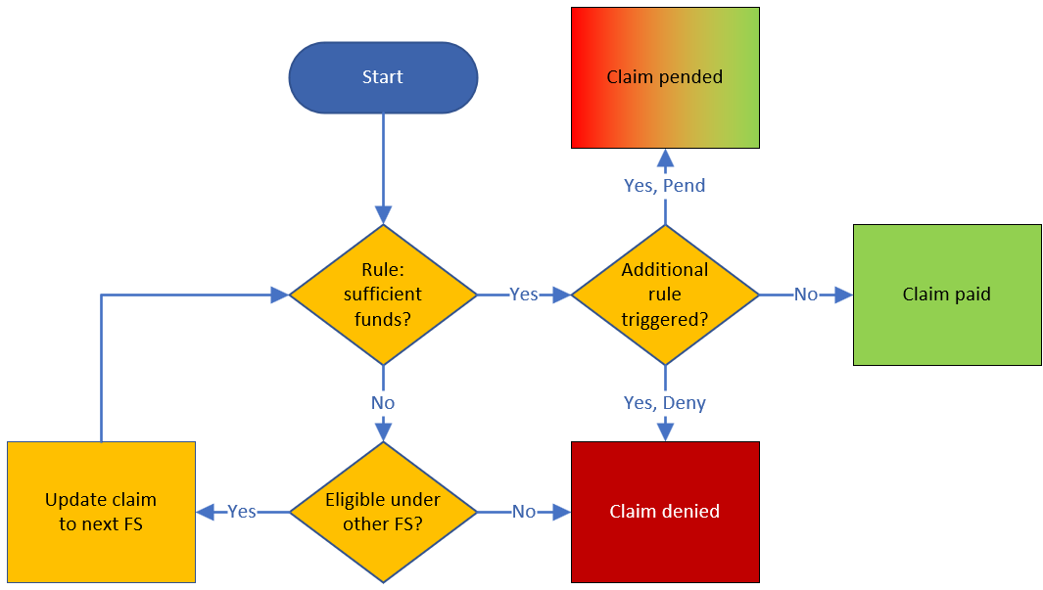
Payor Adjudication: Rules
10/14/2026 Note:
Since payments are automated, the pended status is not used.
The claim is billed against the highest priority tier in the authorization period
If there are insufficient funds, the system checks the next priority tier for eligibility
Adjudication rules set by ADMH

Slide 8
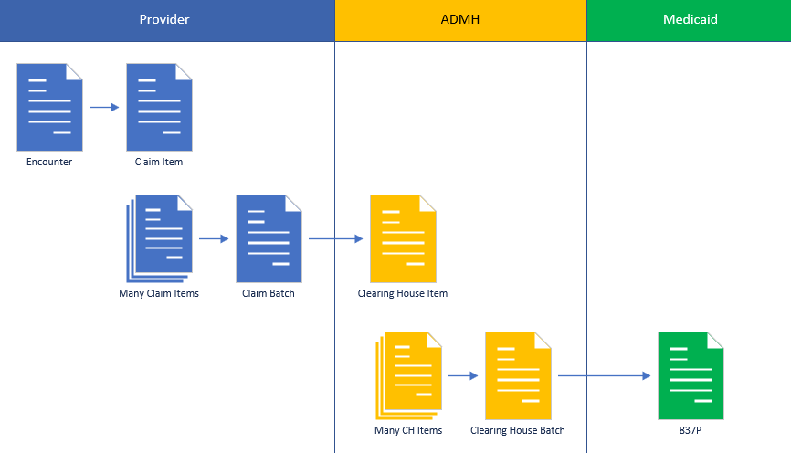
Claim - Medicaid Workflow (automated)
Encounters, claim items,
and claim batches are created in the provider agency
Provider claim batches are sent to the ADMH agency and become clearing house items
Clearing house items are batched and billed to Medicaid

Slide 9
Medicaid Claim Remittance (automated)
Provider 1 claims paid
Medicaid returns 835
WITS receives in ADMH agency
Provider 2 claims paid
Provider 3 claims paid

Slide 10
Medicaid Denial – Government Contract secondary payor
WITS automatically generates a claim against government contract, if the following conditions are met: ​
Medicaid returns a specific claim adjustment reason code ​
Unpaid service has a Contract Service Rate setup with a rate type Standard or Contract​
​
Client has a CGE that matches the Contract Service Rate’s set group (adolescent, special women, adult, etc.)​
​

Slide 11
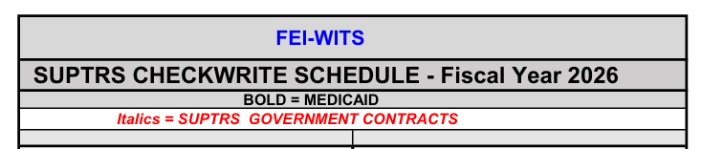
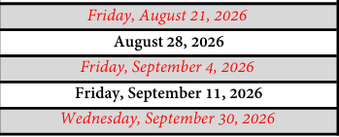
Payment Voucher (Checkwrite)
Payment Vouchers(STAARS), referred to as Checkwrites, are generated on a schedule published by ADMH.
Checkwrites are separated by Government Funding or Medicaid funding.
For a Checkwrite, either government or Medicaid, WITS is to sends ALL paid claims, since the last Checkwrite date.

Slide 12
Individual Claim Reconciliation
Billing records for billed treatment services trace to the Encounter number – sometimes labeled Delivered Service id.
Generally, if you have the option to search by the Encounter number you will see the full billing history for that billed service.
There are several screens in WITS that can be utilized to assist claim reconciliation. These are grouped in the Agency -> Billing menu item.
The screens referenced and discussed in this document are Encounter List, Claim Item List, EOB Transaction List, Payment List and the SSRS Report Check write report.

Slide 13
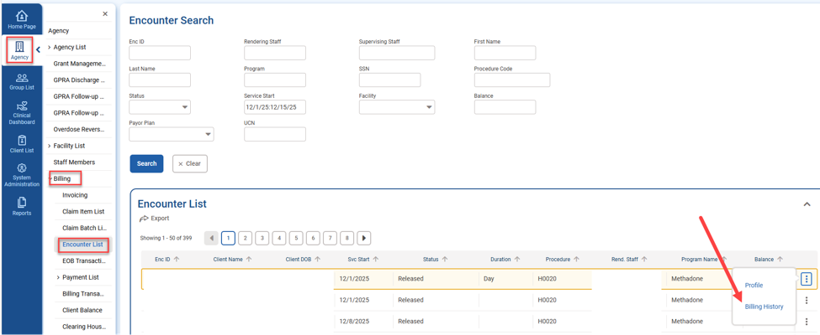
Encounter List
The Encounter List can be used to see the billing history for individual Encounters.
Search for a date range by using the : between 2 dates. Additionally, you can search for Encounters with no balance or a balance more than 0 using >symbol.
When an Encounter is found, the menu to the right includes the option “Billing History.”
Billing History shows records from the Encounter, Billing Transaction and EOB Transaction tables for this individual Encounter.

Slide 14
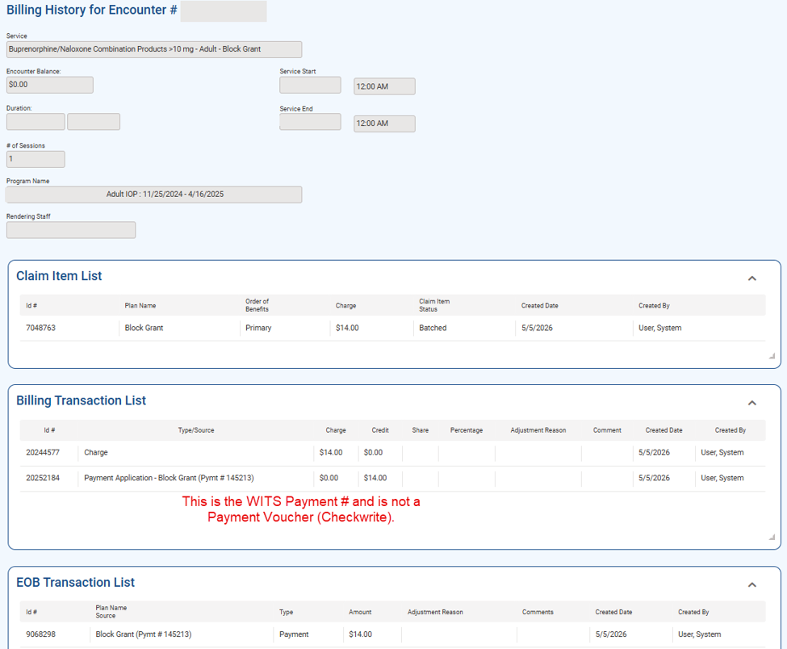
Billing History

Slide 15
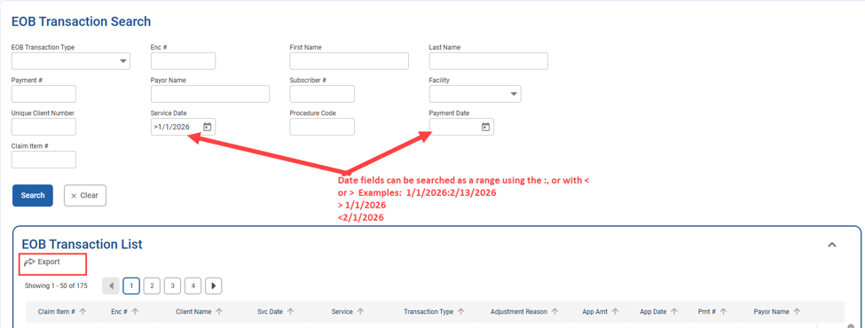
EOB Transactions
The Agency -> Billing -> EOB Transaction menu. This screen has a search at the top with many options to review Encounters/Claim Items.
Date Filtering Examples:
Range:
1/1/2026:2/1/2026
Greater than:
>1/1/2026
Less than:
<1/1/2026
This screen also has an
Export option to review
the list of Claim Items
in Excel.

Slide 16
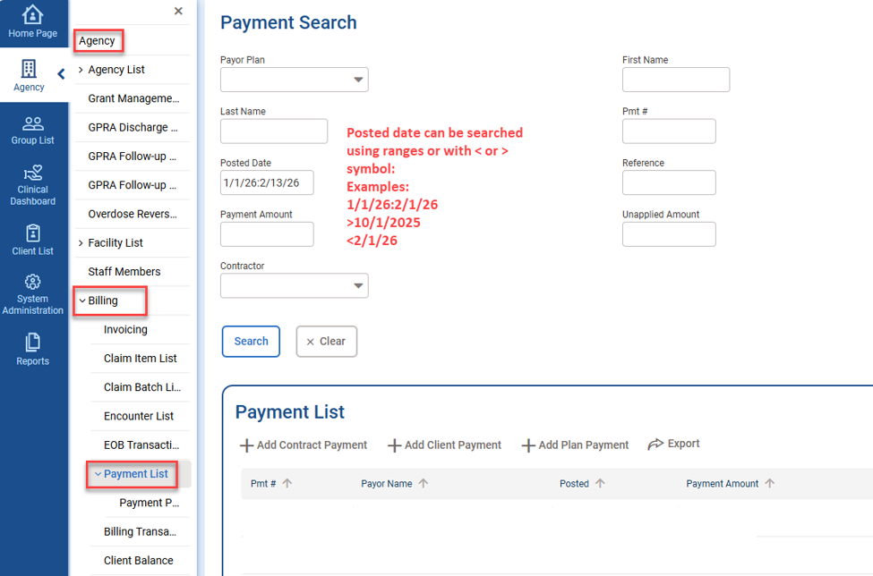
Payment List
The payment list is a universal list of payments the agency has received. It’s available in the Agency -> Billing – Payment list menu item.
Please note: this is WITS Payments not a Payment Voucher or Checkwrite.
Reminder: 1 or many WITS payments could be in the same Checkwrite.

Slide 17
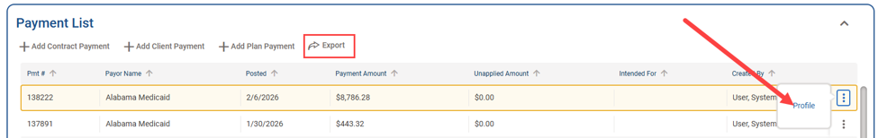
Payment List continued
The list of Payments can be exported using the button at the top of the list. The details of related claims can be found by reviewing an individual Payment and clicking ‘Profile’:

Slide 18
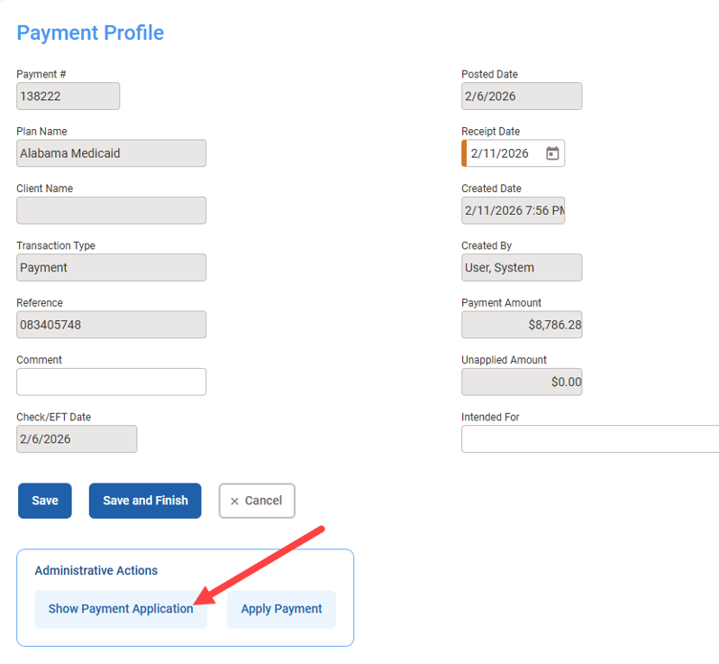
Payment List continued
At the bottom is the “Show Payment Application” button that can be used to see the billed services to which this payment applied, this opens the EOB Transaction list.

Slide 19
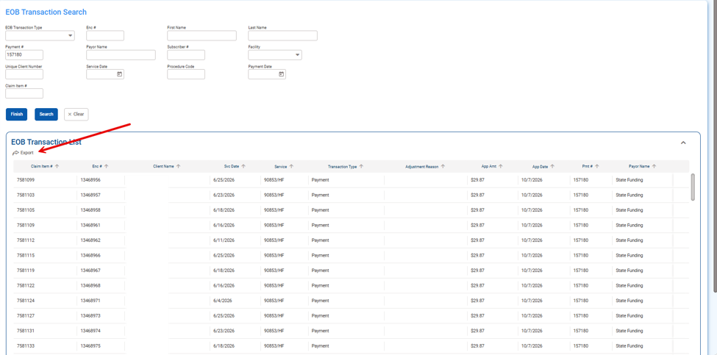
Payment List - continued
The EOB Transaction list opens for the specific payment and has an export button to show all paid billed services.

Slide 20
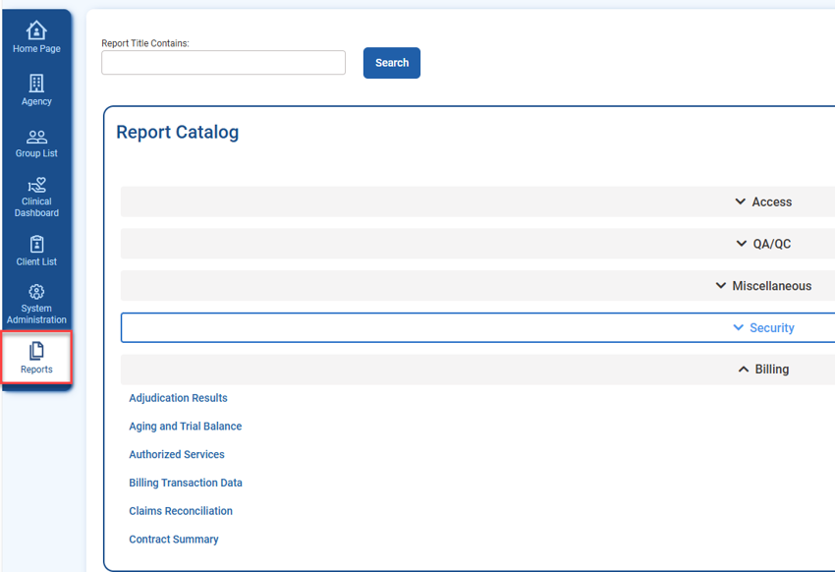
Reports
There are also Billing reports available in WITS.
The following menu item requires a role: Reports Access.
More information about these reports is available in the ADMH WITS Billing document.

Slide 21
SSRS
SSRS is the ad-hoc report tool available in WITS. It allows the staff to create/view custom reports from data in WITS. A role (SSRS Agency Reader) is required to access, and permissions for SSRS have two levels, the first level is read-only, and the second permission allows the staff member to create and/or edit reports.
When the staff member has an SSRS role, the link to SSRS is at the top of the screen.
If you are unable to see the SSRS Reports link, please contact DMH.WITS@mh.alabama.gov for assistance

Slide 22
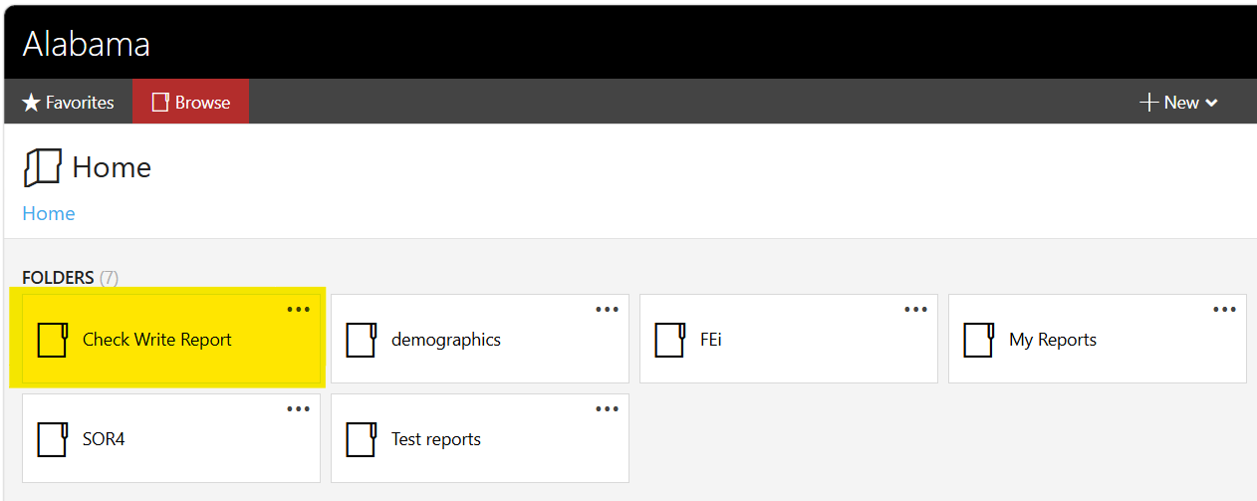
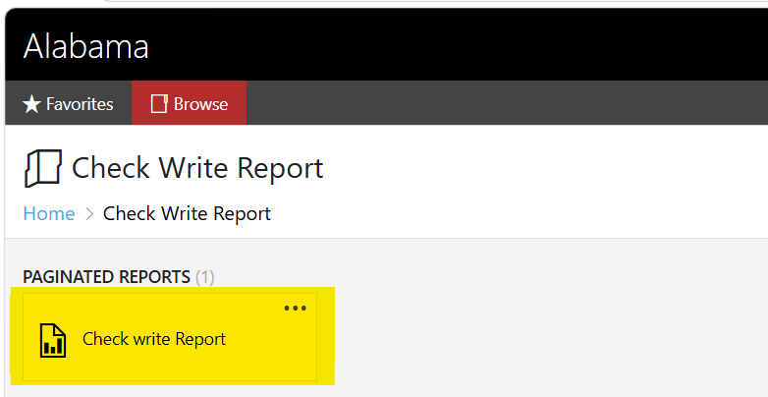
Checkwrite Report (Payment Voucher report)
To facilitate reconciliation, ADMH has provided a Checkwrite report in SSRS.

Slide 23
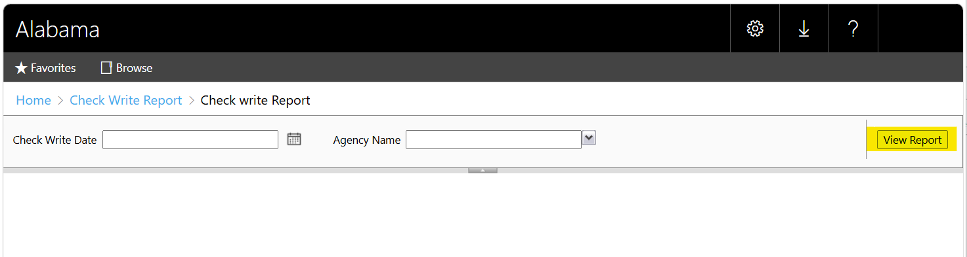
Checkwrite Report continued
Enter the desired Check Write Date and Agency Name, and click “view report”:

Slide 24
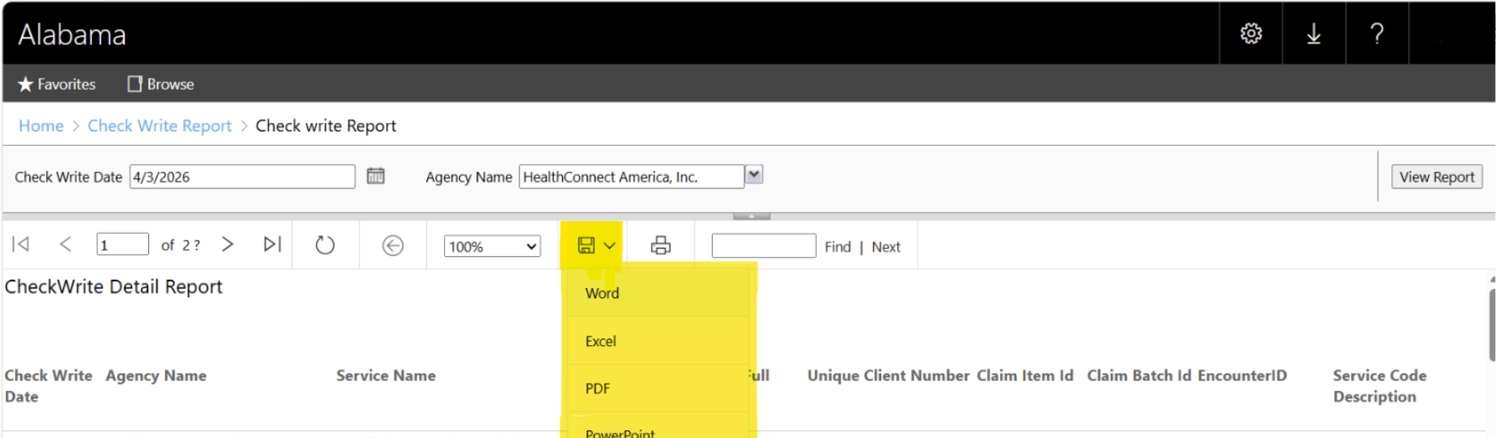
Checkwrite Report - continued
SSRS allows the report data to be exported. The excel format is recommended.
This allows you to save the results outside of SSRS.

Slide 25
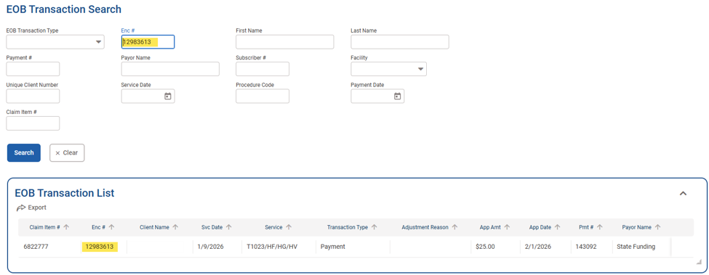
Reconciliation Walk Through Example 1: Paid claim
Encounter # (delivered_service_id) 12983613
Total payment was $25
Complete Checkwrite History for 12983613:

Slide 26
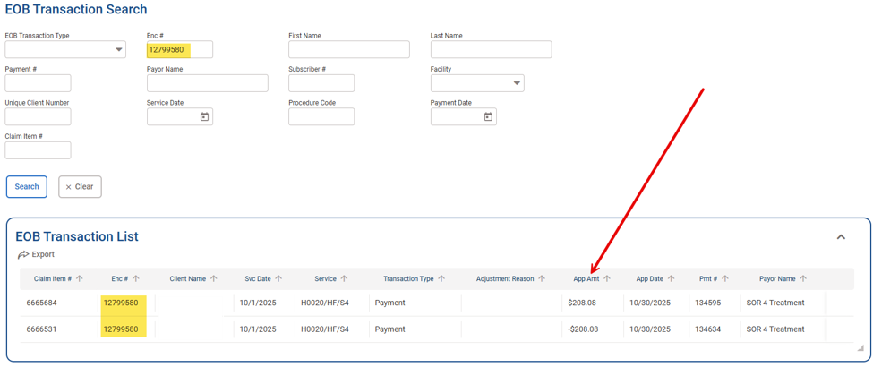
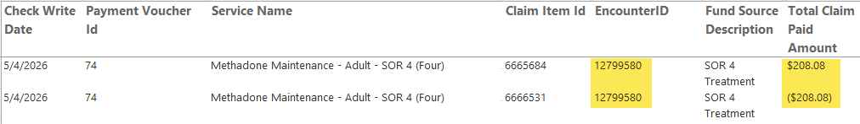
Reconciliation Walk Through Example 2: Voided (Reversed) Claim
Encounter # (delivered_service_id): 12799580
Total payment overall was 0:
Checkwrite report records for 12799580 – matches net 0 payment:

Slide 27
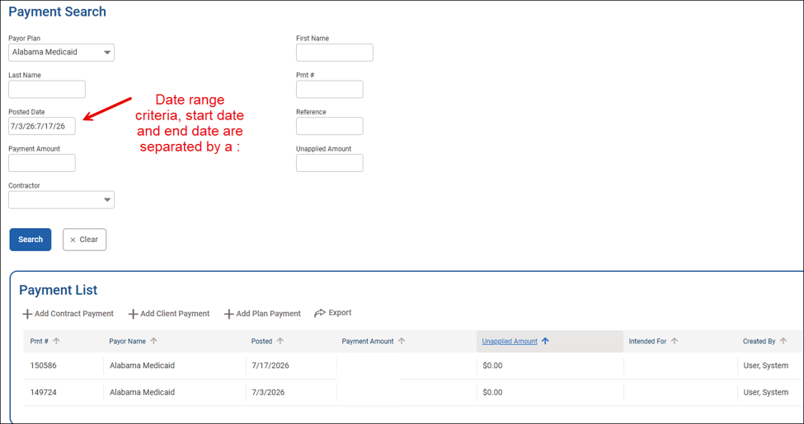
Reconciling to Payment Vouchers(Checkwrite)
The WITS Payment and the EOB Transaction screens can assist reconcilling.
Every government contract adjudication and H835 from Medicaid creates a WITS Payment.
Reminder: WITS Payment is different from a Checkwrite.
In the posted date field, search by date range, use the last Checkwrite date to the current Checkwrite date. Then when reviewing select “Payment Application” from the payment profile to export all claims for that payment.

Slide 28
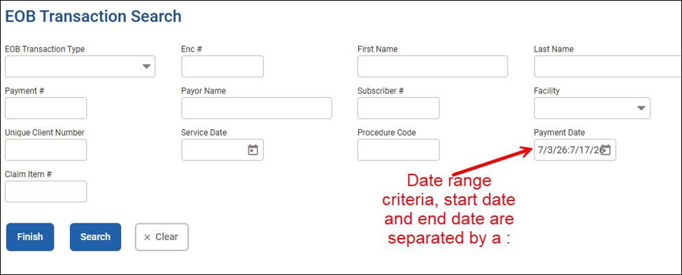
Reconciling to Checkwrite continued
The EOB Transaction screen could be used in a similar manner.
Utilizing this screen allows easier access to view/export all the applicable individual claims.

Slide 29
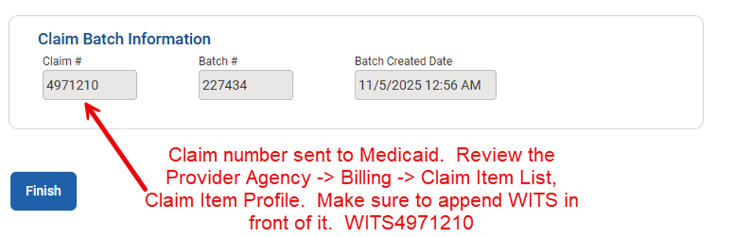
Claim Number Submitted to Medicaid
If investigating a specific claim with ADMH and Medicaid, here's how to find the WITS Claim number.
Navigate to Agency -> Billing -> Claim Item List and reviewing the profile of the Individual Claim Item.

Slide 30
FAQ
We had a claim that was denied, how can we see more information in WITS?
  Run the Adjudication Results report
  Review the Agency -> Billing -> Encounter list, search for the Encounter and select “Billing History.”
  OR
  Review the Agency -> Billing -> EOB Transaction list, search for the Encounter
  AND/OR
  Please contact DMH.WITS@mh.alabama.gov for assistance.

Slide 31
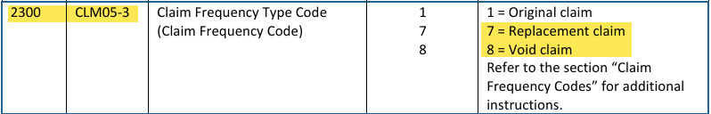
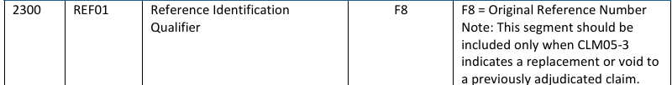
FAQ continued
We need to replace a submitted claim via H837, how do we do this?
For more information please see the ADMH website.

